Slide 1
British colonialism and Aotearoa/New Zealand
Notes:
Kia ora tatou katoa (greetings to all of you.) New Zealand’s temperate climate and landscape often leads to its description as Britain’s antipode. New Zealand’s links to Britain can be clearly seen through their British values, predominantly white population and the symbol of the Union Jack on the country’s national flag. But whilst modern New Zealand appears culturally European, it is necessary to examine the history of its inhabitants prior to British colonialism in order to understand that New Zealand has a rich and vibrant past extending far beyond the arrival of white settlers.
Added this to balance the whakatauki (proverb) at the end and to start with a greeting.

Slide 2
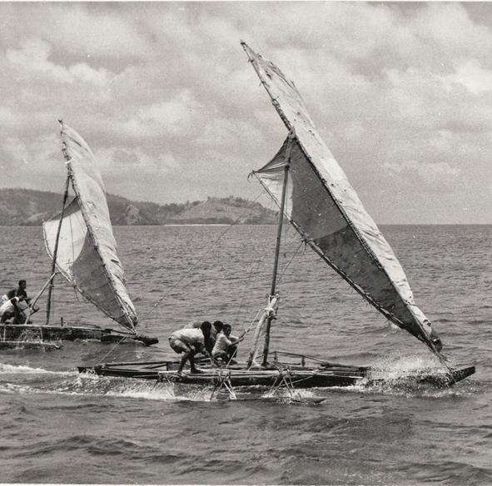
The First Inhabitants
Pacific migrations of Polynesian people from southeast Asia over 5,000 years
Great voyages in waka (canoes) carrying seed crops and animals
Polynesians the first humans to colonise NZ from 1200 A.D. onwards
Notes:
New Zealand is thought to have a shorter human history than any other country, with the first Polynesian settlers migrating to New Zealand in several waves during the 13th century. Travelling in strong double hulled canoes, they utilised constellations and water currents to navigate their way to the islands, bringing with them an abundance of animals and crops including sweet potatoes and bananas. New Zealand is made up of two major islands, the North Island and the South Island. The majority of these Polynesian settlers came to live in the North Island, and over the next 500 years would develop into a culture and community we now know as the Māori people; the original inhabitants of New Zealand.

Slide 3
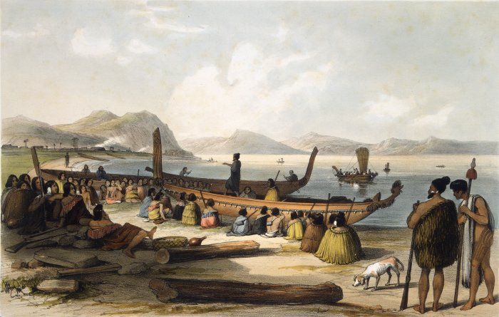

Slide 4
Māori Culture
Over 500 years, the development of Māori culture
Predominantly rural population
Rich and vibrant culture full of arts, performance and tradition
Kinship links and strong connection to the land
Oral folk law used to preserve stories and traditions throughout generations
Ta moko (tattoos – body art)
Importance of mana (status) and accompanying power
Notes:
Māori culture is rich and vibrant, steeped in folklore, arts and traditions. Historically, the Māori are a tribal population, living predominantly in rural areas. Shared ancestry, trade and inter-marriage helped strengthen relations between different groups, forming a hierarchical society based upon a class structure containing chiefs, ruling families, commoners and slaves. Within these societies, regional dialects arose, and oral folklore preserved stories and beliefs which were passed down through generations. Image making through ta moko (tattoos) formed a dominant aspect of Māori culture, traditionally representing individual Māori tribes and containing ancestral messages specific to the wearer, as well as indicating place and status within the social structure. Beyond ta moko tattoos, arts such as carving, weaving and painting formed an essential part of Māori culture and are still practised today. The Māori also observed spiritual traditions such as tapu, (denoting something holy or sacred), and held strong spiritual ties to the land. Despite these commonalities however, the importance of status and competition over land, power and resources meant that warfare between tribes was common. Arts such as the haka – which today we associate with international rugby - were originally performed to indicate a tribe’s readiness to defend itself when meeting with other tribes.

Slide 5
British contact – from 1790s
Abel Tasman and James Cook
Sealing and whaling stations
Guns in exchange for supplies and labor
British – Maori relations appeared friendly but soon escalated to conflict.
Maori using muskets in inter-tribal wars
Notes:
The British weren’t aware of the existence of New Zealand until 1642, when Dutch explorer Abel Tasman became the first European to discover the South Pacific island group. For over 100 years, the islands didn’t attract much attention until the 18th century when James Cook, a British explorer, travelled there providing detailed accounts of the land - its flora, fauna and people. Early settlement in the form of sealing and whaling stations led to the first trade with the Māori for supplies. This was soon followed by traders, whalers and missionaries. New Zealand’s temperate climate attracted British farmers in search of a better life, who brought with them crops and livestock and began to settle. These early settlers exchanged British clothing, guns and food for Māori resources, land and labour. Extensive European settlement began in New Zealand in the early 19th century with early British - Māori relations appearing friendly but soon escalating to conflict, particularly with regard to the ownership of land. The Māori acquisition of British muskets led to a period of intertribal warfare known as the ‘Musket Wars’ – a series of around 3000 battles fought between the Māori in a quest to gain territory.

Slide 6
Treaty of Waitangi 1840
40 Maori chiefs signed a treaty with the British
Maori could keep their land, but their rights were often ignored
Land grabs leading to wars
Armed territorial conflict would continue for another 30 years
Hone Heke chops down the British flagpole in act of resistance
Notes:
Far greater than the threat of inter-Māori warfare was the developing encroachment of British settlers as they looked to take control over Māori lands. In 1840, the Treaty of Waitangi was signed between the British crown and 40 Māori chiefs, stating that Māori could keep possession of their land if they recognised British sovereignty. Whilst this treaty was designed to eliminate violence between the British and the Māori, many of the rights promised to Māori were often ignored, and illegal land grabs frequently took place. Armed territorial conflict between the British and Māori continued for another 30 years until 1872 when disease and murder meant Māori numbers became too few to continue the resistance. Even before the introduction of the Treaty, the British New Zealand Company had stolen land from the mauri population, including land that would later become the New Zealand capital, Wellington.

Slide 7
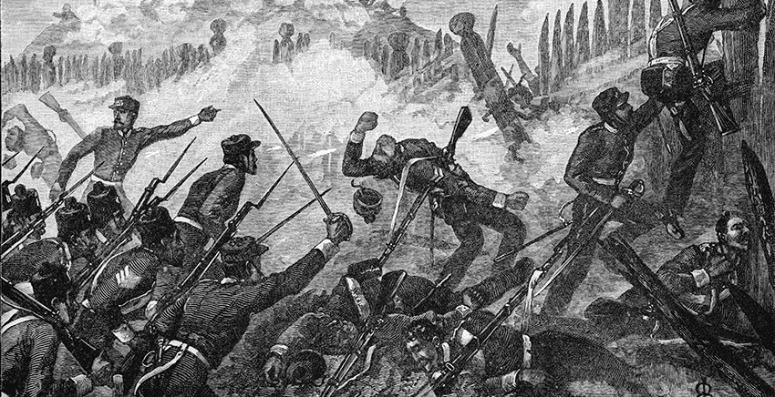
Effect of British Settlement on the Māori
• Reduced due to warfare
• Lost millions of acres of land sold to or confiscated by the British
• Devastated by disease brought over by the British
Notes:
Following the Treaty of Waitangi there was a surge of British settlers, with around 400,000 arriving in the following decades. Meanwhile, the Māori population had been decimated to around 100,000, reducing their influence within an increasingly white nation. By the 1860s the growing number of British settlers resulted in the New Zealand Wars, fought over land ownership between the colonial government and the Māori people. Some Māori people became displaced by the conflict and travelled to raid and colonise the less heavily populated South Island. The Māori eventually lost millions of acres of land to the British, significantly damaging them both socially and economically. Moreover, the Māori population was further devastated by diseases, brought over by the British, killing approximately 10% of Māori and reducing their numbers to 50,000 within a total population of 800,000. This drastic decline in numbers meant that Māori had a little influence on public affairs and decision making, and their culture was severely impacted. By late 1875 much of New Zealand was occupied by British settlers, and it was assumed by both British and Māori that the Māori population would gradually assimilate to western settlement until they failed to exist as an independent culture. Māori and white societies remained largely separate as Māori tribes lived in primarily rural areas and white settlers in cities, but over time many Māori moved from these rural communities to find work in cities, increasing their urban prominence and gradually the Māori population began to recover.
The economy and landscape were transformed by British settlement. Large sheep stations were established from the 1850s with wool being exported for the textile mills in Britain. The invention of refrigerated ships in 1882 revolutionised the market for New Zealand farmers, encouraging large scale export of butter and mutton.
The Otago Goldrush from 1861 saw a rapid increase in migration from Europe. In the following decades, several thousand Chinese migrated to the South Island to work the goldfields there. They tended to be discriminated against and were subject to poor living conditions. Today they remain the largest Asian ethnic group in New Zealand.

Slide 8
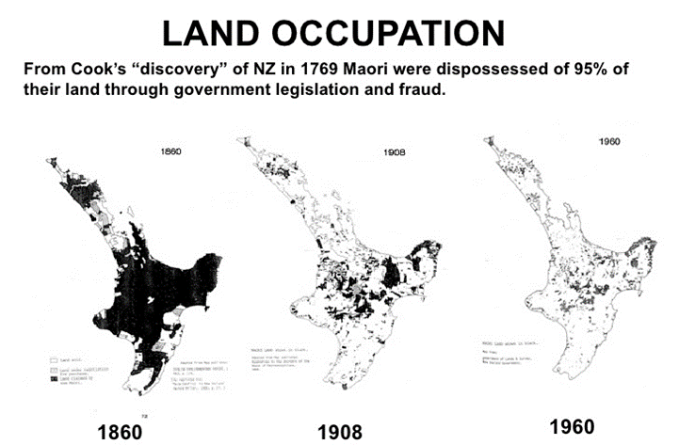

Slide 9
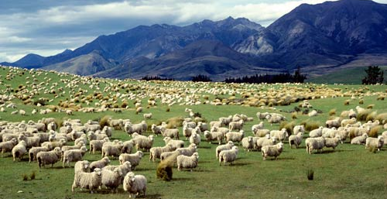
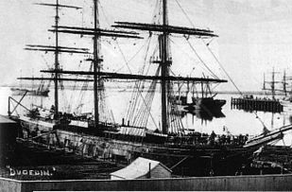
Economy Transformed
400,000 came from Britain to settle in the years after Waitangi
By 1875, much of the country occupied by settlers
Large sheep stations established
Refrigerated ships from 1882 - export of butter and mutton
Notes:
The economy and landscape were transformed by British settlement. Large sheep stations were established from the 1850s with wool being exported for the textile mills in Britain. The invention of refrigerated ships in 1882 revolutionised the market for New Zealand farmers, encouraging large scale export of butter and mutton.

Slide 10
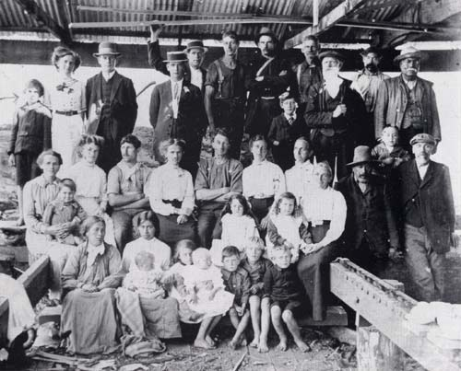
Gold Rush
A flood of migrants from Europe
Many Chinese came to work the goldfields
Discrimination against Chinese
Notes:
The Otago Goldrush from 1861 saw a rapid increase in migration from Europe. In the following decades, several thousand Chinese migrated to the South Island to work the goldfields there. They tended to be discriminated against and were subject to poor living conditions. Today they remain the largest Asian ethnic group in New Zealand.

Slide 11
Maori rights and political control
Britain gained political power through force
Did not want to lose New Zealand to a resistance movement, therefore gave them more freedom
New Zealand became self-governing in 1852
Maori are involved in New Zealand’s political system
All women were given the vote in 1893
Full independence from Britain was granted in 1947.
Notes:
From the outset, British immigrants gained political control primarily through force. New Zealand was granted greater independence than other British colonies, to reduce the risk of instigating a resistance movement, as Britain did not want to lose sovereignty of New Zealand the way it had lost control of the American colonies in the American War of Independence. This, therefore, offered New Zealand more power and self-governing abilities. New Zealand became self- governing in 1852 and Māori were included in the country’s political system, holding reserved seats in parliament since 1868. It became a routine requirement for councils and government organisations to consult with Māori leaders through the decision-making and implementation process. Politically, New Zealand has generally been ahead of its time. As early as 1893 all women were granted the right to vote, well ahead of women in Britain, making them the first country in the world to achieve universal suffrage. In 1931 the statute of Westminster granted the colony control over its foreign policy and military, reflecting the country’s independence, with full independence granted to New Zealand in 1947.

Slide 12
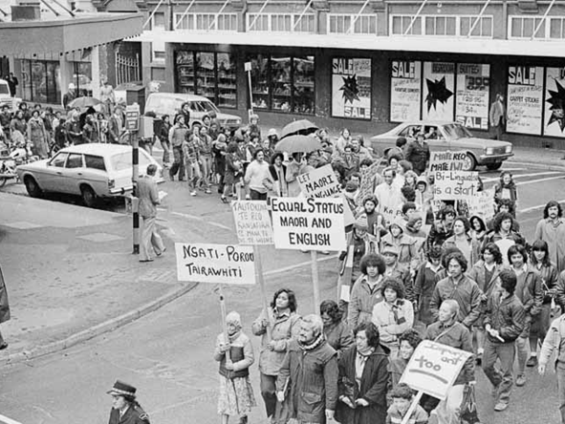
Māori in the 21st Century
Growing protest movement for Māori recognition since 1960’s leading to Māori renaissance in the 1970’s.
Māori are vitally important to New Zealand’s commerce, culture and identity.
Today, 7 seats in the 120 seat Parliament are Māori seats; only Māori can vote for these.
However, the Māori still face problems within the 21st century
Māori still experience systemic racism and are continually having to fight for representation and appreciation in New Zealand.
Notes:
As the negative effects of colonisation on the Māori became apparent, a growing protest movement in the 1960s demanded recognition of Māori rights and culture. This led to a Māori renaissance during the 1970s in which schools were established to promote indigenous language, culture and heritage. As New Zealand’s second largest ethnic group, Māori are now firmly recognised within New Zealand’s modern society and hold vital importance to the country’s commerce, identity and culture. Furthermore, traditional Māori art including carving, weaving and group performance, play a prominent role within New Zealand’s culture as a whole. But despite their integral influence, Māori still face many problems within 21st century society. Due to institutionalised racism, Māori unemployment is high, and living conditions are considerably worse than those of white New Zealanders, with over 50% of the population living in deprived areas. Although the Māori population is becoming increasingly educated to a higher level, literacy within Māori communities remains disproportionately low. Moreover, despite making up only 14% of New Zealand’s population, Māori contribute 50% of the prison population, indicating ongoing levels of discrimination and prejudice within New Zealand’s law enforcement systems. Thus, whilst Māori form an integral part of New Zealand’s culture, they are still experiencing systemic racism within their own country and are continuously having to fight for representation and appreciation within New Zealand’s past, present and future.

Slide 13
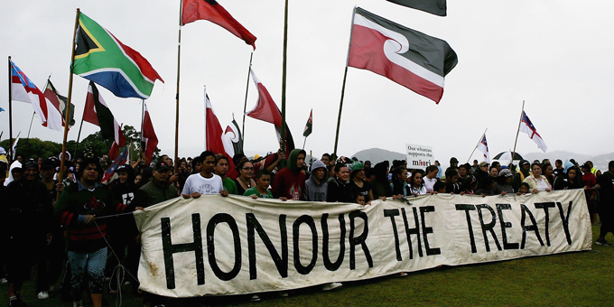
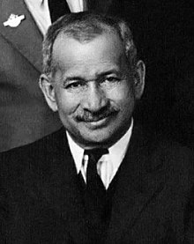
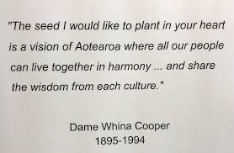
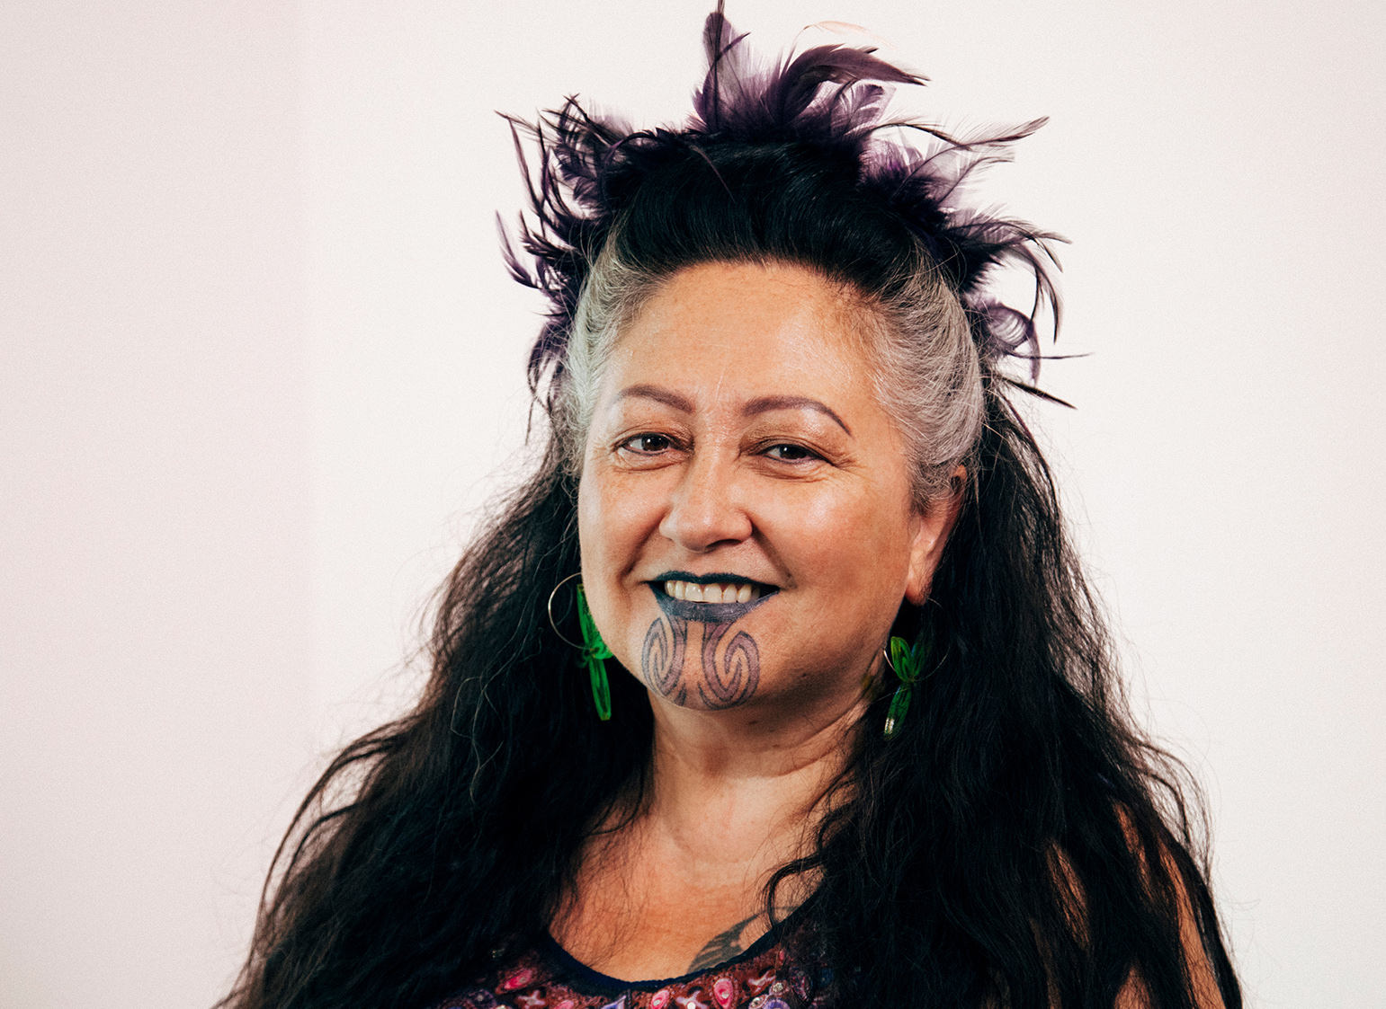
Key Figures in the Fight for Māori Rights: Then and Now
Notes:
There are many influential Māori individuals who have fought and continue to fight for Māori rights and the promotion of Māori culture. Āpirana Ngata (1874 – 1950) served in the New Zealand government as Minister for Māori Affairs between 1928 and 1934. He is known for his work in promoting and protecting the Māori culture and language. Whina Cooper (1895 – 1994) was a Māori activist who fought particularly for Māori women’s rights and is most remembered for leading the 1975 Māori land march (across a distance of 1,100km) at the age of 79. Elizabeth Kerekere is a Māori LGBTQ+ rights activist and a New Zealand Green Party MP.

