Slide 1

SOUTHERN AFRICA
Experiences of British Colonisation

Slide 2

Contents
Geography of Southern Africa
Pre-colonial civilization
  Indigenous population
  Cultural and societal complexity
British Colonisation
  Dutch – British Conflict
  Mfecane (1815-1840)
  Xhosa and Zulu Resistance
Motivations for colonization
British Colonisation of Southern Africa
  Migrant Labour
Experience during WW1 and WW2
Independence
Colonial legacy in Southern Africa

Slide 3
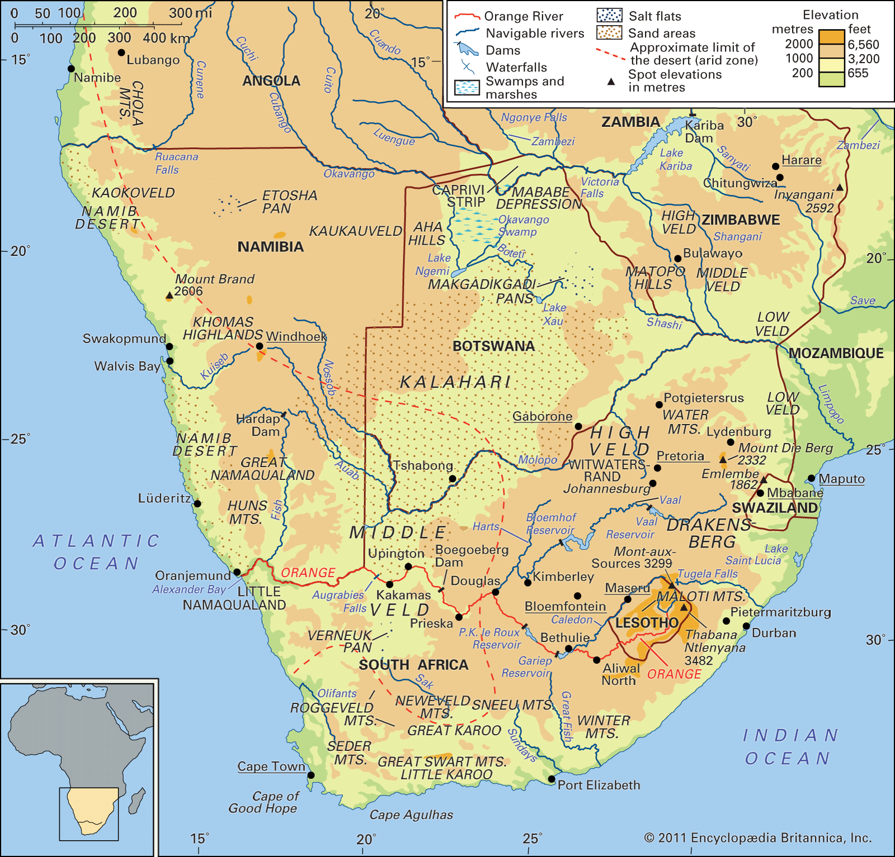
Geography
A vast region
Mostly a plateau with coastal fringes
Mild, sunny climate. Arid in the interior, more rainfall in the coastal areas.
The country of South Africa is 5x bigger than the UK
Notes:
Southern Africa is the southernmost region of the African continent, south of the Democratic Republic of Congo and Tanzania, and comprises of the countries of Angola, Botswana, Eswatini, Lesotho, Malawi, Mozambique, Namibia, South Africa, Zambia, and Zimbabwe. All countries in Southern Africa except for the former Portuguese territories of Angola and Mozambique were once part of the British Empire. The region known as South West Africa and later called Namibia, was initially a German colony but was handed to South Africa after the end of WWI. At that time, South Africa was a self-governing dominion of the British Empire. The area of Southern Africa which was part of the Empire was 3,112,345 km², or about 27% of the total landmass of the African continent.
A number of river systems flow through the region, with the two largest the Zambezi and Limpopo flowing east into the Indian ocean, whereas the Orange River flows into the Atlantic. The Zambezi river flows over the Victoria falls, also known as Mosi-oa-Tunya, on the border between Zambia and Zimbabwe. It is the largest waterfall in the world.
The northern part of the region is in the tropics and is consequently much warmer with a wet season. The Kalahari desert is mainly in Botswana with an arid mixture of grasslands and sand. The Namib desert on the west Atlantic coast of Namibia receives very little rainfall.
Most of the region lies on a plateau which makes the climate generally cooler than other regions at comparable latitude. Lesotho, which is completely surrounded by South Africa, is the only independent country in the world that is entirely above 1000 metres.

Slide 4
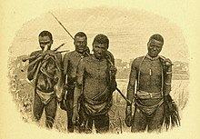
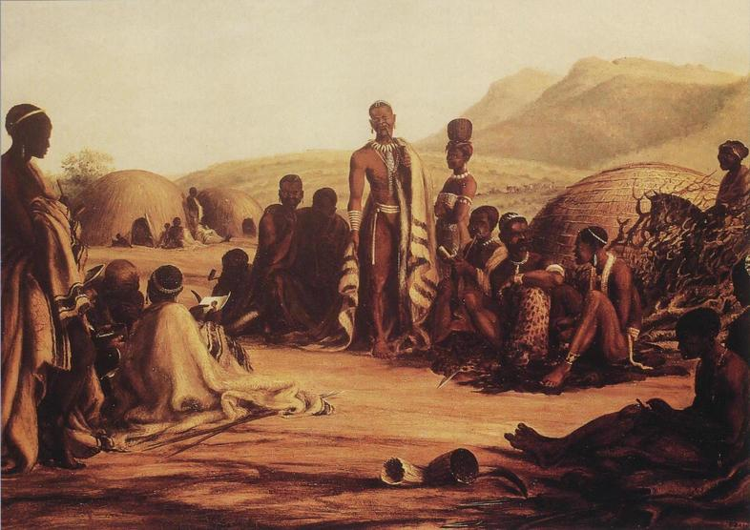
Indigenous populations
In southern Africa there were two main population groups:
  San people - hunters and gatherers, and Khoi-Khoi people – pastoralists
  Bantu peoples, who kept cattle and grew grain
  The Bantu were made up of large ethnic groups such as the Zulu, Xhosa, Sotho and Tswana.
Notes:
The African population of the Southern Africa region were mainly Bantu speaking peoples whose ancestors had begun migrating in an easterly and southern direction about 3,500 years ago from an area that is widely accepted as being between the borders of present-day Cameroon and Nigeria. Some lived in territorially large states with centralised power vested in a monarchy, such as the Zulu, others lived in relatively small kingdoms, and others still lived in societies without any formal authority. All Bantu communities practised agriculture but for some societies, pastoralism also played a very important social and religious role. This was not the case for communities living in the tropics where tsetse flies were endemic since the fly causes sleeping sickness in both animals and humans. The main cereal grains cultivated where sorghum and millet which had been domesticated within Africa further to the north. Later, some peoples adopted the cultivation of maize which became the main food crop after it was introduced by the Portuguese from South America.

Slide 5
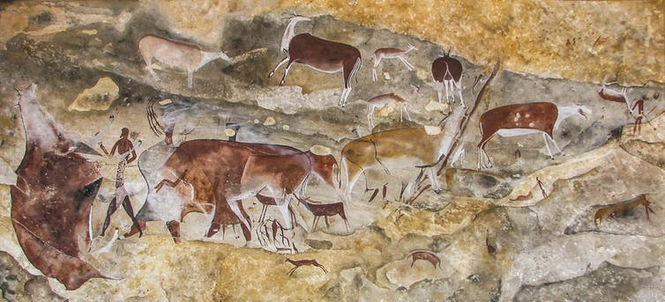
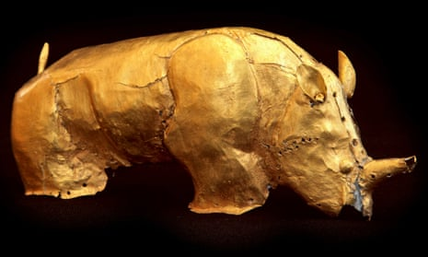
Cultural and Societal Complexity
Cave paintings dated as far back as 30,000 years ago have been found
The powerful Kingdom of Great Zimbabwe, built by the Shona people, was established from the 11th-15thC. It grew rich on trade, including that with China.
The golden rhinoceros of the ancient civilisation of Mapungubwe
Notes:
Mining of iron, gold and copper was carried out as was the cultivation of cotton for textile weaving. Long distance trade for foodstuffs, metal equipment and jewellery, pottery, salt, textiles and leather took place between the various communities using barter. To the north of the region copper crosses, known as ‘katanga’ or ‘handa,’ were used as currency.
Southern Africa did have contacts with the outside world before European exploration and expansion. Goods from the African interior such as ivory, gold and animal skins were traded for centuries for goods such as porcelain and silks from China, India and the Middle East as evidenced from archaeological sites such as Mapungubwe in South Africa and Great Zimbabwe in Zimbabwe.
The non-Bantu speaking Khoisan population had been living in the region prior to Bantu settlement. Khoisan people comprised of two communities that spoke click languages called the Khoi and San. The Khoi were nomadic pastoralists whereas the San were hunters and gatherers. The Khoisan were the first to bear the consequence of European settlement in the Cape as their lands were taken from them and many of them enslaved.

Slide 6
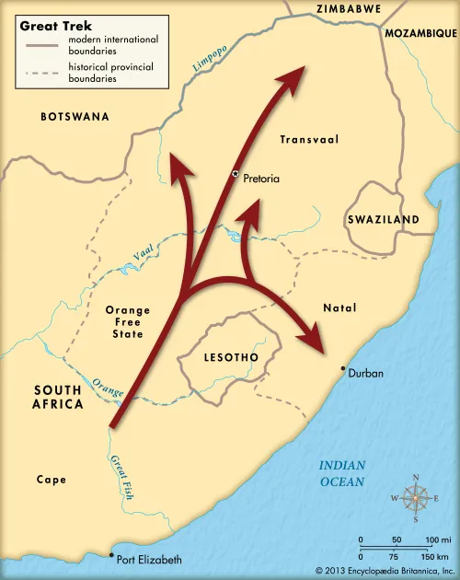
Dutch-British Conflict
The Dutch had established the settlement of Cape Town in 1652, and later Cape Colony. Together with French Huguenots arriving from 1685, they became known as Afrikaners. They imported slaves to help with farming.
1806 British took Cape Town from the Dutch;
This was of strategic importance on the route to India
The Battle of Blaauwberg; Britain take Cape Town (above)
Clash of culture with Afrikaners
Slachter’s Nek rebellion (1815); English replaced Dutch as official language (1827); slavery abolished (1834) – but ‘masters and servants’ laws passed
Afrikaner Great Trek to the east and north (1834 – 38) to get away from British influence
A romanticised depiction of the Great Trek
Notes:
Cape Colony became an important resupply depot for ships of the Dutch East India Company as they travelled to and from the Spice Islands with their valuable cargoes in the seventeenth and eighteenth centuries. The Dutch East India Company allowed Protestants from Europe to augment the Dutch colony to promote the colony's growth. Consequently, there was a large influx of French Huguenots to supplement the Dutch Afrikaner farmers.
Over the course of a century and a half, the Afrikaners would slowly encroach upon the lands of the Khoi and San. In some cases, the settlers intermarried with these Khoi and San. The technological gulf was vast between these two civilisations and the Khoi and San were unable to resist the growth of the Cape Colony. Many of them were forced into slavery by the Dutch settlers whilst others sought refuge in the harsh deserts to avoid them. This in turn meant that the Dutch would import other slaves from elsewhere in their empire to fill the labour gap that ensued.
The colony spread out from Cape Town, and, as the Afrikaners moved to the drier east, they turned from the farming of crops, which was supported by Cape Town’s arable climate, to livestock. They began to compete with the Bantu-speaking Xhosa for livestock and good grazing areas. The Xhosa were well organised with a large population and traded ivory and gold with Arabs and Europeans. An uneasy frontier was agreed along the Fish River.
In 1806, with the Dutch being weakened by the Napoleonic Wars in Europe, the British forcibly took over Cape Town, a strategically important staging post on the route to India which had by then become Britain’s most important colony.
With the British ending their trade in slaves, the issue of slavery proved a source of conflict. Magistrates were encouraged to hear complaints by the Khoisan and when an Afrikaner farmer refused to appear in court to hear a complaint against him there was a revolt in the eastern Cape which resulted in the hanging of five Afrikaners at Slachter's Nek in 1815.
The assault on Afrikaner culture was far from over. In 1827 English replaced Dutch as the official language of the colony. British missionaries were to be given permission to proselytise in place of Dutch missionaries. These missionaries would energetically take up the cause of Africans in cases of any injustice with their Afrikaner masters.
The last straw for many Afrikaners was the abolition of slavery in 1834. Some forty thousand Afrikaner owned slaves would have to be released. Piet Retief, an Afrikaner leader, led three thousand of his people in what would be known as ‘the Great Trek’, eventually going to the High Veld and to the Orange River - away from the British, but deep into African territory. Some Afrikaners though adapted to life in the British colony where they would remain a large and powerful minority.

Slide 7
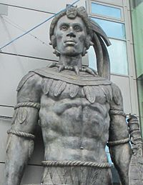
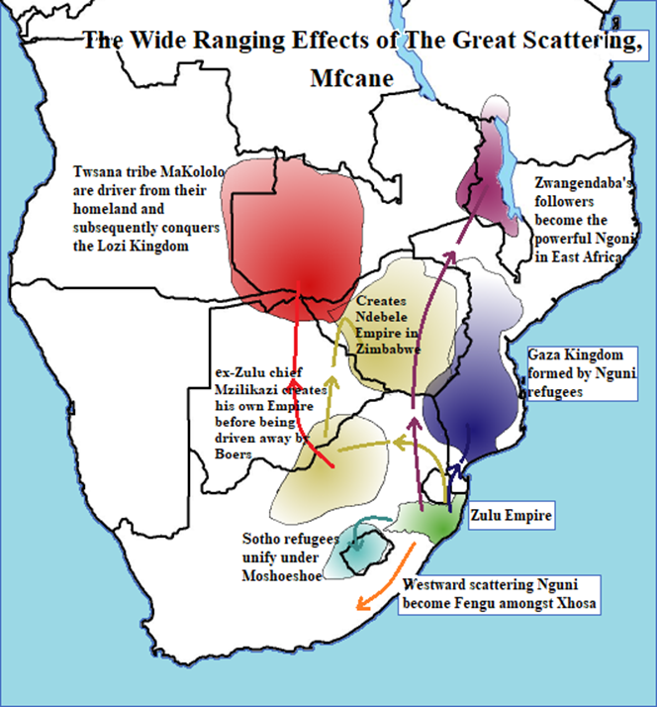
The Mfecane (1815 – 1840)
Statue of Shaka, Zulu monarch
Mfecane: an indigenous African conflict originating in the Zulu Empire under Shaka; a series of wars and forced migrations
The Ndebele migration attacked the Tswana people and pushed the Shona out of their lands
New kingdoms were created by the Sotho, in what is now Lesotho, the Makololo, in what is now western Zambia, the Nguni, in what is now Malawi, and the Ndebele in what is now Zimbabwe.
Great disruption to African populations, to be worsened by Afrikaner/British settlers
Notes:
The Mfecane was an indigenous African conflict originating in the powerful Zulu Empire under Shaka. The causes of this are disputed though it may have been due to increased pressures on land through population growth. The Zulu population had increased greatly with the introduction of maize by the Portuguese. Another cause may have been European pressures on the land and for labour, both from the Portuguese and British colonists. It led to a series of catastrophic wars and forced migrations with huge numbers of casualties. The Ndebele migrated north through Tswana land, attacking its people before pushing the Shona out of their lands and settling in what is now southern Zimbabwe. Several new kingdoms were created, by the Sotho in what is now Lesotho, the Makololo, in what is now western Zambia, the Nguni, in what is now Malawi, and the Ndebele in what is now Zimbabwe.

Slide 8
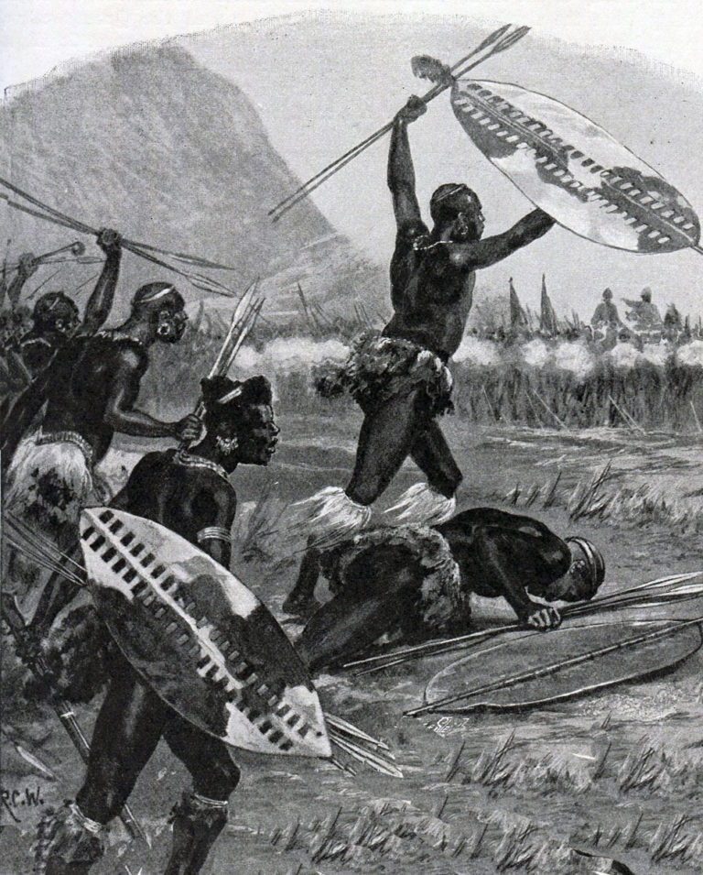
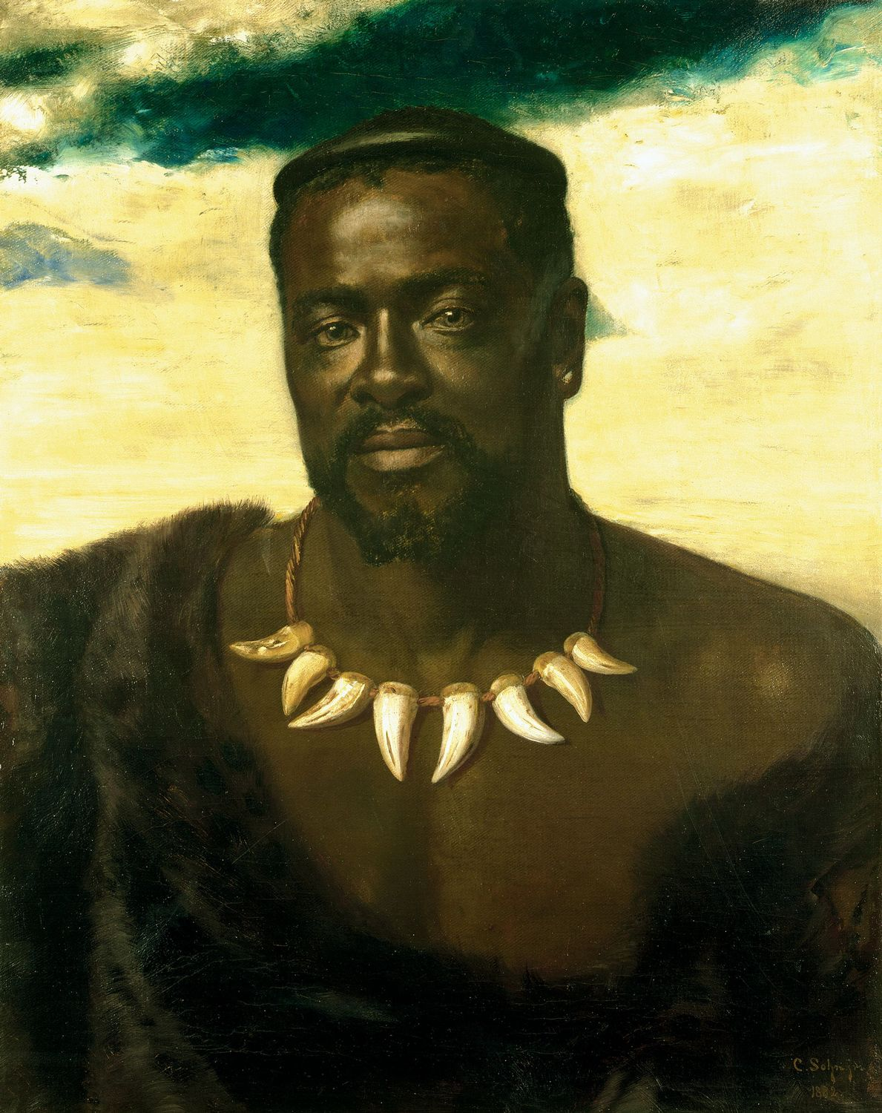
Xhosa and Zulu Resistance
Xhosa conflict with British and Afrikaners – competition with Afrikaner and British settlers for pasture as the colonists move eastwards from the Cape
By 1857: Xhosa exhausted by years of attrition
Zulu keep their lands as Britain annexes Natal in 1843
The Zulu, under Chief Cetshwayo, defeat the British at Isandlwana (1879). Later, a larger British army defeats the Zulu at Ulundi.
Chief Cetshwayo (above)
Notes:
The British settler expansion of Cape Colony’s territory eastwards provoked powerful African resistance. The frontier was an extremely volatile place and was costing a lot of money to pacify.
From 1844, the British began to administer Natal, a region in south-east Africa with good soils and climate. This was a precarious settlement due to it being surrounded by powerful African polities and the ongoing difficulties of dealing with the Afrikaners. From 1860, indentured Indian workers were brought in to work the sugar plantations there; an arrangement that continued until 1911.
Afrikaners, via their Great Trek, settled in what became the Transvaal and the Orange Free State. They were encroaching on land that had already been occupied by African peoples for close to a millennium meaning that they were always in a precarious security position. Powerful Xhosa and Zulu groups were less than happy to find so many Europeans trespassing on their lands, stealing their cattle and even enslaving young African children. Clashes were frequent, the largest of them being the Battle of Blood River. Superior firepower and equipment gave the Afrikaners a decisive advantage over the Africans, but it did not mean that the isolated Afrikaner farmers were going to be safe. Many of the African states had treaty agreements with the British and appealed to the British for aid against their unwelcome invaders. However, in 1852 at the Sand River Convention, the British disclaimed authority in this region and hence went back on its treaty obligations to its African allies.
The British in Natal were drawn into a conflict between the Zulus and the Afrikaners. In the 1870s the Zulus were rightfully complaining about Afrikaner encroachments into their lands from the Transvaal. Although a British boundary commission found in favour of the Zulu, the disputed land would only be returned if the Zulu army was disbanded. This was too harsh a term for the Zulu, who simply ignored the unacceptable and provocative ultimatum. British leaders on the ground wanted to destroy Zulu military power.
The British invasion in 1879 from Natal was destroyed by the Zulu at Isandlwana. The British responded by sending out an even larger regular army with artillery and Gatling guns that defeated the Zulus at the battle of Ulundi. Chief Cetswayo was captured, and Zululand partitioned. The irony of this pointless war was that it helped the Afrikaners more than the British colonists. With the threat of the Zulu removed, the Transvaal no longer needed British protection and promptly declared its independence but only after fighting the first Afrikaner War of 1880-1881. The antagonism between the British and Afrikaners was set to continue, but Zulu military power had been broken.
The Orange Free State was constantly at war with its African neighbours. Again, the British would be called in to keep the peace and help protect the Sotho and Tswana from the claims of the Afrikaners.
Basutoland: The mountainous and largely arid land that came to be Basutoland was populated by the San until the end of the 16th century. From then Bantu-speaking peoples began to migrate into the area, including the Basotho. People fled into the area as a consequence of the Mfecane wars. From around 1820, a leader named Moshoeshoe emerged to resist invaders and became King Moshoeshoe I in the 1830s. During Moshoeshoe's reign there were a series of clashes with the Afrikaners of the Orange Free State, the British and with other indigenous groups. Despite a certain amount of success in battle and Moshoeshoe’s skills in diplomacy, the kingdom lost considerable territory, including the arable land west of the Caledon River which is referred to as the Lost or Conquered Territory. Moshoeshoe died in 1870.
The Basotho resisted the British when in 1879, Morosi, a leader of the Baphuthi, rose in revolt, and in 1880-1881 through the Gun War, which incurred significant casualties upon colonial British forces sent to subdue it. In 1884 though it became a British Protectorate as the Territory of Basutoland.
Bechuanaland: As a consequence of the Mfecane, in about 1817, Mzilikazi, the founder of the Ndebele nation, fled from Shaka’s Zulu Empire, and conquered large swathes of territory belonging to Tswana speaking groups and enrolled large numbers of Batswana into his armies. Eventually the Ndebele settled to the north-east of the country.
In 1821 Robert Moffat arrived at Kuruman as agent of the London Missionary Society and made it his headquarters for fifty years. He was the first to translate the language of the Tswana people (SeTswana) into English. The arrival of David Livingstone in 1841 marked the beginning of the systematic exploration of the northern regions.
From the 1850s, Tswana territory was subject to repeated Afrikaner incursions from their settlement in the Transvaal. Khama, chief of the Bamangwato in northern Bechuanaland, wrote in August 1876 to Sir Henry Barkly, ‘I write to you, Sir Henry, in order that your queen may preserve for me my country, it being in her hands. The Afrikaners are coming into it, and I do not like them. Their actions are cruel among us black people. We are like money; they sell us and our children. I ask Her Majesty to defend me, as she defends all her people.’ It seemed the Afrikaners were still enslaving Africans, and the British were being ineffectual. Under pressure from public opinion in Britain, Bechuanaland was formally taken under British protection in 1885.
However, in 1895 the country was annexed to Cape Colony. At the same time, it was provisionally arranged that the Bechuanaland protectorate should pass under the administration of Cecil Rhodes’ British South Africa Company. Khama and two other Tswana rulers, Bathoen and Sebele, came to England and protested this arrangement, touring Britain to successfully promote their cause. The result was that their territories and those of other petty chiefs lying to the north of the Molopo were made native reserves. Anxiety was caused on the western frontier during the German campaigns against the Khoi and Herero (1903-1908) when many sought refuge in the protectorate.
The Tswana proved loyal to the British during the Anglo-Afrikaner war in which Khama and other rulers supplied assistance by providing transport.

Slide 9
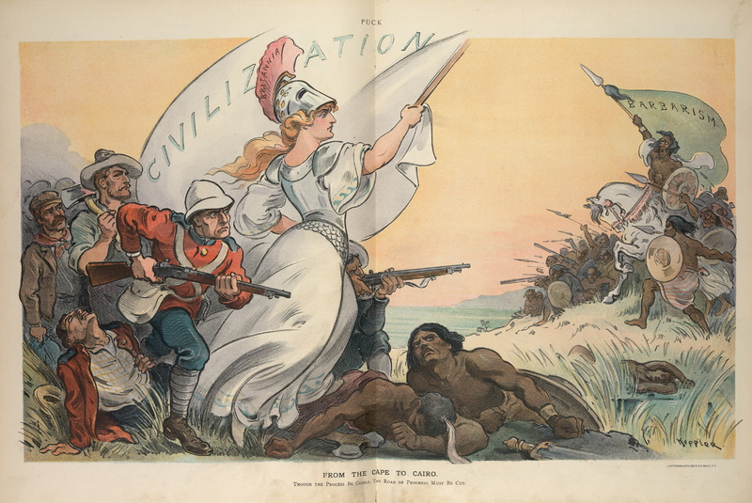
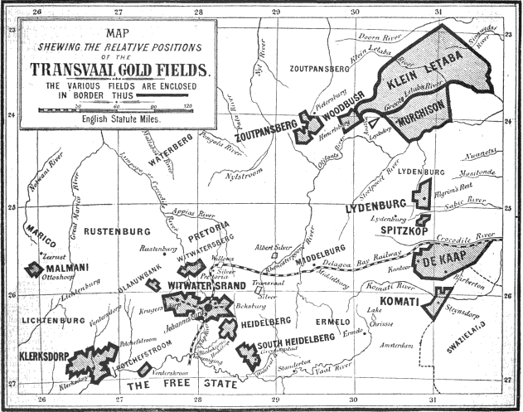
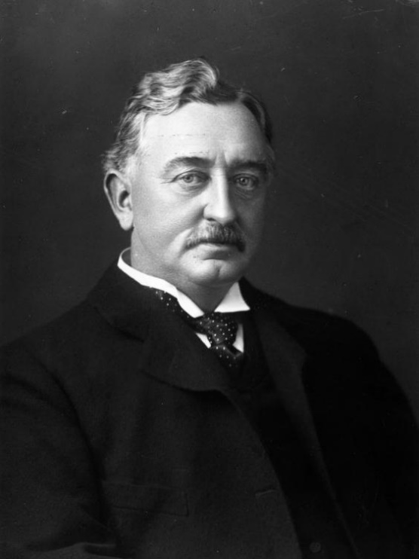
Motivations of British Colonisation
Social
‘The white man’s burden:’ Livingstone philosphised that duty of the white, Christian colonist was to bring civilization, Christianity and commerce
Impact was a denigration of African thought, religion, art or music
Economic
1880s Gold discoveries in the Afrikaner colony of the Transvaal
British imperial ambition to take over the gold fields led to the Boer War
Political
Cecil Rhodes and British South Africa Company promoted and justified the colonisation of Southern Africa
  Prime minister of Cape Colony (1890 – 96)
  Acted to push Africans from their lands: ‘Black people need to be driven off their land to stimulate them to labour’
Cecil Rhodes

Slide 10
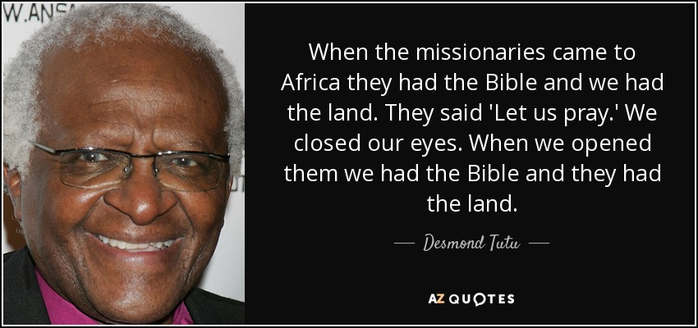
Livingstone: ‘Christianity, Commerce and Civilisation’
David Livingstone
Exploring, mapping central Africa for European commerce
Highlighted Portuguese slave trade
Missionary zeal: set up mission stations north of the Zambezi
The duty to ‘civilize’
Image entitled ‘Pioneers of Civilisation;’ represents Livingstone’s colonial ideology.
Notes:
David Livingstone explored the interior from 1841 until his death in what is now Zambia in 1873, mapping the land and navigating the rivers. He highlighted the slave trade that was being carried out by the Portuguese, Swahili and Arabs in East Africa. This in turn led to the setting up of mission stations north of the Zambezi which came to be seen as areas of British interest. The missionary zeal encouraged by Livingstone’s travels were part of a vision in which Europeans, because of their inherent superiority, would be the ones who would come to the rescue of the African heathen and impart their superior civilization onto an Africa that was otherwise incapable of uplifting itself.
The three C’s refer to Christianity, commerce and civilization, which, according to Livingstone, Europeans had to bring to Africans to lift them from the shackles of heathenism and savagery.

Slide 11
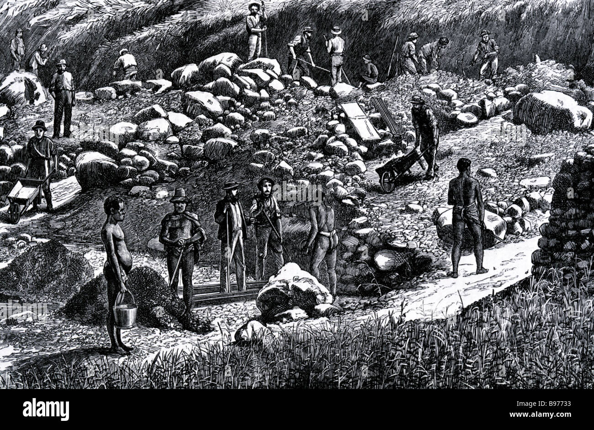

Diamonds and gold
The Griqua, a group of Tswana, Khoisan and European descent moved away from the Cape; racial attitudes
1867 diamonds in Griqualand West – Britain annexes the Griquas’ land
1880s gold discoveries in the Afrikaner colony of the Transvaal
British imperial ambition to take over the gold fields led to the Boer War
Notes:
The discovery of diamonds and gold transformed colonialism in South Africa. The Cape Colony would expand further North by a diplomatic sleight of hand in the 1860s and 70s. In 1867, diamonds were discovered in Griqualand West on the lower Vaal. The Griqua were a mixed race predominantly Tswana and Khoisan group who had undergone their own treks to avoid European rule as racial attitudes against them hardened. The discovery of diamonds brought the interest of the Afrikaners and the British to this valuable land. The Transvaal claimed the land on the basis of the Bloemfontein Convention. The African Griqua declared that they were entitled to British protection, probably regarding them as the lesser of two evils. An independent arbitrator found in favour of the Griqua and against the Transvaal. The British formally annexed the area in 1871, declared it a Crown colony in 1873 and incorporated it into the Cape Colony in 1880. This was after Griqua unhappiness over ownership of their land and the right to make claims on the diamond fields led to a full rebellion in 1878. The Griqua and Tlhaping rose up against the British but were crushed. Although the diamond mines were quickly brought under British control, the gold mines developed from the 1880s were a different matter. They were located mainly in the Afrikaner controlled Transvaal and their sheer size meant that they attracted the attention of the world. The Afrikaners were now in financial ascendency.
Over the next two decades, Cecil Rhodes gained near-complete domination of the world diamond market. His De Beers diamond company, formed in 1888, is still the world’s leading diamond dealership to this day. His views on white racial supremacy and that black people needed to be driven off their land were a precursor to South Africa’s 1913 Native Lands Act. He formed the British South Africa Company (BSAC) with its own armed police force.

Slide 12
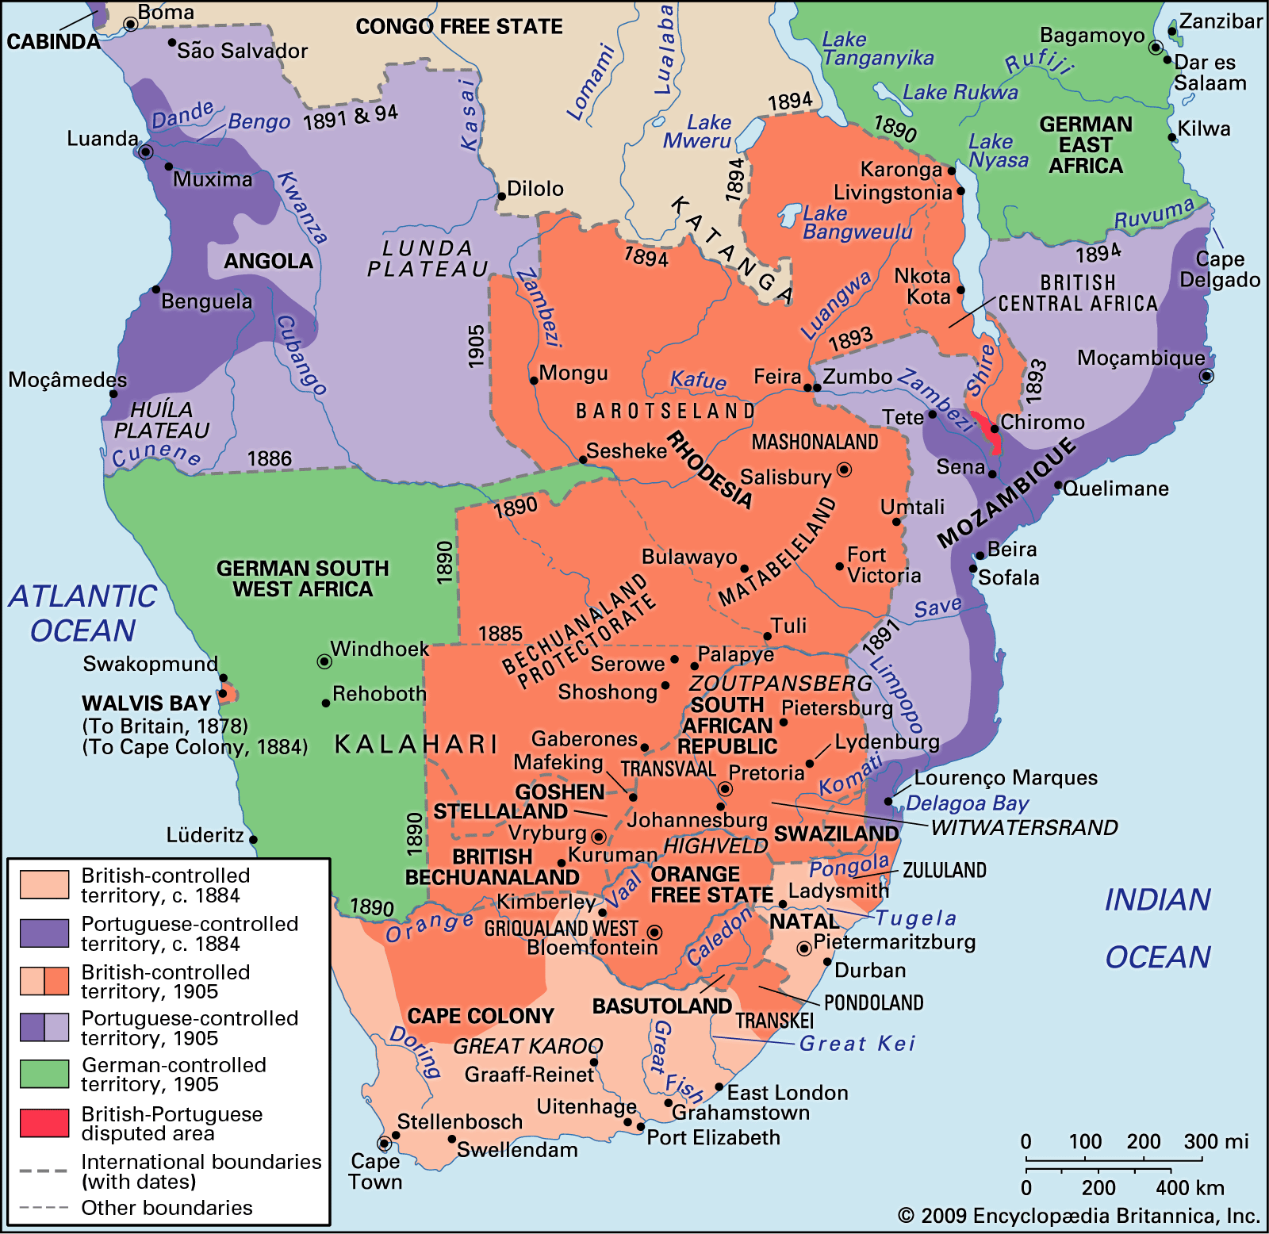
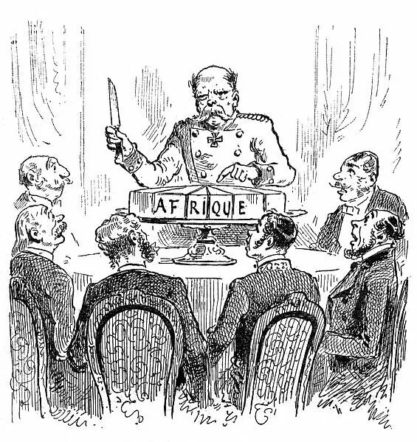
Overview of Colonial Southern Africa, 1884–1905
British penetration into Southern Africa in the late 19th and early 20th centuries, encouraged by Rhodes.
Note this was part of the ‘Scramble for Africa’, with Britain competing with the Portuguese and the Germans.
Source: Encyclopædia Britannica, Inc.
Notes:
The Berlin Conference of 1884-85 began the process of carving up Africa, paying no attention to local culture or ethnic groups, and leaving people from the same tribe on separate sides of European-imposed borders. In southern Africa for instance, the Chewa people now reside in three different countries – Malawi (was Nyasaland), Mozambique and Zambia (was Northern Rhodesia). Over the following 20 years, Britain vastly expanded its colonial control, establishing protectorates in Bechuanaland, Basutoland and Swaziland, and taking over by force through Rhodes’ BSAC the territories of what became Southern Rhodesia, Northern Rhodesia and Nyasaland.

Slide 13
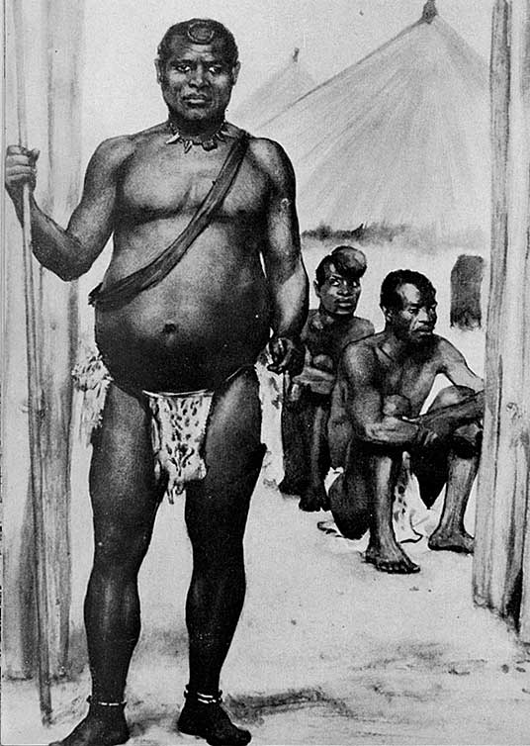
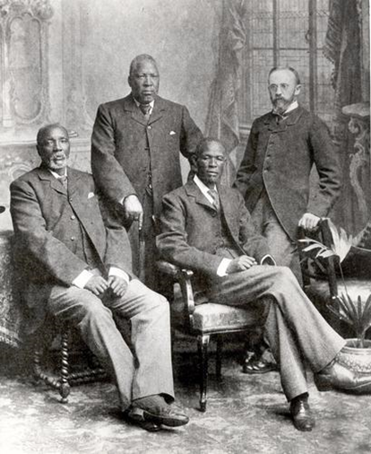
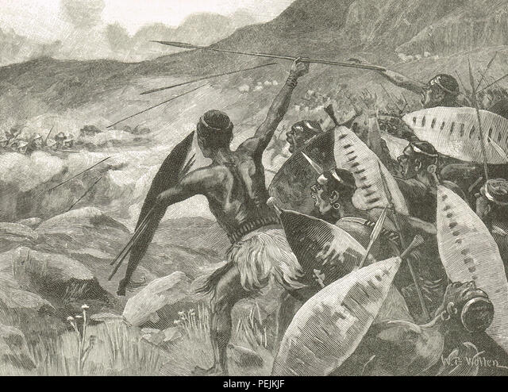
Colonising southern Africa
Basutoland, Bechuanaland and Swaziland resist being taken over by South Africa by becoming British protectorates of the Crown
King Lobengula of the Ndebele deceived by British SA Company leading to the Matabele Wars
The Matabele Wars
King Lobengula
The 3 Tswana Kings seeking Britain’s protection
Notes:
Swaziland: The Swazi or Swati were a Bantu speaking people who, under the leadership of Mswati II, brought together many different clans and occupied land between the Afrikaners of the Transvaal to the north and the Zulus to the south. The Afrikaners were interested in acquiring a port of their own and Swaziland lay between the only one available and the Transvaal. In 1893 the British agreed to allow Swaziland to become a protectorate of Transvaal but only with stipulations and provisions safeguarding the rights of the Swazi. The Afrikaners had a reputation for being notoriously racist and tended to treat the Swazi with contempt. With the Boer War and Afrikaner defeat in 1902, Swaziland passed under full British protection.
Southern Rhodesia: Named after Cecil Rhodes, Southern Rhodesia was to be formed as part of the ‘Scramble for Africa’. However, the lands were under the control of the powerful Ndebele kingdom under Lobengula, and included the Shona speaking people who had occupied the land for millennia. Although the land was in the tropics, it was on a high plateau, which mediated the temperature, and was very high quality, as well as being suitable for western agriculture.
The discovery of gold on the Witwatersrand in the Transvaal in 1886 was to draw the attention of the world to Southern Africa so that Lobengula was besieged by requests for land grants. Rhodes encouraged him to enter an agreement where in effect, his kingdom was turned into a British protectorate thus spreading British control northwards and keeping out the Afrikaners. Rhodes also persuaded Lobengula to sell the mineral rights of his kingdom. Britain allowed him to create the British South Africa Company (BSAC) to exploit this huge concession of land.
From 1890, the search for gold began but was frustrated because gold mined by Africans from the ancient site of 'Great Zimbabwe' had been exhausted many years before. Although the country had fine quality agricultural land, Lobengula’s concessions did not run to ownership of the land. The BSAC found a pretext to gain control in 1893 when they intervened militarily on the side of the Shona who were in dispute with the Ndebele. The brave Ndebele warriors were no match for the BSAC with the latest military equipment including Maxim machine guns and modern artillery. This opened up control of the land for white settlement.
By 1896, Shona religious leaders led by a woman called Mbuya Nehanda and a man called Kagubi organised a rebellion using guerrilla warfare.
In 1899, the BSAC created a Legislative Council with a small number of directly elected seats. The electorate was almost exclusively comprised of white settlers.
Northern Rhodesia: The area north of the Zambesi had become known to Britain through the exploits of David Livingstone. Although unsuccessful in the south, the BSAC still endeavoured to discover gold north of the Zambesi. The Ngoni in the north east resisted signing over their rights until defeated in battle by the BSAC. In 1897, with over 4,000 warriors, their leader Mpezeni rose up against the British, but was defeated. The BSAC took control and Mpezeni signed the treaty which allowed him to rule as Paramount Chief of the Ngoni.
The land and climate here however was not as suitable for western agriculture as that in Southern Rhodesia so that few white settlers made the journey to the north.
Nyasaland: Nyasaland was made famous to the British public through the exploits and explorations of David Livingstone in the 1850s. He vehemently opposed the slave trade and pioneered missionary activity in the region. The existence of this and the commercial activity of the British owned African Lakes Company was enough to allow the British government to declare the area around Lake Nyasa a British protectorate in 1889 as part of the ‘Scramble for Africa’. Armed Arabs under Portuguese leadership invaded the area and only relinquished control in 1891.
The BSAC took control of the Nyasaland protectorate in 1893 but it took until 1897 to subdue the Arab slavers in the area.
White settlement was encouraged at the expense of black Africans. The settlers began to plant coffee plantations with extensive use of African labour. However, Christian Africans challenged the racist policies of the settlers and the BSAC government, with the churches back in Britain providing effective lobbies. In fact, it was partly as a result of this lobbying that Nyasaland was withdrawn from BSAC control in 1907 and returned to direct British rule.
Black ordained ministers would provide one of the first effective forms of opposition to colonial rule. This would be demonstrated in 1915 when John Chilembwe, a black minister, led a revolt against British rule whilst Britain was distracted by the First World War. The revolt was put down with relative ease but would provide inspiration for later acts of rebellion.

Slide 14
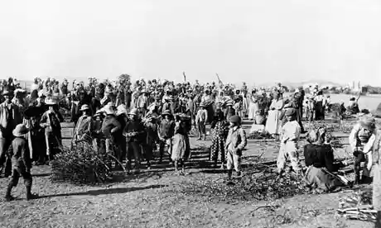
Importance of the Boer War (1899 – 1902) and Union of South Africa
Top right: a British concentration camp for Afrikaners, bottom right: the first Union cabinet
1880s, valuable gold and diamond mines developed in Afrikaner territory
Military defeat of Afrikaner armies; then two years of guerilla war
British set up concentration camps for Afrikaner civilians though a small number of Africans were also interned; 26,000 died of famine and disease
Treaty of Vereeniging, 1902, gave considerable rights to the defeated Afrikaners
1910: Union of South Africa with all power held by white politicians and settlers, especially the Afrikaners; no African involvement!
Notes:
British imperialists like Chamberlain and Alfred Milner made clear their intentions for adding Transvaal and the Orange Free State to the Empire one way or another. By 1899, the Afrikaner Republics concluded that their best chance at avoiding being annexed by the British was to launch a pre-emptive strike into parts of the Cape Colony, Bechuanaland and Natal. Natal's security was once more under severe threat as the North of the colony was captured by the Afrikaners and Ladysmith found itself besieged.
Their initial successes would bring the full force of the British Empire onto the Afrikaner Republics. However, the military defeat of the Republics would only mean that the war would move into a longer drawn-out guerrilla phase of warfare for the next two years. The human and physical costs would be enormous for all involved. A small, localised problem became a huge international embarrassment for the British. The determination and skill of the Afrikaners took all by surprise. British set up concentration camps for Afrikaner civilians though a small number of Africans were also interned; 26,000 died of famine and disease.
The ultimate consequence of the war would be the Union of South Africa. Paradoxically, for such a long and difficult war, the British awarded surprisingly liberal terms for their foe with the Treaty of Vereeniging. The British gained formal control of the two Republics but gave considerable rights to the defeated Afrikaners. 1910 would see this formalised yet further with the Cape Colony, Natal, Transvaal and the Orange Free State formed into one state, the Union of South Africa.
In the 19th century, a combination of Afrikaner and British enmity and large African polities had made unification too difficult to contemplate. Those problems no longer existed. Afrikaner recalcitrance had been subdued and African political power had been reduced or isolated into the kingdoms of Basutoland, Swaziland and Bechuanaland.

Slide 15
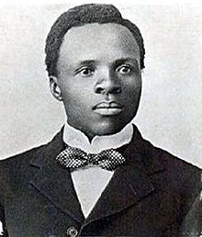
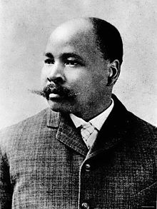
Under the Union, Africans have no rights
Sol Plaatje
South African Native National Congress (1912) – later the African National Congress (ANC), ‘to bring all Africans together to defend their rights and freedoms’.
John Dube and Sol Plaatje were its founders
Gandhi encouraged them to adopt non-violence and participation by all races
John Dube
‘By dint of our perseverance, our patience, our reasonableness, our law abiding methods and the justice of our demands, all these obstacles shall be removed and enemies overcome’ – JL Dube
Notes:
The Union of South Africa was devised by white politicians. Africans were not consulted in any way. Previously, many of their rights had actually been defended by the British Parliament in London which respected treaties and rights of private property. Now, that power was handed over to white politicians and settlers in South Africa who saw the Africans as rivals or as little more than units of labour and very often sitting on land that they would like to possess. Africans’ rights to vote, to own land and even freedom to work were about to be assaulted by the provincial concerns of the local white population who deliberately denied them a political voice.
This was demonstrated in 1913 with the Native Land Act. This denied Africans the right to own land on 87 percent of the Union's land area. The remaining 13 percent was of marginal, poor-quality scrub with little access to fresh water or port facilities. These reserves could not support the African population. This pushed more of the Africans into the labour market as marginal migrant workers. In time, successive pass laws and stern employment regulations would further push wages down especially for the ‘unskilled.’ The white settler parliament defined whites as automatically skilled. Besides, the white population was the only one given a decent education. The circle of discrimination was emplaced. The animosity between the Afrikaners and the British was solved by combining to crush the rights of the black African. By trying to appease one recalcitrant community, the British government had victimised another, far larger, community.
When the missionaries came to Africa, they had the bible and we had the land. They said ‘Let us pray’. We closed our eyes. When we opened them, we had the bible and they had the land!’ - Archbishop Tutu
British Protectorates
Basutoland: When the Union of South Africa was founded in 1910 the colony was still controlled by the British and moves were made to transfer it to the Union. However, the people of Basutoland opposed this and when the South African Nationalist party put its apartheid policies into place the possibility of annexation was halted.
Swaziland: Given its large population, the white framers of the Union of South Africa did not wish to add such a large black grouping to their new political entity. Swaziland would therefore not join the Union in 1910. This was probably a blessing as the Swazi avoided the worst racist laws of South Africa. However, a third of the country was designated a native reserve whilst the remaining area became available for European exploitation.

Slide 16
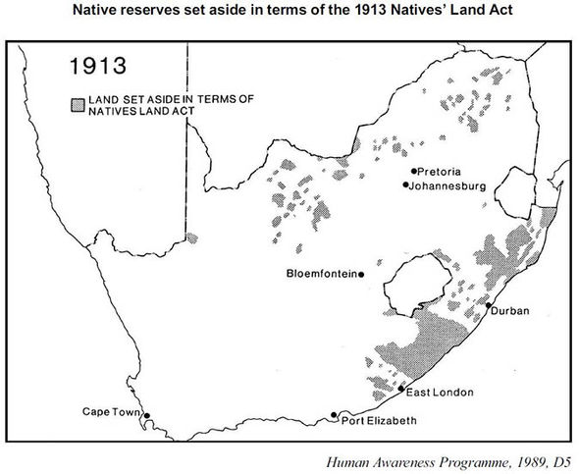
Control of the land
1913 Native Lands Act
13% to black Africans
Poor quality land for African farming
White settlers took all the best land
South Africa Spotlight

Slide 17
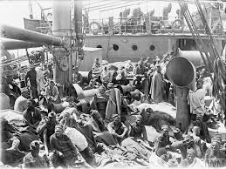
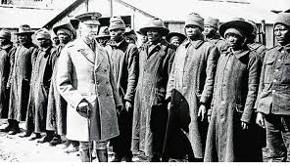
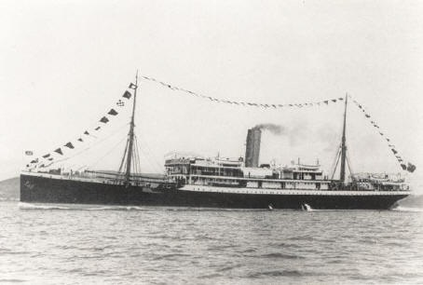
South Africa in World War One
Africans involved in WW1 gained ‘a new sense of unity and amity […] unknown before among our Bantu races’. D.D.T.Jabavu
In spite of an Afrikaner rebellion, South Africa fought with Britain. It played a crucial role in fighting and capturing the German colonies in Africa.
White and ‘Coloured’ South African troops fought in East Africa, but Africans were not allowed to carry weapons.
In the SS Mendi accident off the Isle of Wight in 1917, over 600 African volunteers to build trenches were drowned.
Notes:
The Union of South Africa loyally followed Britain into World War One. Indeed, it played a crucial role in fighting and capturing the German colonies in Africa. White and ‘Coloured’ South African troops fought in German East Africa, but Africans were not allowed to carry weapons. However Africans involved in WW1 gained ‘a new sense of unity and amity […] unknown before among our Bantu races’ - D.D.T.Jabavu
The German colony of South West Africa would be awarded as a League of Nations mandate to South Africa in 1920.
Nyasaland: World War One would also provide a strategic threat to the colony as the German Tanganyika commander Paul von Lettow Vorbeck fought a highly effective guerrilla campaign throughout Eastern and Central Africa for the entire duration of the war. Many settlers and Africans would be called up to help fight this German force. It was a serious drain on resources.
Note the SS Mendi accident off the Isle of Wight in 1917 whereby over 600 African volunteers (100 of whom were Basuto) to build trenches were drowned.

Slide 18
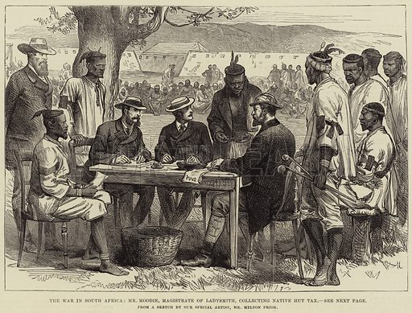
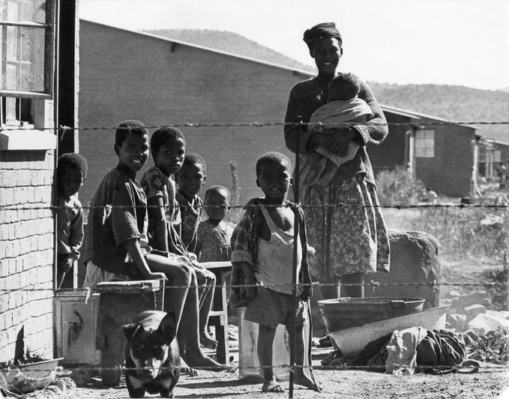
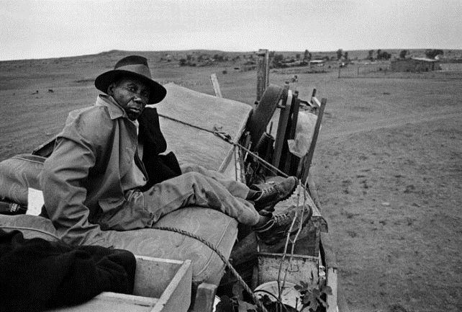
Migrant labour within Southern Africa
Imposition of hut tax and the control of the British over the labour of African populations in these colonies
Work available in South Africa mines and farms, which created large movements of migrant labour within southern Africa
Collecting the hut tax (above)
Poverty in the Native Reserves left to women, children and older people with no facilities provided.
Notes:
A feature of economic life in southern Africa became large movements of migrant African labour to work in South Africa’s mines and farms. The freedom of movement for Africans within the territories was mainly restricted to travelling to seek such employment. Otherwise, they were compelled to remain in what were called ‘Native Reserves’, made up of the least productive land. All Africans were compelled to carry a pass. A white district commissioner ensured that the hut tax was paid and that enough men had been recruited to work in the new white owned industries. Strict racial hierarchy rules also underpinned the workplace. For example, in the mines no African was allowed to be in a position which would mean that a white miner was in a subordinate position to him.

Slide 19
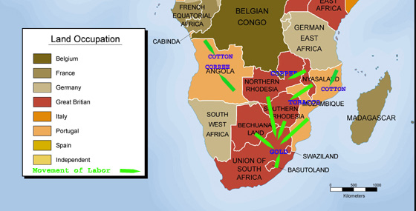
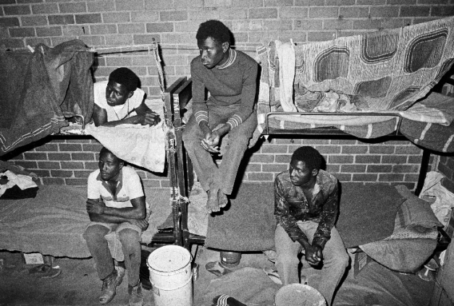
Migrant labour
Migrant labour from other British colonies
And from the Native Reserves in South Africa
African gold miners lived in hostels
They carried passes
They had no rights; no family visits
Notes:
Under-development: Little or no infrastructure or manufacturing was developed in the colonies apart from that to support British commerce. The exception to this was South Africa which had an economy that was based on mining and farming but had also developed a manufacturing base. The other countries in the region such as Botswana, Lesotho, Swaziland and to a lesser extent Malawi could be seen as simply labour reserves – regions that exported male labour to the mines and commercial farms. The British imposed a hut tax on the people of the protectorates and other colonies in order to raise revenue to pay for their running. This was generally done with the cooperation of the tribal chiefs. It had the effect of generating migrant labour to earn cash in South Africa. It also resulted in some impoverishment, particularly in South Africa’s Native Reserves left to women, children and older people with no facilities provided.
The colonial government’s spending on social welfare was minimal. There was no universal education or healthcare, just what was provided by missionary societies. This situation put a lie to the paternalistic justification of colonialism by which it was meant to be a process of elevating Africans from savagery to civilisation.

Slide 20
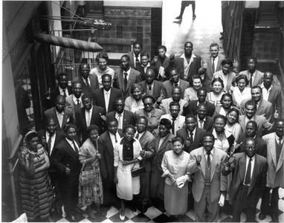
Emerging nationalisms
African movements for political rights: the Industrial Commercial Workers Union in the 1920s and the South African Communist Party in the 1930s
South Africa becomes a self-governing dominion
Afrikaner nationalism – fear of African competition for jobs, antipathy towards the English, and growing identity (the Great Trek, the Boer War) – creation of Nationalist Party
From 1948 the Nationalist government implements apartheid or separate development
SACTU Conference (1958)
Nationalism is a strong attachment to a particular ethnic group, country, or nation.
Notes:
With the Union of South Africa being formed and Africans being excluded from any form of representation, the South African Native National Congress, later the African National Congress (ANC), was created in 1912, ‘to bring all Africans together to defend their rights and freedoms’. John Dube and Sol Plaatje were two of the founders. African trade unions, such as the Industrial Commercial Workers Union, emerged in the 1920s and further developed the struggle both for better working conditions and for political rights.
South Africa: In 1931, the statute of Westminster granted the remaining vestiges of government to all the dominion powers. This mainly gave them full responsibility for their own defence and foreign affairs which had previously been reserved to Westminster. South Africa was to all intents and purposes an independent country.
South Africa's loyalty to Britain was not clear cut by the outbreak of World War Two. Elements of the Afrikaner population were sympathetic to the Nazi views on race, particularly as they thought the British were 'going soft' on the native question in other African colonies further North. In the end it was only by a razor thin majority that the South African government agreed to declare war and support Britain.
The predominantly Afrikaner backed Nationalist Party won the 1948 election, again by the slimmest of majorities. But it would now use all the powers delegated to it from Westminster to withdraw from the British Empire in 1961 and set up a fully segregated apartheid regime. The attempt to placate and draw the Afrikaners into the Empire had ended in failure. The main victims of this failure were not the British settlers or government but the Africans who found themselves living under this odious regime.

Slide 21
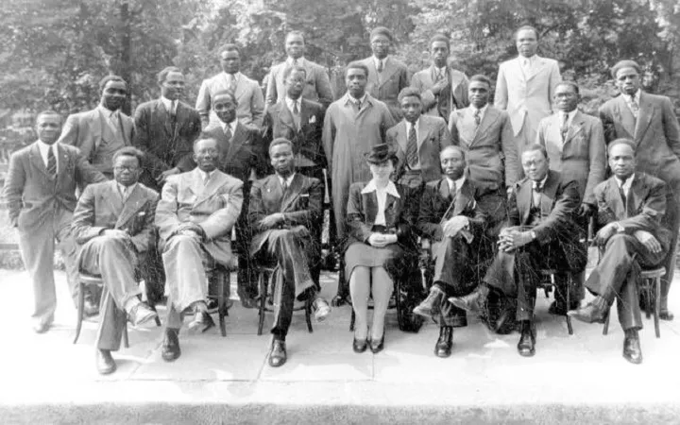
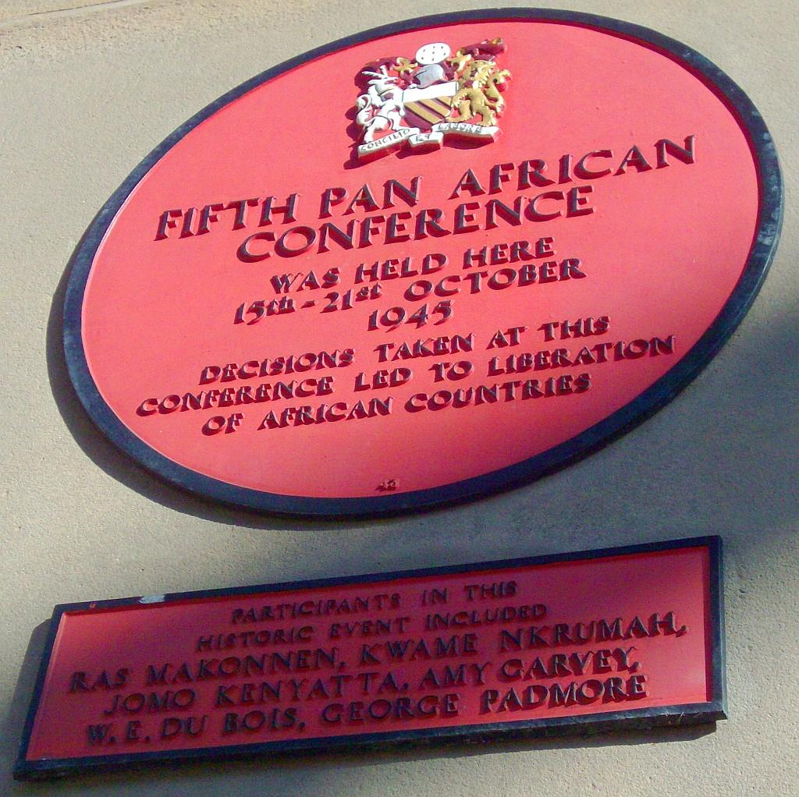
African nationalism after World War Two
Pan-African Congress, Manchester (1945): Future presidents Kwame Nkrumah of the Gold Coast, Jomo Kenyatta of Kenya and Hastings Banda of Nyasaland all attended.
Notes:
Southern Rhodesia: White settler Rhodesians rejected the incorporation of Southern Rhodesia into the Union of South Africa in a 1922 referendum and in 1923, the BSAC handed control over to the settlers. With control of the executive, the settlers were free to abandon any pretences of protection for black African subjects and passed punitive and restrictive laws. Most of these laws concerned the distribution of land, in particular reserving the best 50 percent of the land for the small white settler community. This impoverishment of African agriculture helped drive an increase in migrant labour.
Rhodesia was badly affected by the depression of the 1930s but was to resurrect its economy during World War Two by providing much needed supplies of food to the allies.
Northern Rhodesia: Post WW1, Northern Rhodesia became a protectorate with no representation from the African majority.
The economic prospects for this colony were soon to change as copper was discovered in the north of the colony in 1928. These were huge deposits and Northern Rhodesia became one of the largest producers of the copper in the world. The significance of this product would be further enhanced by the advent of the Second World War. The conditions for the African workers however were harsh, the precedent for poor working conditions had been set in the gold and diamond mines in South Africa. The use of compounds, poor health and safety conditions and very low wages led to several strikes. The authorities had no compunction in using force to put these down. In 1935, 13 miners were killed. The large population of Africans meant that unruly workers could always be replaced or be undercut by others desperate for work.
Nyasaland: The 1920s and 30s saw substantial infrastructural improvements; railways, roads and port facilities were all improved. There was also to be a subtle shift back towards African rights in the colony. The 1923 Devonshire Paper and the 1930 Passfield Memo both argued the wisdom of giving black Africans more rights in the colony. The white settlers were vehemently opposed to these developments. However, as the crown appointed the majority on the Legislative Council it could afford to ignore the sentiments of these settlers.

Slide 22
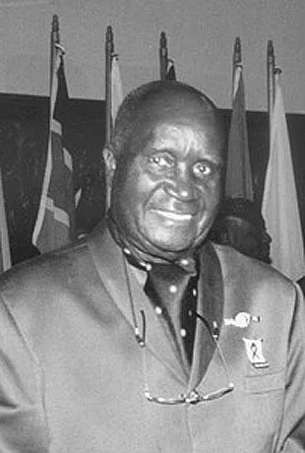
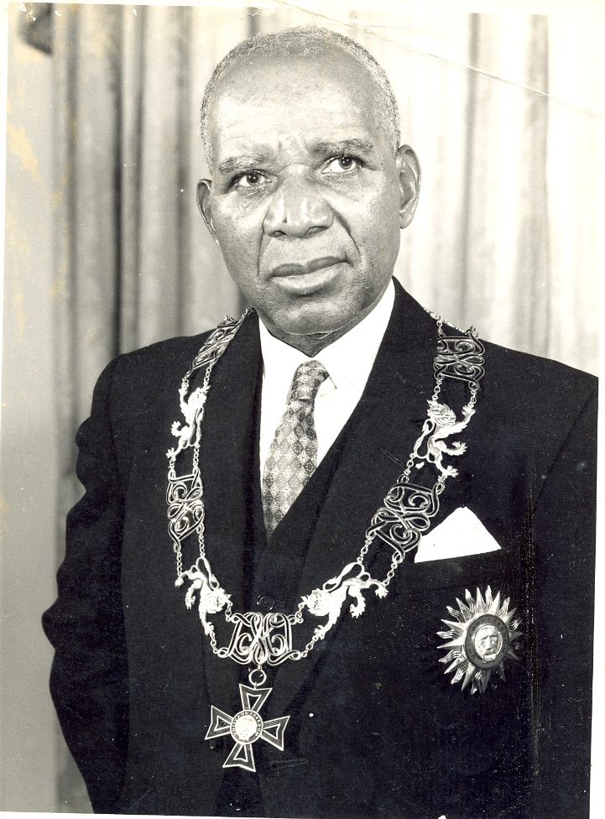
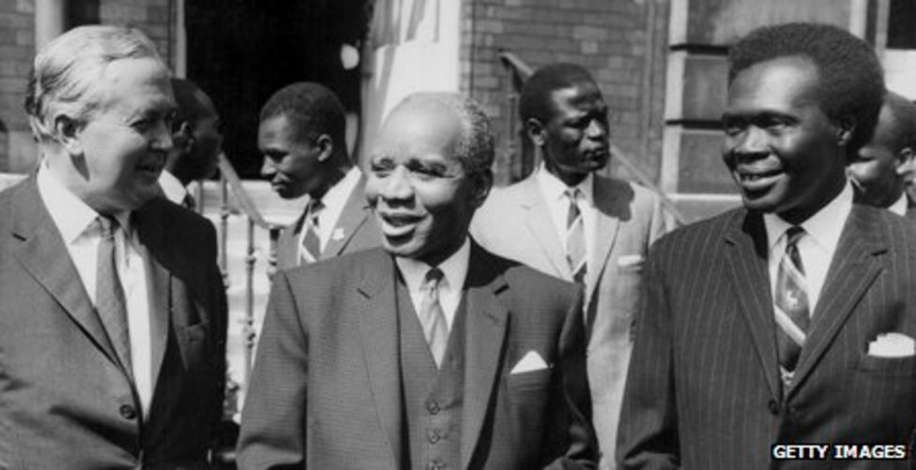
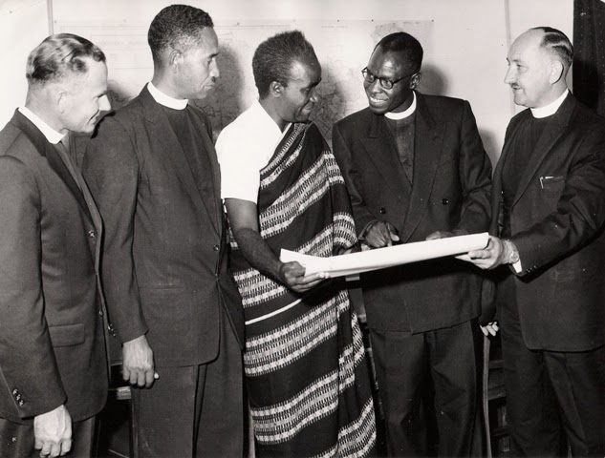
Independence
Kenneth Kaunda, first President of Zambia (right)
Britain giving way to majority rule
1964 Northern Rhodesia becomes independent Zambia
1964 Nyasaland becomes independent Malawi
1966 Botswana, Lesotho and Swaziland gain independence
Hastings Banda, first President of Malawi (left)
Notes:
A key characteristic in Africa of claiming independence was the rise of pan Africanism, which was a movement to unify African nations in opposition to colonial rule. Some important characters of this movement included Kwame Nkrumah, a key political philosopher who paved the way for African independence and was the first Prime Minister of Ghana (West Africa). Note the Pan-African Congress held in Manchester 1945 at which future presidents Kwame Nkrumah of the Gold Coast, Jomo Kenyatta of Kenya and Hastings Banda of Nyasaland all attended.
From the end of WW1 until independence, the 3 protectorates experienced a loss of labour to South Africa and little in the way of infrastructural development. What they avoided was harsh racist South African rule which they persisted in resisting until they gained their independence. Africans from the protectorates were recruited to fight for Britain in WW2 with for instance over a thousand Basuto being killed.
Southern Rhodesia: White settler Rhodesians rejected the incorporation of Southern Rhodesia into the Union of South Africa in a 1922 referendum and in 1923, the BSAC handed control over to the settlers. With control of the executive, the settlers were free to abandon any pretences of protection for black African subjects and passed punitive and restrictive laws. Most of these laws concerned the distribution of land, in particular reserving the best 50 percent of the land for the small white settler community. This impoverishment of African agriculture helped drive an increase in migrant labour.
Rhodesia was badly affected by the depression of the 1930s but was to resurrect its economy during World War Two by providing much needed supplies of food to the allies.
Northern Rhodesia: Post WW1, Northern Rhodesia became a protectorate with no representation from the African majority.
The economic prospects for this colony were soon to change as copper was discovered in the north of the colony in 1928. These were huge deposits and Northern Rhodesia became one of the largest producers of the copper in the world. The significance of this product would be further enhanced by the advent of the Second World War. The conditions for the African workers however were harsh, the precedent for poor working conditions had been set in the gold and diamond mines in South Africa. The use of compounds, poor health and safety conditions and very low wages led to several strikes. The authorities had no compunction in using force to put these down. In 1935, 13 miners were killed. The large population of Africans meant that unruly workers could always be replaced or be undercut by others desperate for work.
Nyasaland: The 1920s and 30s saw substantial infrastructural improvements; railways, roads and port facilities were all improved. There was also to be a subtle shift back towards African rights in the colony. The 1923 Devonshire Paper and the 1930 Passfield Memo both argued the wisdom of giving black Africans more rights in the colony. The white settlers were vehemently opposed to these developments. However, as the crown appointed the majority on the Legislative Council it could afford to ignore the sentiments of these settlers.
independence. They provided a refuge for those fleeing apartheid South Africa. Africans did not enjoy universal suffrage until the final days of empire. This meant that British-style democratic institutions and forms of governance were not able to develop organically but were imposed.
Basutoland became independent as Lesotho in 1966, Bechuanaland became independent as Botswana in the same year whilst Swaziland would gain its independence in 1968. Its name was changed to Eswatini in 2018.

Slide 23
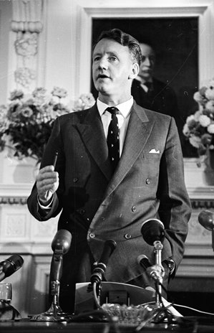
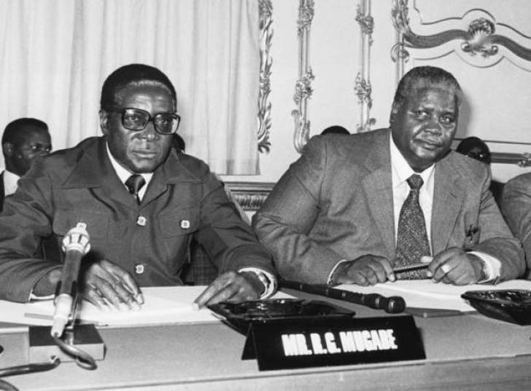
Southern Rhodesia/Zimbabwe Independence
But in 1965 Unilateral Declaration of Independence (UDI) by White settler minority
UN sanctions
African insurrection – the second Chimurenga
Support from surrounding African countries
1979 Lancaster House Agreement and independence for the African majority
The Lancaster House Agreement
Notes:
Post WW2, the 1950s would see a re-evaluation of the role of empire and colonies. The British government was aware that by making the richer colonies independent they might be left with uneconomic colonies that might never become self-sufficient. It therefore experimented with the creation of federations of colonies. It was tried in the West Indies, East Africa and Central Africa where Northern and Southern Rhodesia were combined with Nyasaland to form the Central African Federation from 1953. This was an unhappy union from the very start. The black Africans in Northern Rhodesia wanted the same rights as the whites had in Southern Rhodesia. The white Southern Rhodesian government resented using their wealth to pay for infrastructure for the other two nations. Nyasaland was too poor to contribute much at all. Finally, the black Africans became increasingly suspicious that the federation was a way of preserving white and colonial domination over them. In a period of rising nationalism, the federation would ultimately fall apart in 1963.
The withdrawal of South Africa from the Commonwealth in 1961 and its continued imposition of harsh racist laws was an acute embarrassment to the British Government. They made reassurances to the other black African leaders that they would not allow this to happen elsewhere. Representation of blacks became a priority and an election held in 1962 resulted in an African majority in Northern Rhodesia for the very first time. Preferring to hand over independence in a peaceful manner, the British granted independence to the new states of Zambia and Malawi (formerly Nyasaland) in 1964.
In Southern Rhodesia the situation was very different, with a white minority settler government and 250,000 whites, about 3% of the population, controlling the land and the economy. The withdrawal of South Africa from the Commonwealth in 1961 left the humanitarian spotlight uncomfortably on the racist policies of Rhodesia. African nations who had recently received their independence from the British demanded that something be done about the racism of Rhodesia.
In 1962 the Rhodesian Front was formed to maintain the existing white settler rights that had been granted to them since 1923. As it seemed Britain was more determined to hand over power to black majority rule on a one person one vote basis, the Rhodesian Front won a clean sweep in elections and in 1965, the white administration in Rhodesia made its Unilateral Declaration of Independence (UDI).
International condemnation was swift, backed principally by Britain. Britain organised the first ever United Nations use of sanctions against its renegade colony. The relatively rich colony could survive these sanctions for a while, with racist South African support. However, over time, the sanctions did have an impact.
The black majority in the country appreciated the international support for their plight and started an insurrection of their own. This was known as the second Chimurenga. Surrounding black African countries gave military and logistical support to those fighting the regime. Although there were no large-pitched battles, the constant guerrilla hit and run tactics steadily wore down the resolve of at least some of the white settlers, who emigrated to the more secure South Africa, to Britain or to the ‘white dominions.’ The South Africans began withdrawing their economic and military support for the regime in the mid to late 1970s. The end of Portuguese rule in neighbouring Mozambique in 1975 increased the isolation of Rhodesia and further restricted its communication routes. At a peace conference in London in late 1979 UDI was ended, Rhodesia reverted to the status of a British colony and a year later, the British handed independence to a black majority government of Zimbabwe.

Slide 24
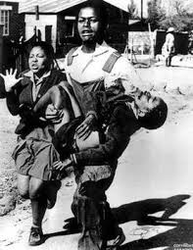
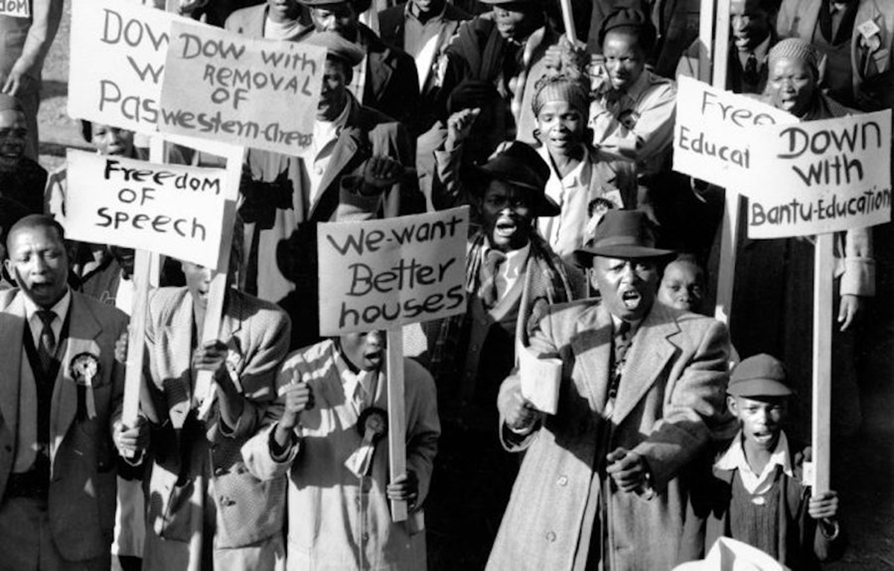
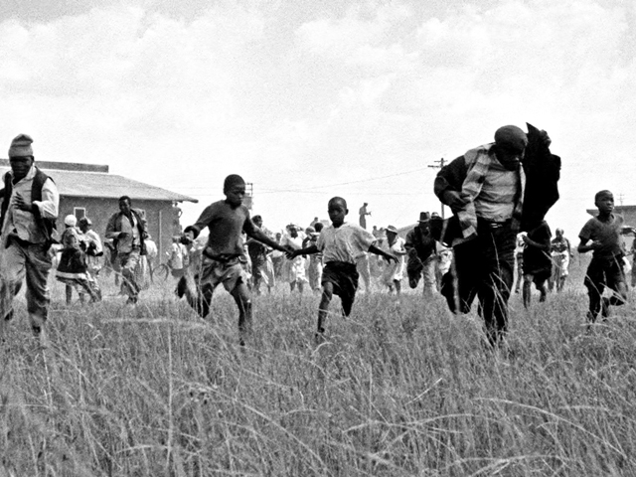
Colonial legacy in South Africa – the roots of apartheid and the long struggle for ‘independence’
South Africa an independent country from 1931 – the Statute of Westminster
From 1948, the Nationalist Party in power – apartheid laws/Verwoerd – building on the Native Lands Act and migrant labour system
Apartheid; Sharpeville; Soweto
Notes:
In South Africa and Southern Rhodesia African peoples lost control of and use of their land. Resettlement in South Africa through the 1913 Native Lands Act put the most productive agricultural land into European hands. Consequences were rural poverty and a migrant labour system that was dysfunctional for family life. European farming methods came to pre-dominate with negative environmental consequences being felt today. The prevailing economy, established under colonialism and one of the most unequal in the world, leaves huge numbers of Africans in poverty and unemployed. The racial disparity is still evident.
Some regions were developmentally neglected, such as Bechuanaland, so that at independence the economy was under-developed, and little in the way of education or preparation for self-rule had been provided. In regions where infrastructure was created it was done so to support agricultural exports, mining and military control. Colonially imposed boundaries both divided peoples and brought together a range of different peoples and ethnicities into European created nation-states.
Politically, laws to establish white supremacy were enacted, particularly in South Africa and Southern Rhodesia – the roots of apartheid. Traditional leaders were co-opted or undermined. South Africa became an independent country from 1931 through the Statute of Westminster and from 1948, the Nationalist Party in power brought in apartheid laws, building on the Native Lands Act and migrant labour system

Slide 25
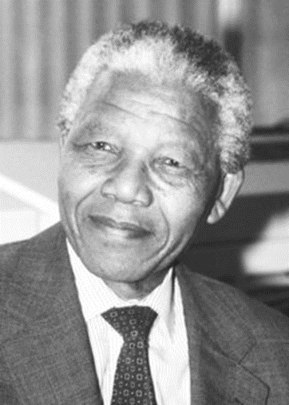
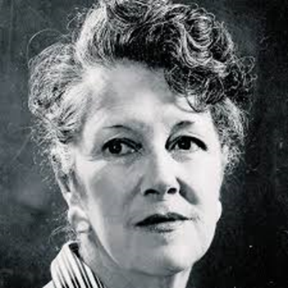
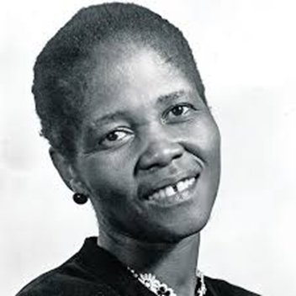
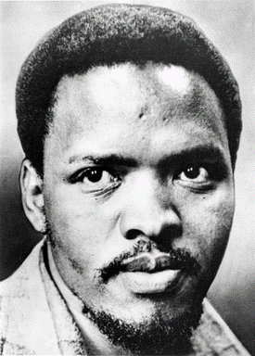
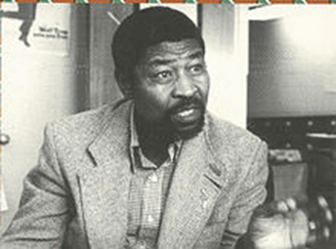
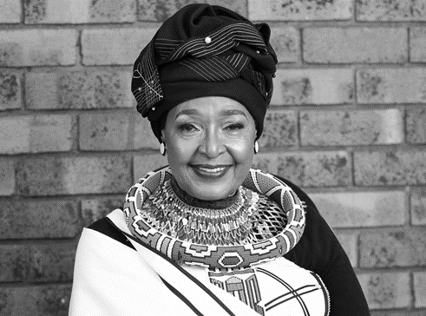
Some of those who led the fight for racial justice in South Africa.
Helen Joseph
Lilian Ngoyi
Nelson Mandela
Winnie Mandela
Zola Zembe
Steve Biko

Slide 26


Legacy of colonialism in southern Africa
Notes:
Colonialism promoted cultural alienation with African cultural values being neglected and despised. These negative Western views of Africa and Africans has persisted, being internalised by much of the population. The colonists brought European gender stereotyping of the male breadwinner and female dependent so that even domestic service was carried out by African men.
Legacy: The name ‘Rhodesia’ was changed with independence, but no name linked to Livingstone was changed, so on the Zambian side of the falls the main town is still called Livingstone whilst the sister town on the Zimbabwean side of the border retains the name of Victoria Falls. In Malawi, the city named after Livingstone’s place of birth Blantyre, still holds that name today. Maybe this is an indication of how entrenched the Christianity Livingstone helped usher into the region has become in Southern Africa in general.

