Slide 1

North america
Experiences of British Colonisation

Slide 2
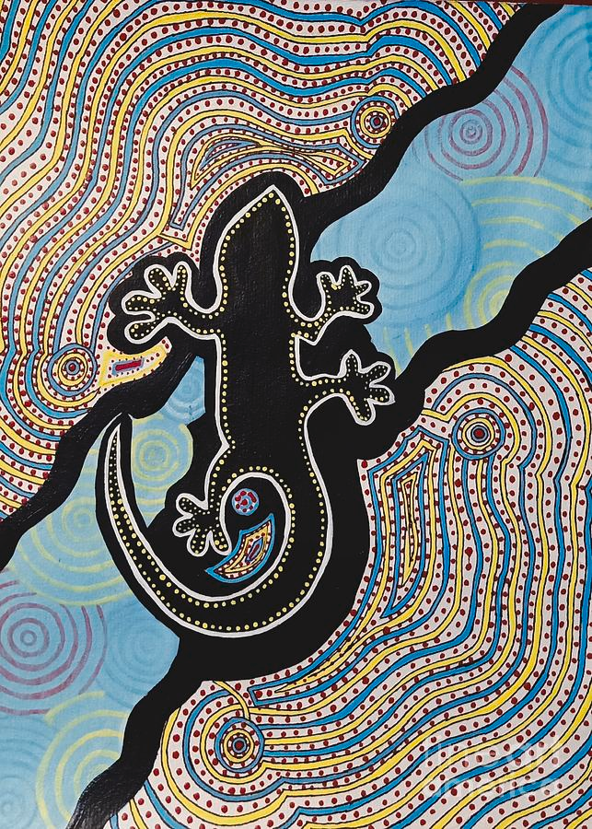
Contents
Geography of North America
Pre-colonial civilization
  Indigenous civilisations
  The Mississippian Mound Builder cultures
British Colonisation of North America
  British contact and colonisation
  Impact on indigenous communities
  The Seven Years war, and Royal Proclamation Line
Indigenous resistance
Declaration of Independence and The American war 1776
Slavery and American Civil War
The legacy of colonization

Slide 3
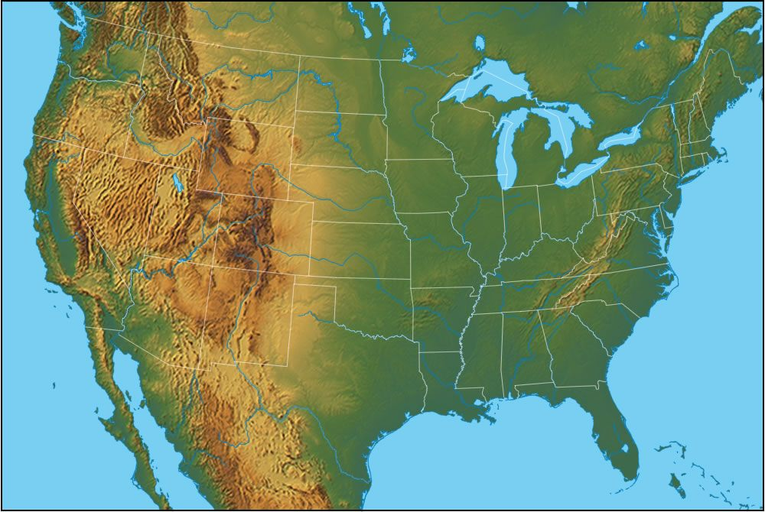
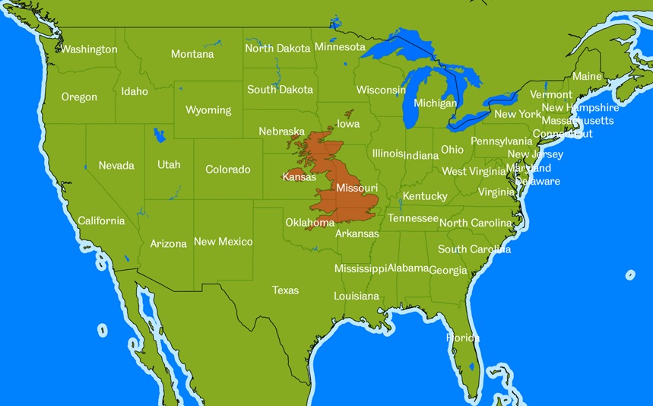
Geography of North America
The USA is around 40 times bigger than the UK
Northern America has a very varied climate and landscape, with wide coastal plans in the middle and mountains in both the East and West
Notes:
North America is a huge continent with the United States alone being around 40 times the size of the UK. In the 17th and 18th centuries Britain colonised most of the eastern seaboard of North America. Here the region’s climate and topography varied greatly from north to south. New England colonies to the north were hilly, thickly forested with poor soil and very cold winters. The Middle colonies had a number of great estuaries with good farmland and milder temperatures. The Southern colonies had a wide coastal plain, with a warm, wet climate. The Appalachians Mountains to the west formed a barrier to the interior of the continent.

Slide 4
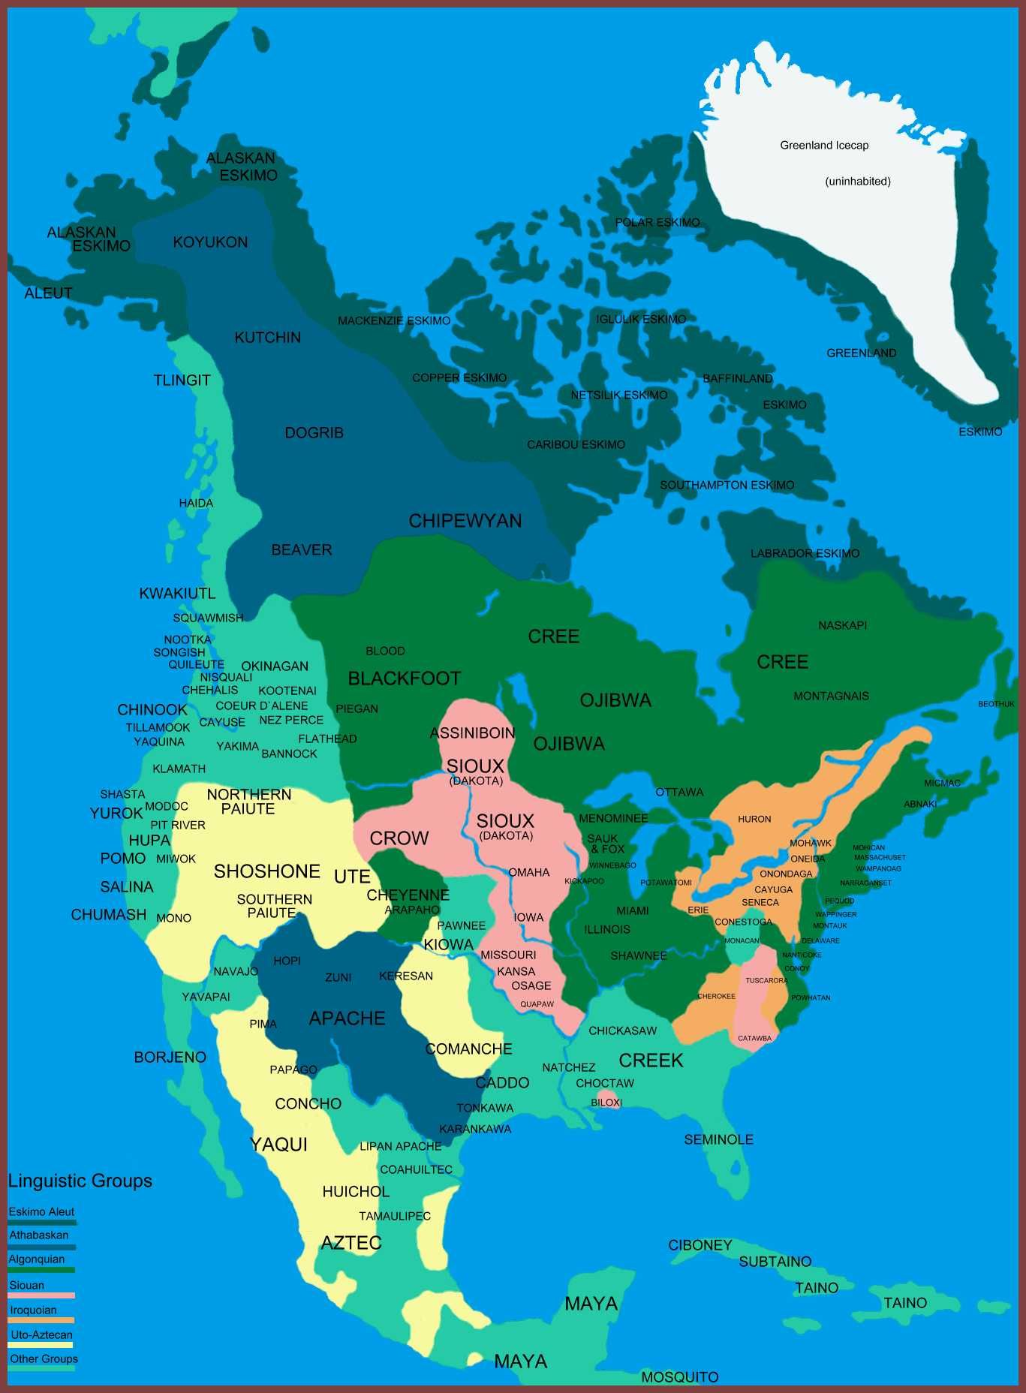
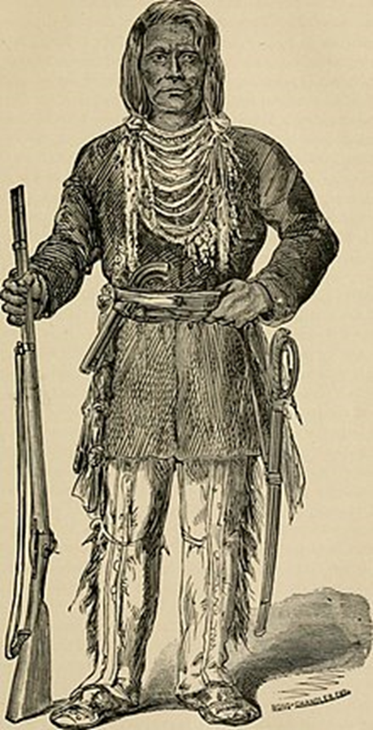
Indigenous civilisations
The total population in North America was estimated as roughly 50 - 60 million before 1492.
There were examples of peaceful cooperation between different tribes
  Such as the powerful Iroquois Confederacy was formed sometime after 1450 CE and was a voluntary union of 6 Native American peoples based in upper ‘New York’ state
  The Wampanoag confederation in the North East
Sketch of an Iroquois chief, circa 1802
Map showing the distribution of indigenous peoples over the continent
Notes:
There has been human habitation in North America for thousands of years. Much was nomadic or semi-nomadic in nature. The continent was settled by a range of indigenous Native American peoples prior to European colonization, with very differing cultures, languages, names, and adaptations to contrasting environments. The total population is roughly estimated as about 50 million before 1492 with the arrival of Columbus and European contact.
In the less hospitable north-east, a loose confederation of tribes named the Wampanoag thrived through fishing and growing what they referred to as the ‘3 sisters:’ corn, beans and squash. This is a region where early British settlement occurred. Elsewhere, the Iroquois of the Great Lakes region had developed a powerful confederacy, a remarkable long-term political arrangement involving cooperation and reciprocity among 6 different nations. The Wampanoag and the Iroquois Confederacy are examples of peaceful coexistence and advanced political cooperation between different Native American peoples prior to British arrival.

Slide 5
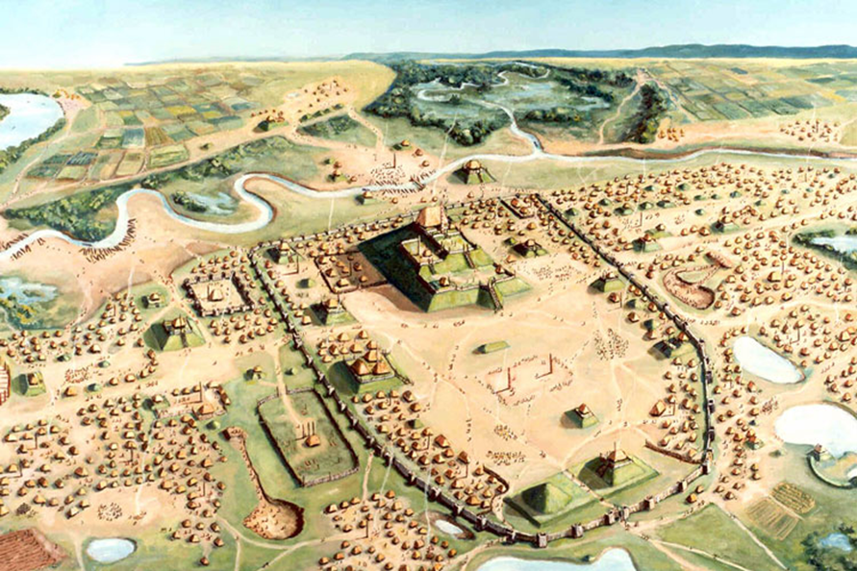
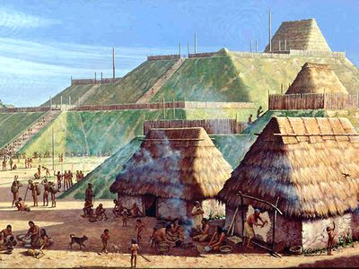
Mississippian Mound Builder
Mississippian Mound Builder communities (800 – 1500 AD) lived in permanent settlements, which featured ceremonial mounds. The largest, in southern Illinois, contained up to 50,000 residents.
They farmed maize and beans and established large towns, with specialised crafts and long-distance trade links.
The peoples’ religion was animism, a belief that all things in nature are animated by a spirit and are all inter-connected.
The sudden disappearance of these cultures around 1500 AD is a mystery but may be linked to the spread of European diseases brought be Spanish explorers.
Notes:
The Mississippian Mound Builder cultures (800 to 1500 AD) are an example of complex civilisations in North America predating the arrival of the British. These peoples spread widely across central and south-eastern North America and developed specialised crafts as well as long distance trade links. Their livelihood consisted of farming maize and beans, and they established large towns featuring great ceremonial mounds encircled by ditches and ramparts. Evidence of these cultures demonstrates that there were established urban areas, agriculture and trade in this region prior to European arrival. The Mississippian mound builders had religious beliefs and practices embedded in a deep connection with the natural world, holding ceremonies to mark the passing of seasons, celestial events, and the harvesting of crops, officiated from the tops of their mounds by priests.
The peoples’ religion was animism, a belief that all things in nature are animated by a spirit and are all inter-connected. There was reciprocity with the natural world expressed through ritual, honour, and a minimising of waste.

Slide 6
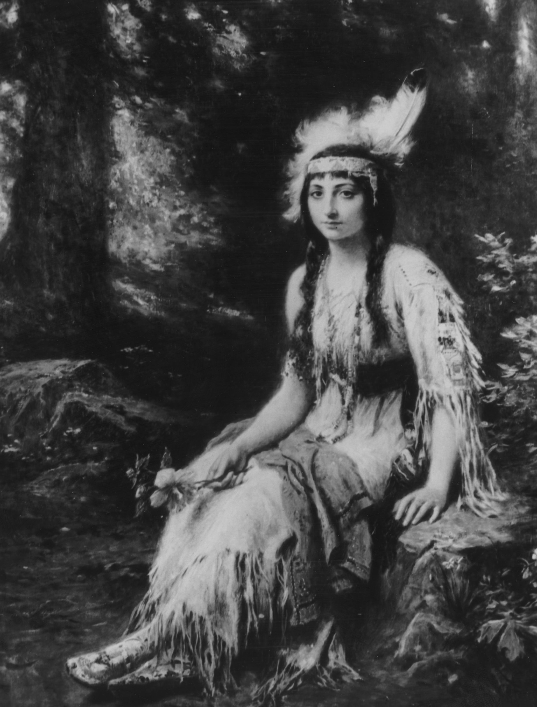
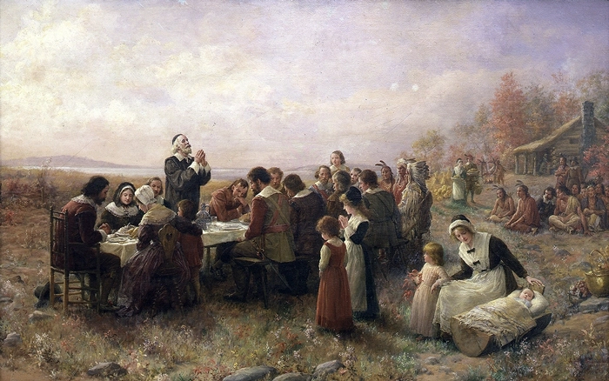
British contact
1607 Jamestown in Virginia the first colony
1620 the Pilgrim Fathers arrive from Plymouth
The Wampanoag people enabled the English explorers to survive the first winters and taught them to grow the ‘3 sisters’ (corn, beans and squash)
Pocahontas, a daughter of the Chief of the Powhatan, brought food to the Jamestown colony as a little girl.
Notes:
English explorers had unsuccessfully sought the North-West Passage around the north of the continent. Newfoundland and Nova Scotia, both of which eventually became part of Canada, were explored and settled.
Through the 17th century, England began to develop colonies on the eastern seaboard of North America, starting in Jamestown in 1607 and later with the Mayflower bringing settlers to what became New England in 1620. The Wampanoag people helped the Mayflower settlers survive the first winters. Pocahontas of the Powhatan people is thought to have helped the early settlers in Jamestown, bringing food to the colony as a little girl. Her story, one of adopting Christianity and providing a model as to how to bridge cultures, is worth exploring further from a Native American perspective. Early interactions between Native Americans and the initial British settlers were often relatively amicable, as the British were reliant on the indigenous peoples for survival in an unfamiliar climate.

Slide 7
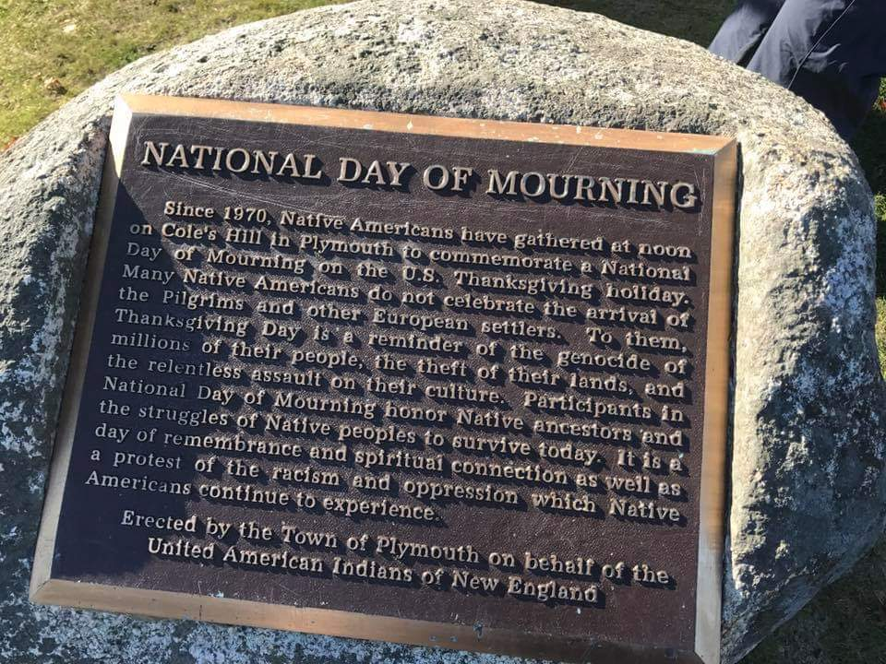

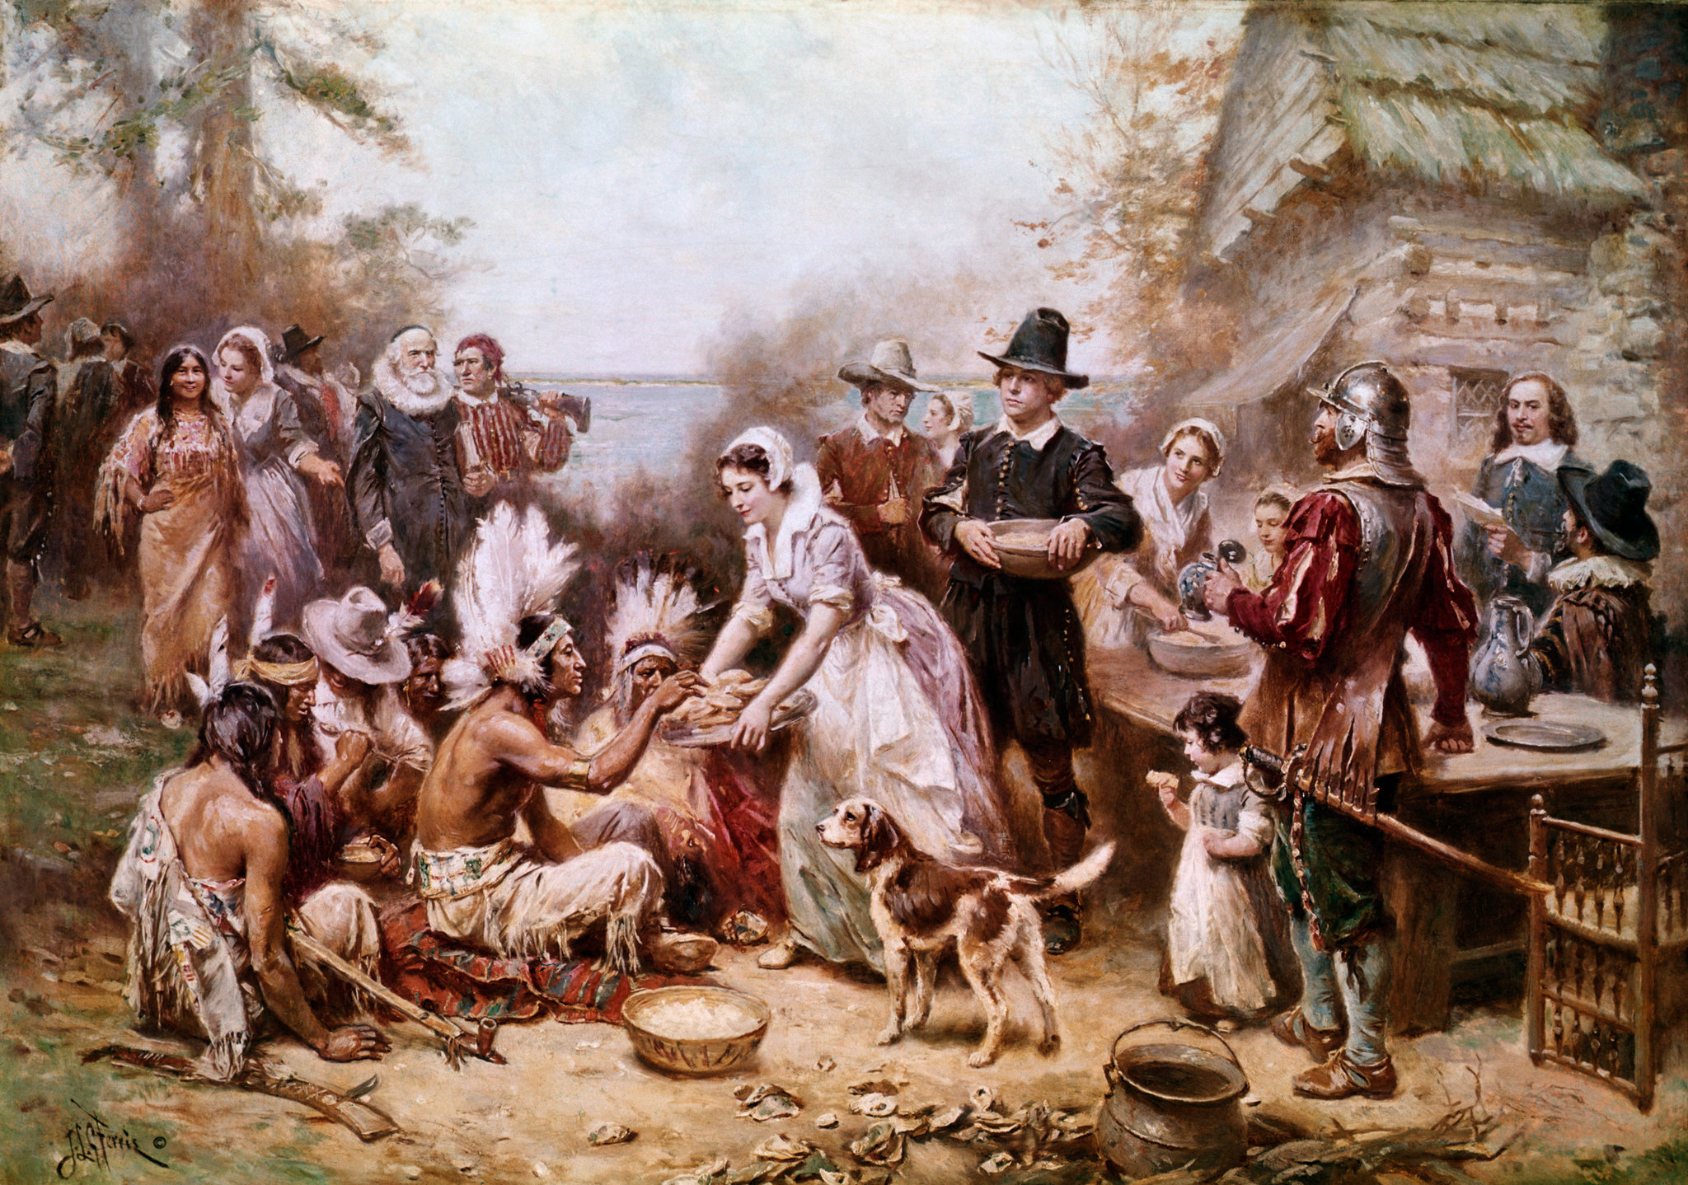
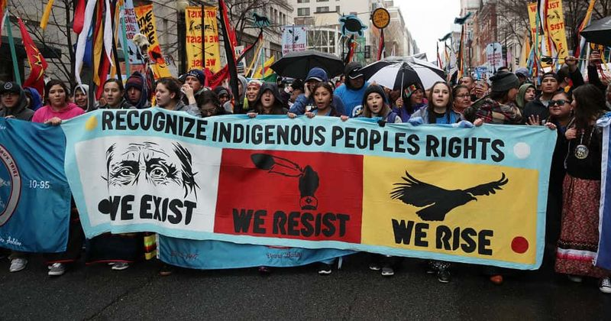
Thanksgiving: Two Sides of the Story
Notes:
"Since 1970, Native Americans have gathered at noon on Cole's Hill in Plymouth to commemorate a National Day of Mourning on the US Thanksgiving holiday. Many Native Americans do not celebrate the arrival of the Pilgrims and other European settlers. To them, Thanksgiving Day is a reminder of the genocide of millions of their people, the theft of their lands, and the relentless assault on their culture. Participants in a National Day of Mourning honor Native ancestors and the struggles of Native peoples to survive today. It is a day of remembrance and spiritual connection as well as a protest of the racism and oppression which Native Americans continue to experience."

Slide 8
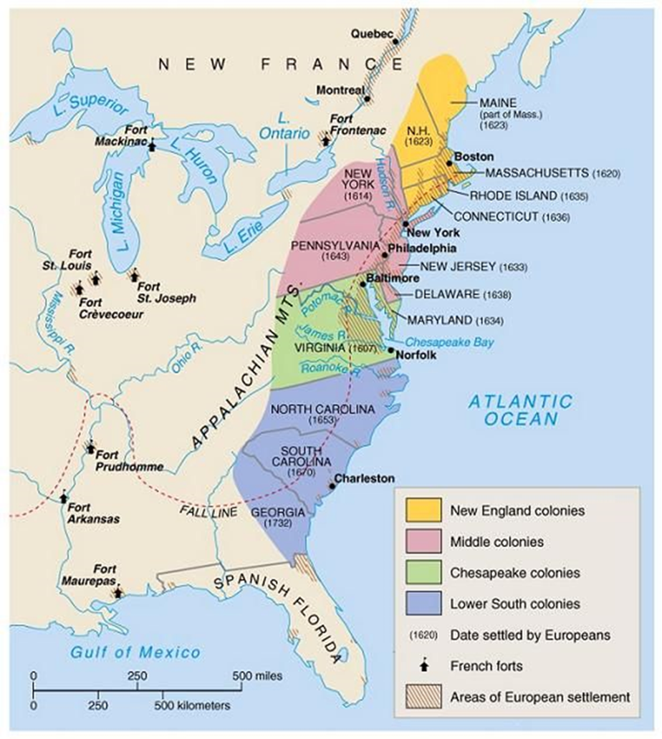
British colonisation
Britain took more than 100 years to colonise the eastern seaboard creating colonies from Maine in the north to Georgia. In 1783, these gained their independence from Britain and became the United States of America.
These lands were taken from indigenous peoples
The New England colonies to the north were hilly, thickly forested with poor soil and cold winters.
The Middle colonies had a number of great estuaries with good farmland and milder temperatures.
The Southern colonies had a wide coastal plain, with a warm, wet climate.
The Appalachians Mountains to the west formed a barrier to the interior of the continent.
Notes:
13 colonies were established over the years between 1607 (Virginia) and 1733 (Georgia). In the New England colonies Puritans sought to create a new society and religious freedom away from England. Here they could practise the teachings of John Calvin, which were opposed by the Church of England. Over the years fishing became a mainstay of the economy of the New England colonies. Further north, in what was to eventually become Canada, fur trading, in association with First Nations peoples and in competition with the French, became established in the Hudson Bay region.
People migrated from England due to religious conflict and the forcible loss of land in rural areas due to the enclosure movement. As numbers of migrants and settlements began to grow, tensions rose with Native Americans over access to land. These led to violence with the First Anglo-Powhatan War near Jamestown in 1620, the massacre of the Pequot people in 1637 in New England, and King Philip’s War (led by Metacomet, also known as Philip, of the Wampanoag) 1675 to 1678 against the colonists of New England for taking their land, culture and way of life. Few Wampanoag people survived the war, and of those remaining, many were sold into slavery.
The Middle Colonies were Pennsylvania, New York, New Jersey and Delaware. They had more fertile land than the colonies of New England. People of a variety of religions and different European nationalities settled seeking religious and political freedom as well as economic opportunity. England acquired the Dutch colony of New Amsterdam (later New York) in 1664, exchanged for sugar plantations in Guyana.

Slide 9
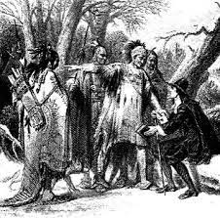
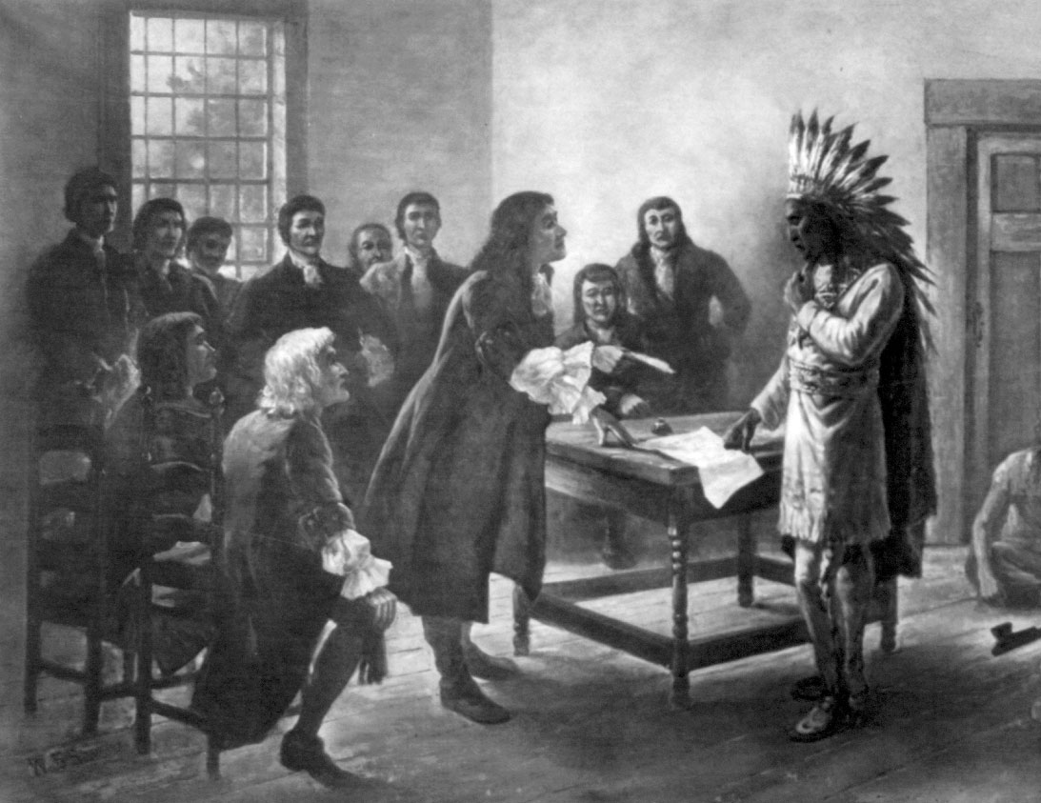
Impact on indigenous communities
The European settlers brought with them foreign diseases like smallpox, which ravaged many native communities.
The Native Americans lost more and more of their land.
The number of Native Americans east of the Appalachian Mountains fell from 120,000 to 20,000 by 1750.
King Philip’s War was led by Metacomet (also known as Philip) of the Wampanoag from 1675 to 1678 against the colonists of New England for taking their land, and endangering their culture and way of life. Few Wampanoag people survived the war, and of those remaining, many were sold into slavery.
Notes:
Through the 18th century there was expansion of British migration and settlement with the population reaching 1.2 million by 1750. Native American numbers east of the Appalachians fell from an estimated 120,000 at the start of colonization to just 20,000 in 1750 due to displacement, massacres and diseases brought from Europe. The Iroquois Confederacy however, a league of Native American peoples based in upper New York, defended their territory from settler encroachment until 1779.

Slide 10
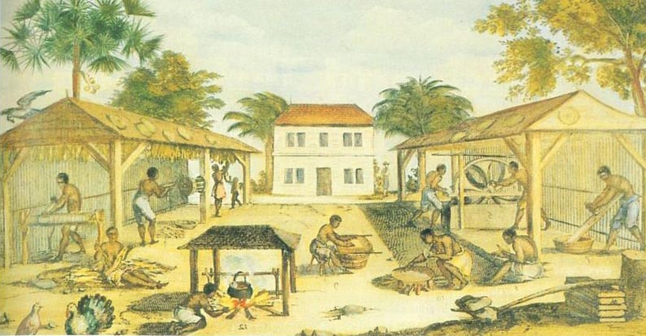
Slavery established
From 1619 tobacco began to form the basis of the Southern States colony's economy.
By 1770 there were c. 465,000 slaves in the American colonies, with many born into slavery.
  By 1724 the enslaved population in South Carolina outnumbered the settlers 2:1.
  Enslaved people endured terrible conditions and exploitation.
‘Life on the fields meant working sunup to sundown six days a week and having food sometimes not suitable for an animal to eat.’
Slaves processing tobacco in 17th-century Virginia
Notes:
In the Southern colonies tobacco was developed as a valuable cash crop and was exploited early on by the London Virginia Company. From 1619 it led to the development of major settlements at Norfolk, Alexandria, and Richmond and formed the basis of the colony's economy.
Around 175,000 enslaved people from Africa were brought to work in the tobacco plantations. By 1770 there were c. 465,000 slaves in the American colonies as a whole, with many born into slavery.
By 1724, the enslaved population in South Carolina outnumbered the settlers 2:1
Enslaved people endured the most terrible conditions and exploitation. But slavery became institutionalised and proved very profitable for plantation owners.

Slide 11
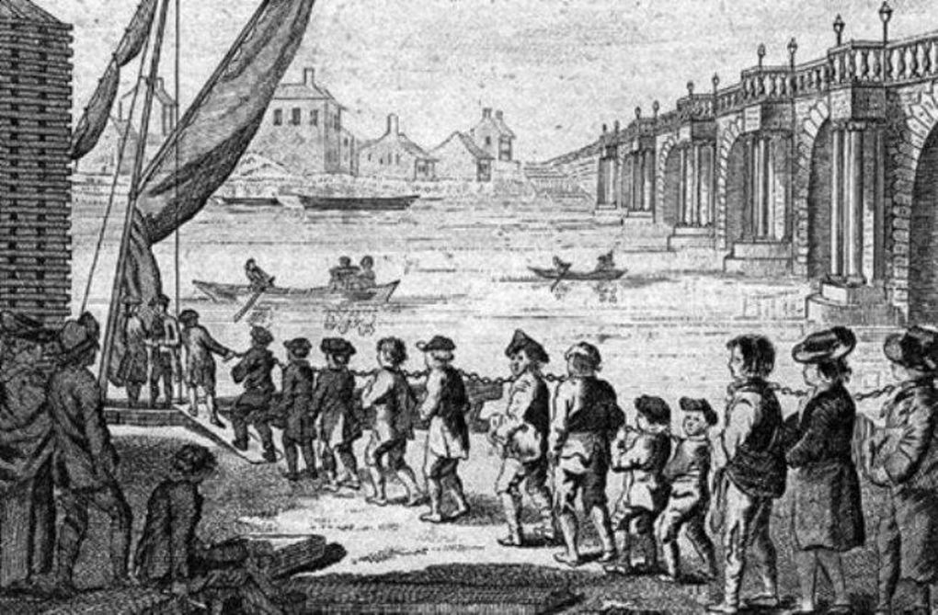
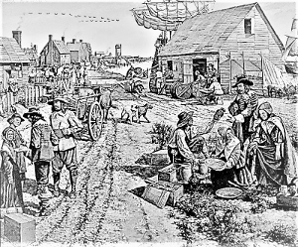
Indentured labour from Britain
Some 200,000 British migrants came to the North American colonies in the 17th century, many as indentured servants.
They typically came and worked for 4-5 years to pay off the debt of their travel costs. Convicts were transported too.
English prisoners transported to North America
Indentured Servants from Britain
Notes:
The scarcity of labour generally in these colonies was made up for not only by enslaving and transporting Africans to the territories, but also by bringing indentured servants from Britain. Some 200,000 British migrants came in the 17th century, many being indentured servants, who would come to the colonies and work for typically 4 to 5 years to pay off the debt of their travel costs. They would come to escape poverty, religious or political persecution, and for economic opportunity. Involuntary prisoners, often held for petty offences, were transported too.

Slide 12
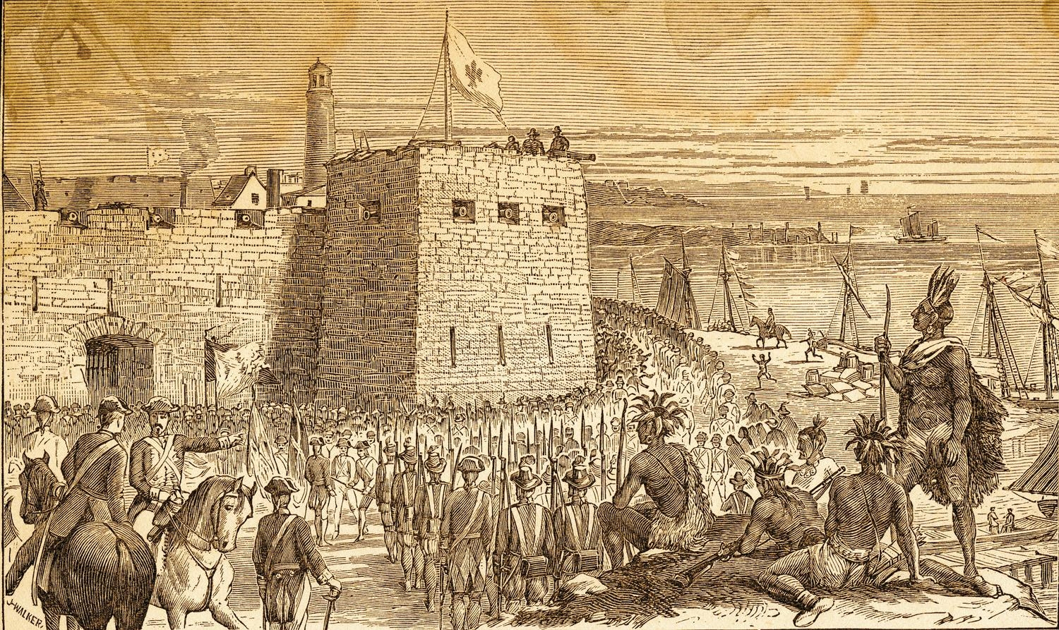
Seven Years War 1756-1763
A European war between France and Britain was partly fought in North America where it was known as the French and Indian war. Native American communities played an important role on both sides of the conflict. The French were eventually defeated and lost their territory in North America.
Despite bitter complaints over colonists settling in their territory, the Six Nations of the Iroquois Confederation finally allied with the British.
But Indigenous Americans were excluded from the 1763 Treaty of Paris at the end of the war.
French soldiers and allied Native American warriors besiege British fort Oswego.
Notes:
The Seven Years War (1756-1763) between Britain and France was partly fought in Northern America, over territory and claims of dominance. Britain gained control of eastern ‘Canada’ from the French through winning the Battle of Quebec. The French were eventually defeated and lost their territory in North America.
Native American and First Nation peoples in Canada were drawn into the British-French conflict. The Six Nations of the Haudenosaunee or Iroquois Confederation allied with the British. Mohawk Chief, Thayendanega (also known as Joseph Brand) led 4 of the Iroquois nations as well as the Cherokees and the Creeks to support the British. But Native Americans were excluded from the 1763 Treaty of Paris at the end of the war.
In the aftermath of the War, Britain imposed taxes on the settlers of the Thirteen Colonies to try to recoup its cost. They also sought to appease Native American peoples by forbidding colonial settlement beyond the Appalachian Mountains.

Slide 13
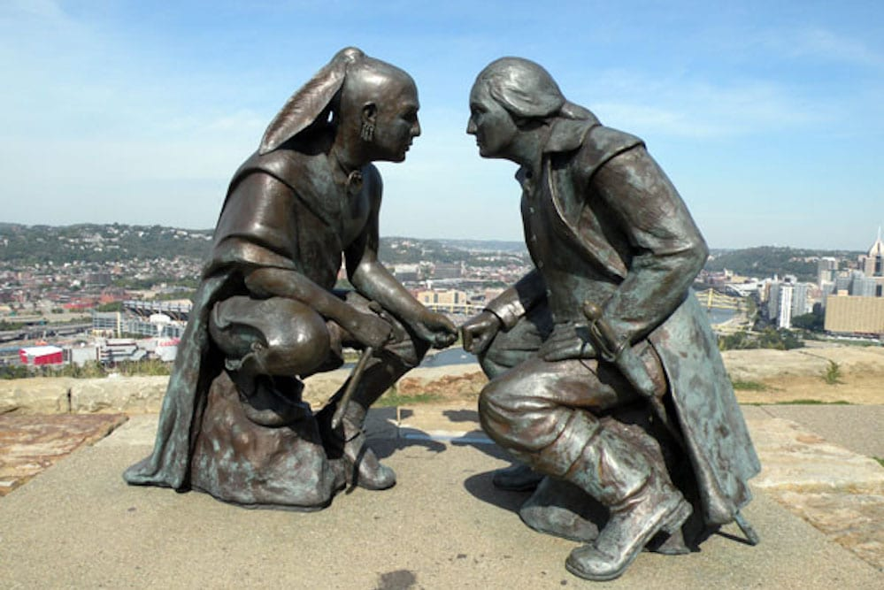
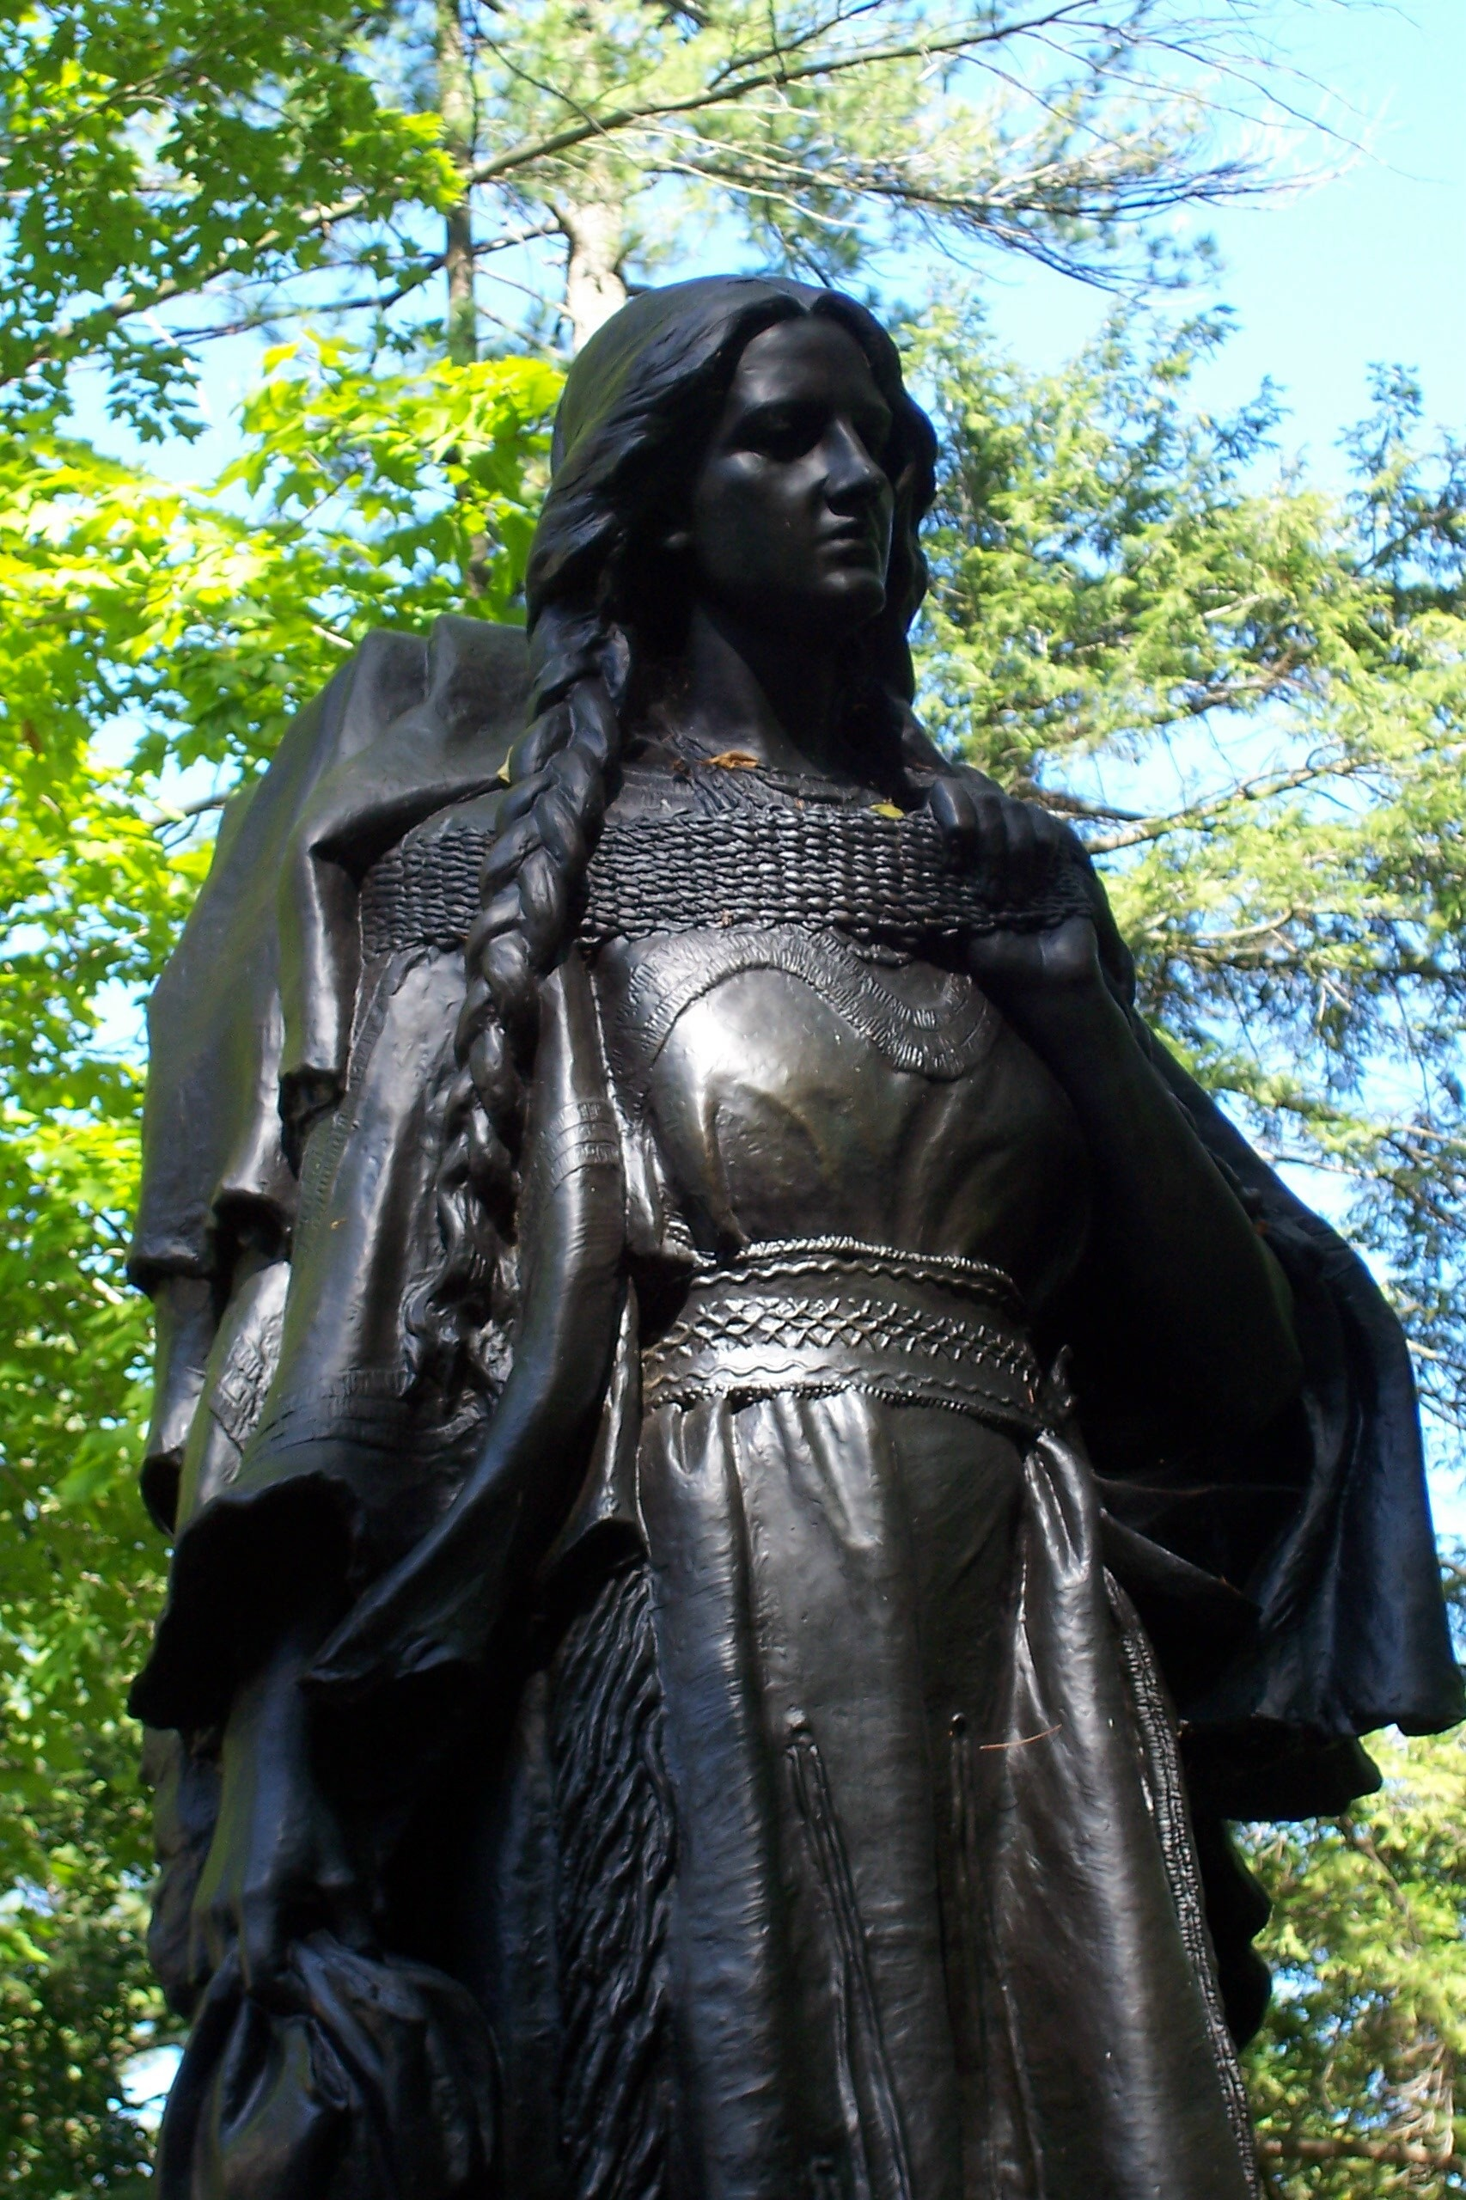
Statue of George Washington and Seneca Chief Guyasuta, who allied with the French. He later supported Chief Pontiac’s Rebellion.
Statue of Mary Jemison, an Irish immigrant, who was captured by the Seneca people when she was 12. Her family killed, she assimilated with the Seneca and lived out her life as a member of the tribe.

Slide 14
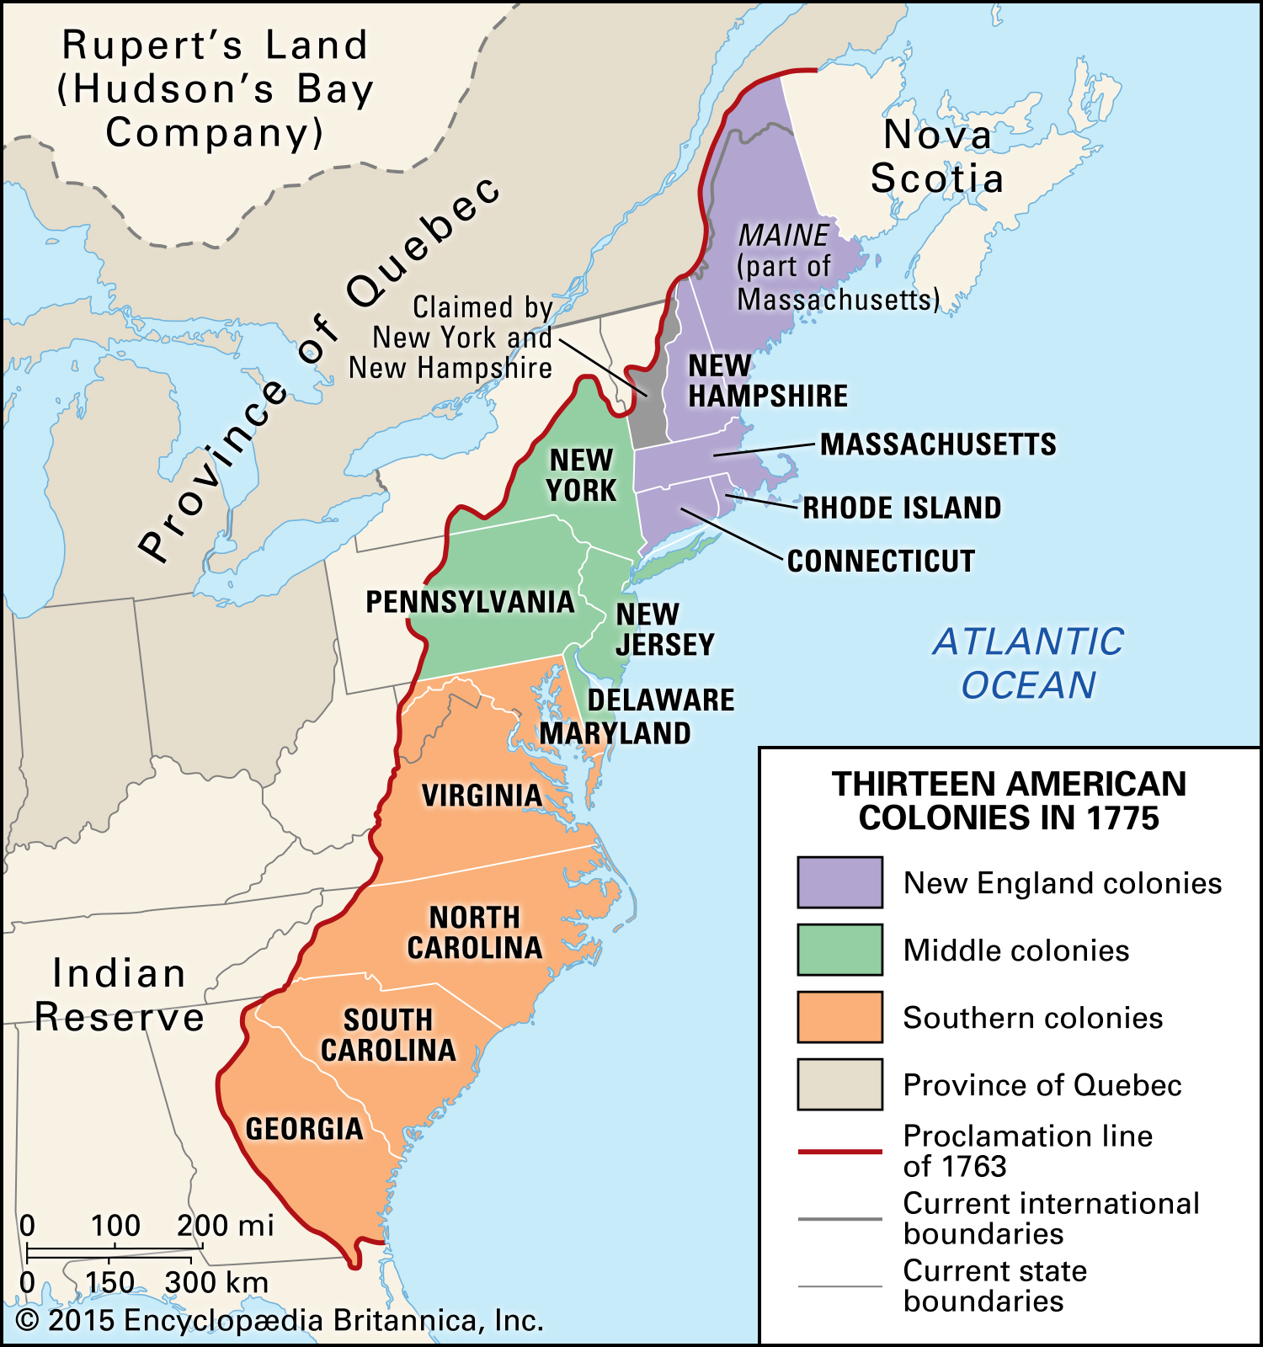
1763, Royal Proclamation line
A vast tract of land between the Appalachians and the Mississippi River was reserved to the First Americans. This was the first legal recognition of Native American claims to land, and a point of contention between the British Crown and the settlers, as it tried to stop the settlers moving West.
In the 5 years following the proclamation, 30,000 settlers ignored the treaty and settled west of the Proclamation line
Notes:
The Royal Proclamation line of 1763 aimed to forbid all colonist settlements in the area west of the Appalachian Mountains, the land there was to be reserved for Native Americans. This Proclamation was regarded as the first legal recognition of Native American rights and claim to land in North America; it related to the First Nations peoples of Canada too. However, it was largely ignored for within 5 years, 30,000 settlers had disobeyed the territory lines and moved west to settle in indigenous lands. The Creeks felt that this showed “people greedily grasping after lands of *red* people”.

Slide 15
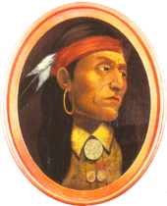
Indigenous resistance
Pontiac Rebellion 1763 – 1766
This was a large, multi-tribal rebellion against the British presence that even included the Senecas from the Iroquois Confederation. The Native Americans seized 8 British forts, including the capture of Fort Detroit.
Overall, 2000 colonists killed and 400 soldiers; unknown Native American losses
It ended in stalemate but with a legacy of bitterness and mistrust
“It is important for us, my brothers, that we exterminate from our lands this nation which seeks only to destroy us” – Chief Pontiac
Pontiac (as imagined, authenticity of this painting is unknown)
Notes:
Pontiac’s Rebellion (1763 – 66), led by the Odawa leader Pontiac, was the first multi-tribal resistance to British colonialism in North America. The French had cultivated Native American peoples as allies, providing their leaders with ‘gifts’ in exchange for using the land. The British saw this as bribery and approached Native Americans as conquered peoples.
Odawa Chief Pontiac made an agreement with Major Robert Rogers after the French-Indian war to let British troops pass through the region in return for respectful treatment. He realised that with British rule his people would suffer and would lose more access to hunting grounds and land, so in 1762 he gained support from many tribes across Lake Superior to Lower Mississippi in a campaign against the British. Each tribe would attack the nearest fort and then combine. Fighting was brutal and British forts and settlements were destroyed. He was victorious in many battles but in the end he agreed to a peace treaty in 1766. The war served to increase a racial divide and mistrust.

Slide 16
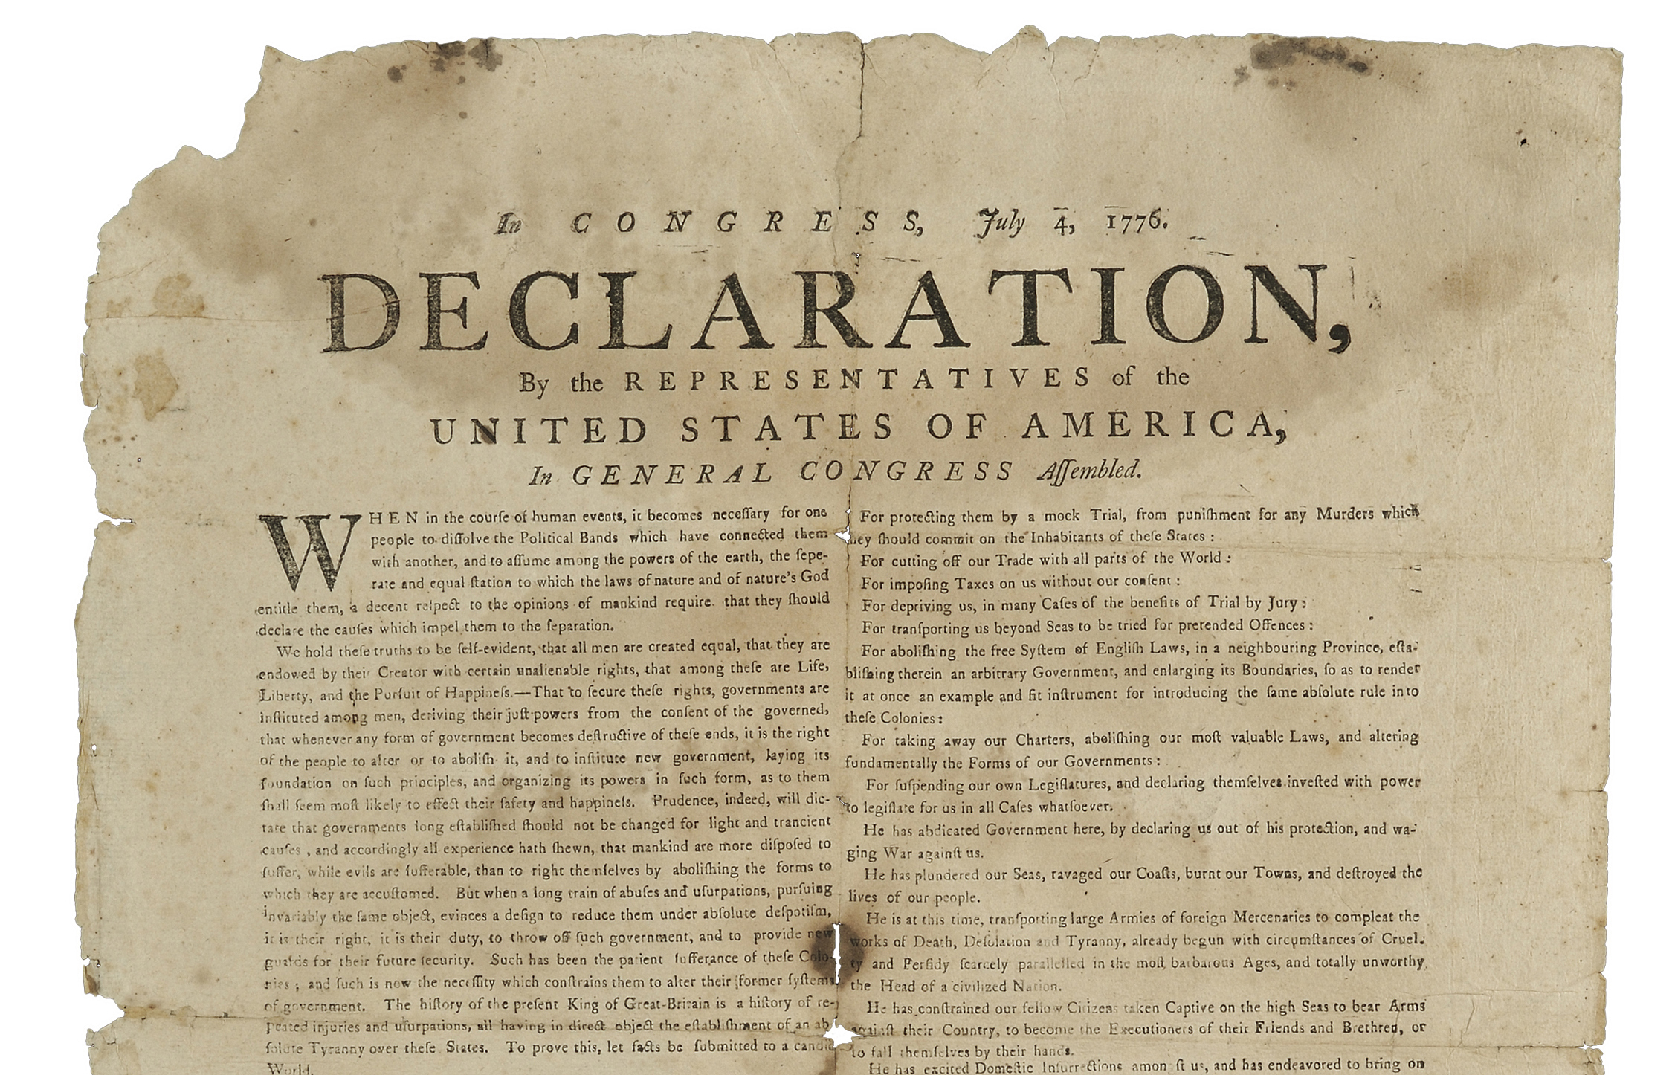
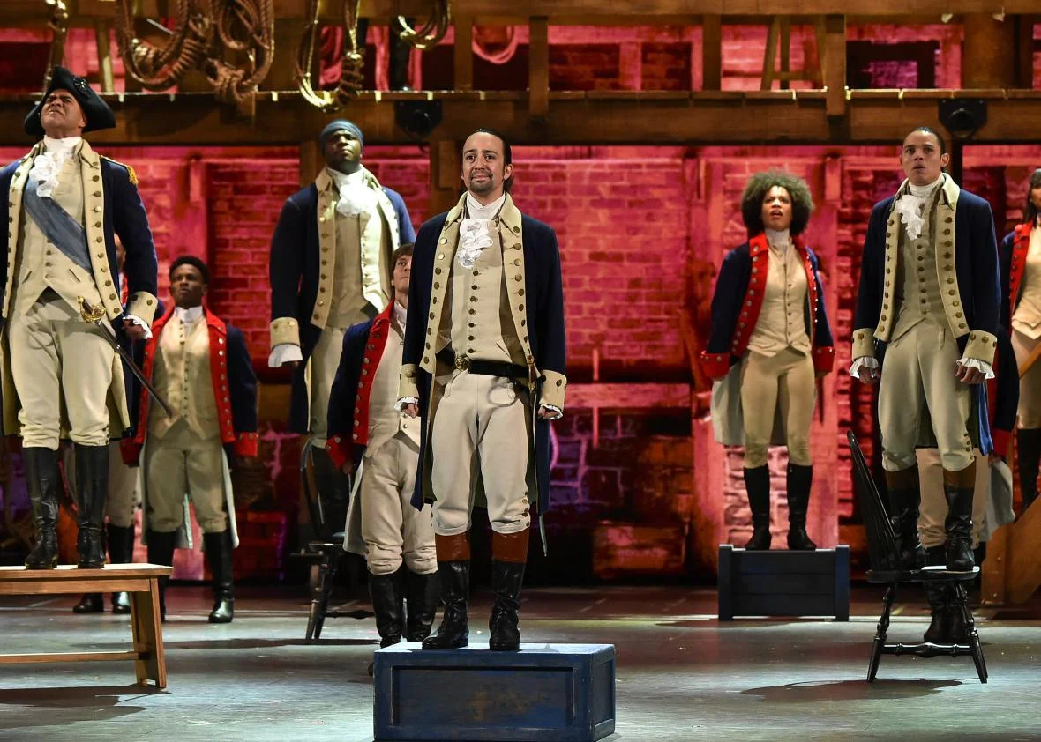
Declaration of Independence 1776
By the leaders of all 13 of the American colonies, rebelling against British tax and what they saw as interference
“All men are created equal”
(Except for women, Native Americans and enslaved people!
American Revolutionary War
From 1775 – 1783 there was a civil war with many settlers staying loyal to Britain. It became international when France and Spain later joined the revolutionaries.
By 1783 the British were defeated, and the United States of America came into being.
No Native Americans were represented in the treaty at the end of the war.
Notes:
In the aftermath of the Seven Years War, Britain imposed taxes on the settlers of the Thirteen Colonies to try to recoup its cost. This, together with the Royal Proclamation (above), led to resentment against the Crown. The slogan ‘no taxation without representation!’ resonated with the British settlers, and contributed to the American Revolution. This Revolution was inspired by Enlightenment ideals, and together with the support of the French and Spanish, the colonists won their independence by 1783 to form the United States. However the Revolution made no provision for the rights of enslaved Africans or Native Americans.
Many loyalist settlers, who continued to support the British Crown, moved north to Canada in the Revolution’s aftermath.

Slide 17
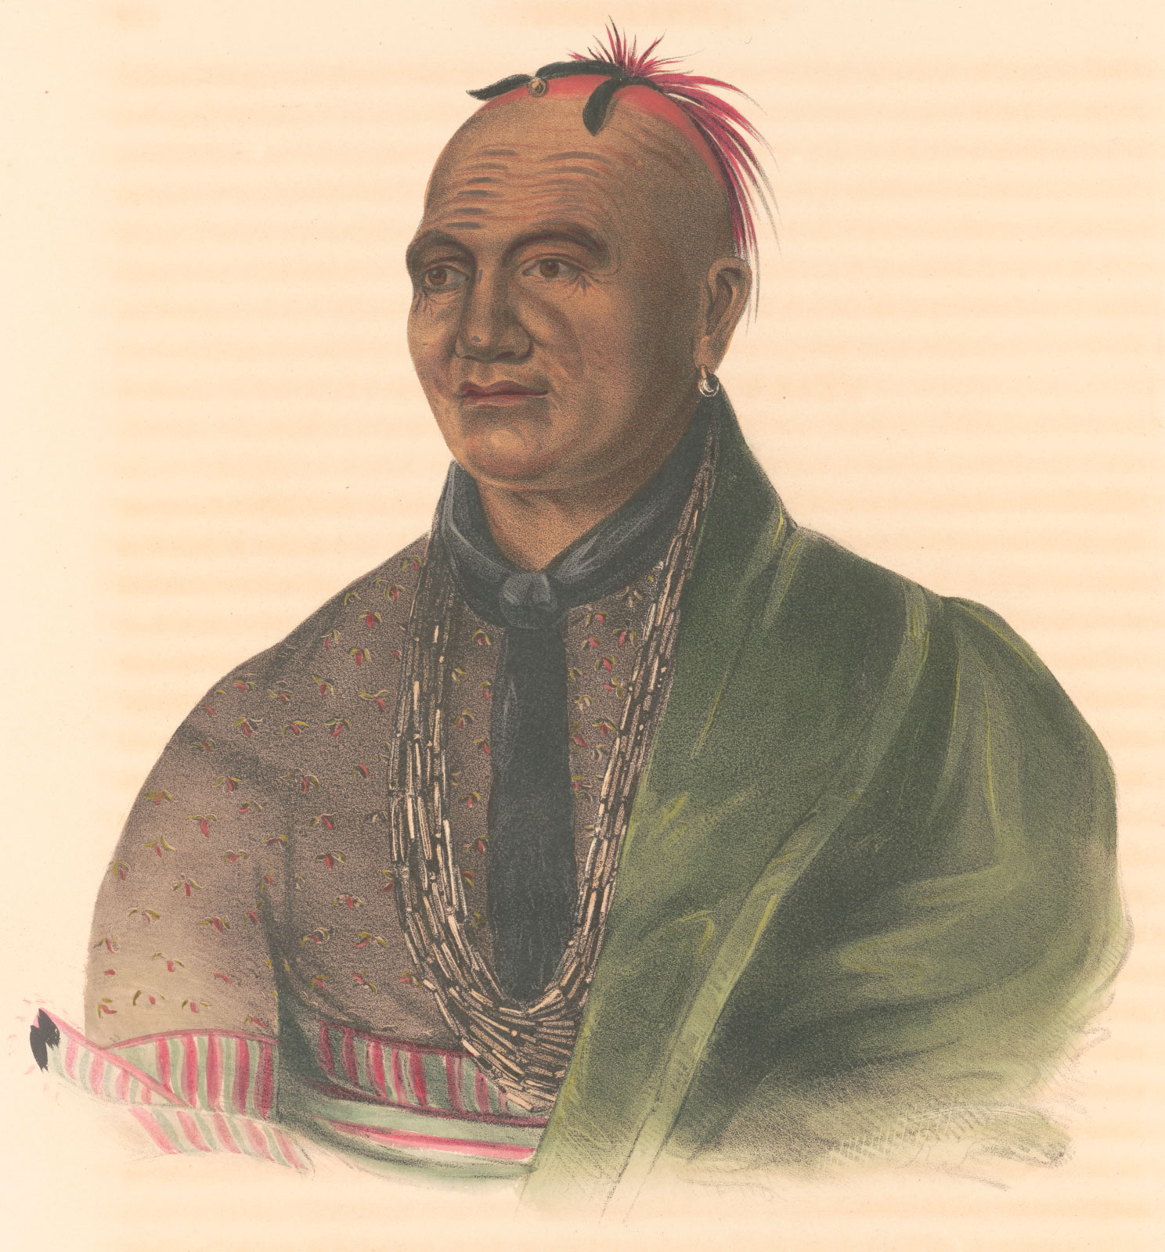
Impact on indigenous communities
Most Native American peoples tried to remain neutral during the American revolutionary war – it was not their war!
However, they were often drawn into it, although it was a no-win situation for them.
It led to the split of the Iroquois confederation with 2 of the 6 Nations supporting the Revolution
Native American women took on additional burdens after having land and crops destroyed and with the men more involved in the fighting.
Native Americans gained no legal land rights after the war, despite promises of these.
The British gave over to the USA all the Indian Reserve lands between the Appalachians and the river Mississippi.
Mohawk Chief, Thayendanega (also known as Joseph Brand)
led 4 of the Iroquois nations as well as the Cherokees and
the Creeks to support the British. He led his people to settle in Canada after the war.
Notes:
The outbreak of the Revolution brought further challenges for Native American populations. Most tried to remain neutral. The Iroquois Confederacy, a long-standing alliance of six nations, split so that former allies/friends ended fighting against each other. Native American women also played a significant role in the revolution, although mainly undocumented and uncelebrated, with accounts of women being frontier scouts and messengers.
The United States become independent, but no independence for Native Americans!
After independence, all territory east of the Mississippi and south of Canada, recognised as Native American under the Royal Proclamation, was ceded to the United States without any input from the Native American peoples who lived there, many of whom had sided with the British. The United States, now free from the limitations on settlement that the British had established, could expand to the west without engaging in treaties with the indigenous population. Over the next 100 years the Native American population of the continent was decimated with the majority of survivors being forced to live on reservations. Huge numbers of migrants came from Britain and were part of this forcible and exploitative westward expansion of the country.
https://www.youtube.com/watch?v=PJdT3MVYkTY

Slide 18
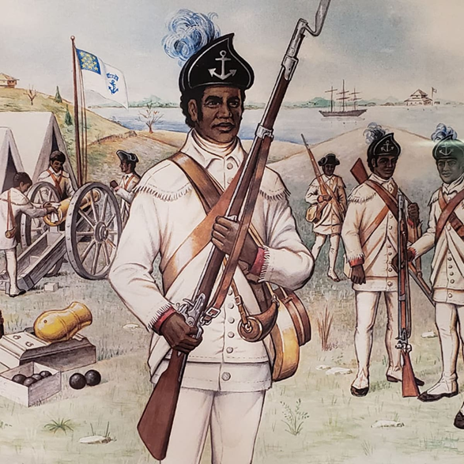
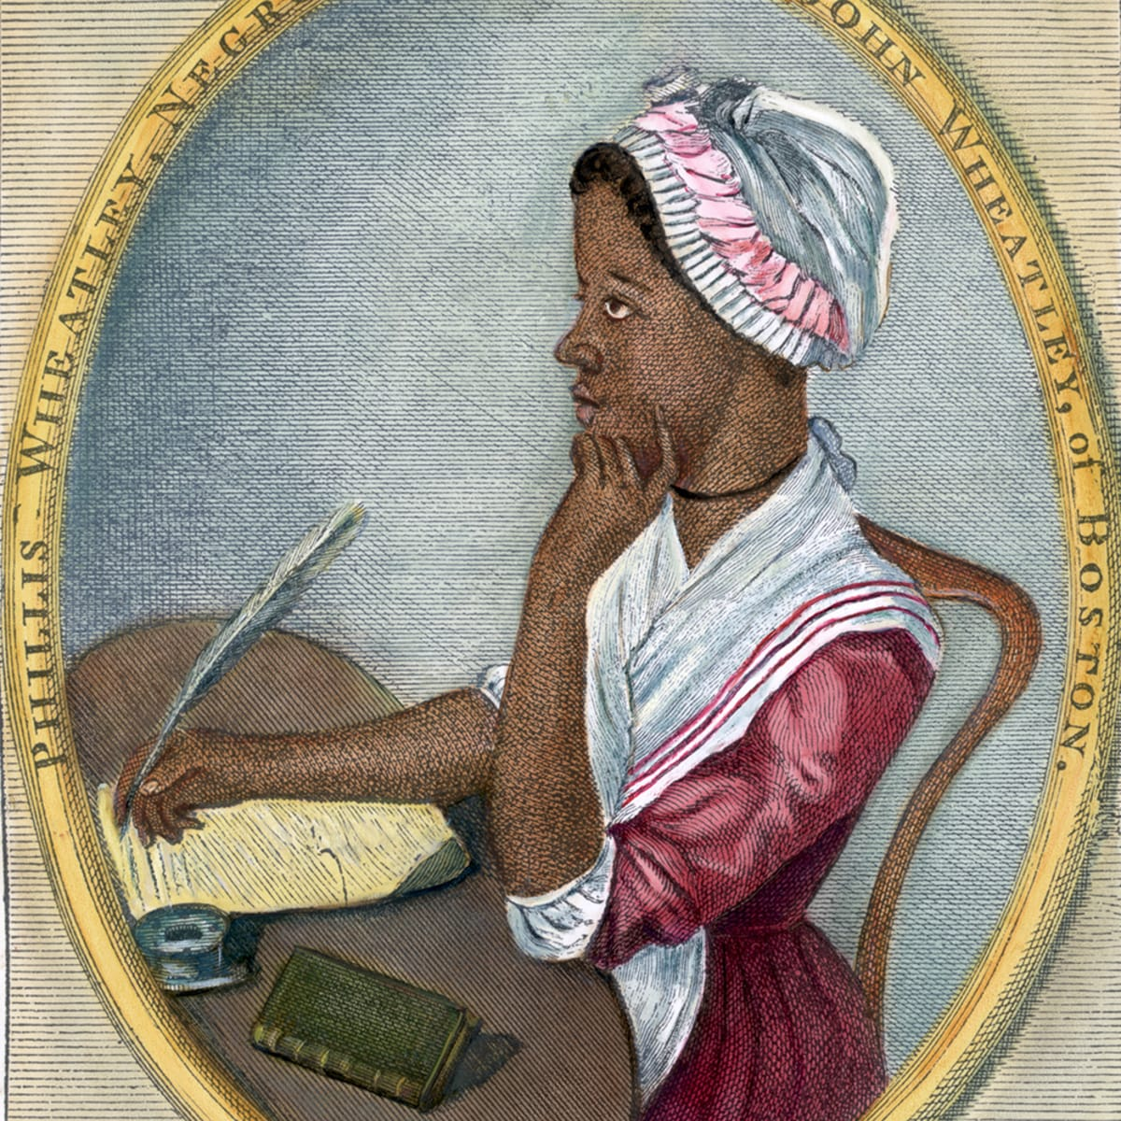
Black Americans: War of Independence
The British promised freedom to enslaved people who joined their army.
Around 8 to 10,000 slaves were bought and freed to fight for American Independence
1st Rhode Island Regiment, made up of 95 slaves and 35 free Blacks as well as some Native Americans, helped win the Battle of Rhode Island against the British in 1778.
Many enslaved people escaped during the disruption that the war caused and fled to Canada. After the war, some former slaves were transported to Nova Scotia, from where many went on to be re-settled in Sierra Leone in west Africa.
Slavery expanded rapidly in the newly constituted United States of America
Rhode Island Regiment
Phyllis Wheatley –previously enslaved inspirational Patriot poet
Notes:
Over this period, slave traders had brought around 175,000 African slaves to work on the plantations around Chesapeake Bay and in the southern colonies. This was mostly for tobacco; cotton plantations became highly significant only after United States independence. Enslaved people endured the most terrible conditions and exploitation, but slavery was institutionalised in the country. The slave population continued to expand throughout the 18th century. As early as 1724, the enslaved population was higher than the white settler on by a ratio of 2:1 in South Carolina. The tobacco plantations’ high profits were based on this availability of slave labour.
During the American Revolution around 8 to 10,000 enslaved peoples were drawn into the American forces forming about a quarter of the total fighting men in the Revolutionary war. Many were bought up and freed to make up army quotas. Note the Rhode Island Regiment, made up of 95 slaves and 35 free Black people, as well as some Native Americans, who won the Battle of Rhode Island against the British in 1778. Many enslaved people escaped during the disruption that the war caused and fled to Canada. After the war, some former slaves were transported to Nova Scotia, from where many went on to a kind of freedom in Sierra Leone in west Africa. With independence, the slavery established by the British continued as an institution in the new United States. The Constitution acknowledged slaves as 3/5s of a person, and allowed for slave owners to repossess their property. Slavery actually expanded to become a central part of the new southern states cotton economy that developed, especially in the early 19th century, and by 1860 there was an estimated slave population of 4 million.

Slide 19
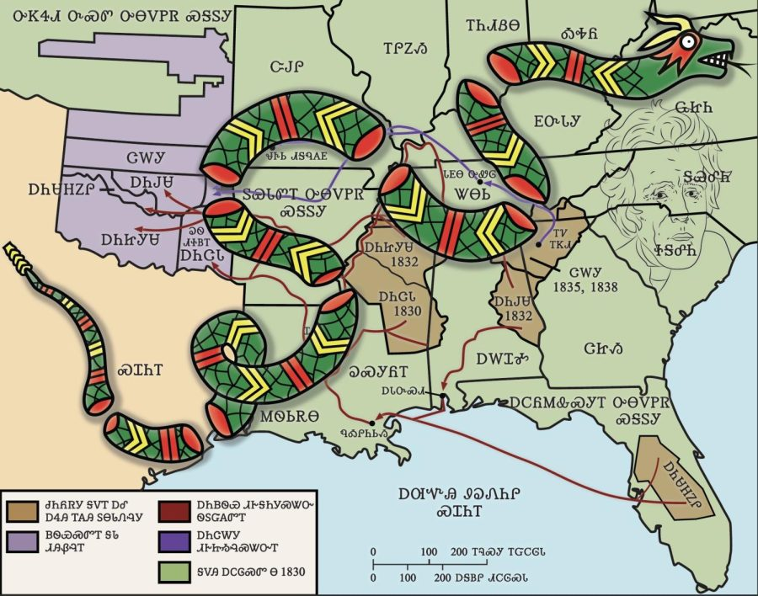
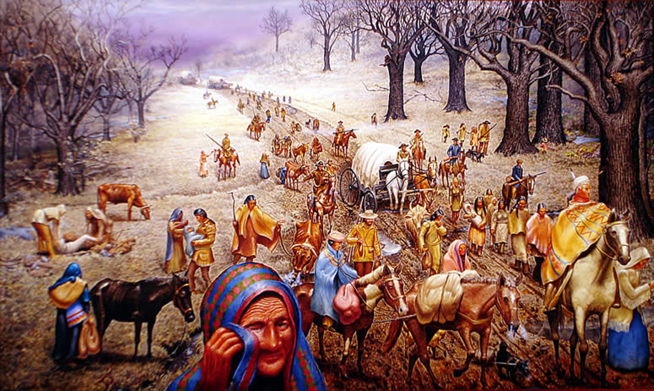
The Trail of Tears
In 1838-39 the Cherokee were ordered to relocate from Kentucky/Georgia to the Great Plains (now Oklahoma)
60,000 people were forcibly displaced and as many as 4000 may have died on the ‘Trail of Tears’
Painting by American artist Max Stanley – ‘By far the saddest painting I’ve ever done’
‘Relocate and/or Die’ by Cherokee artist Jeff Edwards
Notes:
The ‘Trail of Tears’ was the forced mass displacement carried out by the United States government following the declaration of independence from the British empire. At the beginning of the 1830s, nearly 125,000 Indigenous peoples lived on millions of acres of land in Southern America, which was regarded as the settlers as an ‘Indian problem’ as George Washington famously said. In 1838-39 the Cherokee were ordered to relocate from Kentucky/Georgia to the Great Plains (now Oklahoma).
Estimates suggest that around 60,000 people were forcibly displaced and as many as 4000 may have died on the ‘Trail of Tears’.

Slide 20
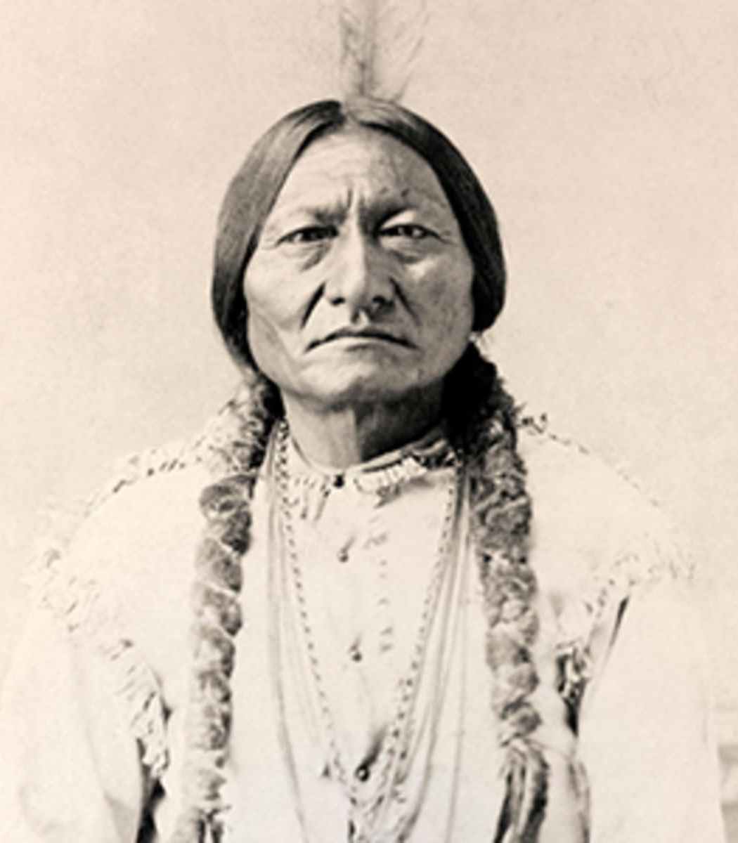
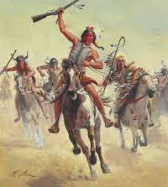
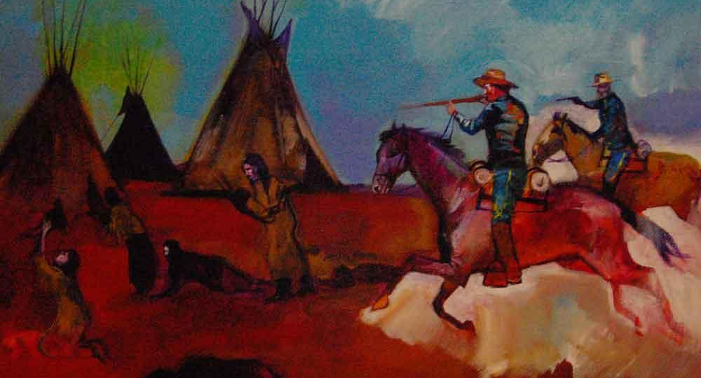
Legacy of colonialism: Land
The continued forcible and violent taking of land and denigration of the culture of Indigenous peoples
Fort Laramie Treaty of 1851: US recognised Native American lands, Cheyenne, Sioux, Arapaho, Crow, Assiniboine, Mandan, Hidatsa and Arikara Nations agreed peace and granted safe passage for settlers through their territories
Plains Indian Wars (1850-90): prolonged and bloody conflict between the US army and the Native Americans of the Great Plains – the Sioux fought heroically but were ultimately defeated in1890
Notes:
Following the mass displacement of Indigenous people known as the ‘trail of tears’, there was the continued forcible and violent taking of land and denigration of the culture of Indigenous peoples.
Fort Laramie Treaty of 1851: US recognised Native American lands, Cheyenne, Sioux, Arapaho, Crow, Assiniboine, Mandan, Hidatsa and Arikara Nations agreed peace and granted safe passage for settlers through their territories.
Plains Indian Wars (1850-90): prolonged and bloody conflict between the US army and the Native Americans of the Great Plains – the Sioux fought heroically but were ultimately defeated in1890

Slide 21
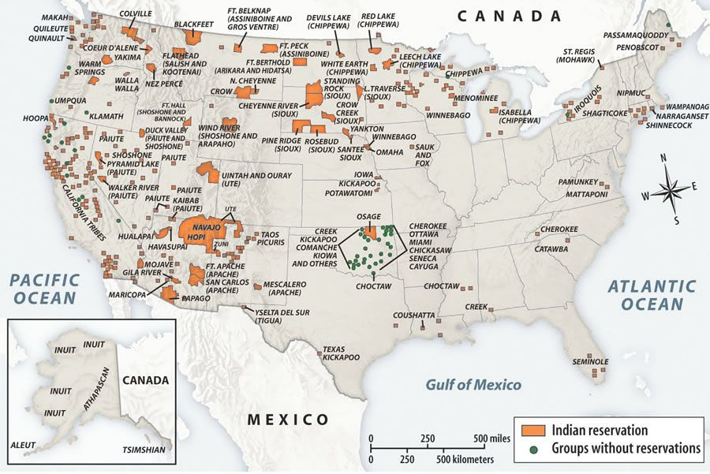
Legacy of Colonialism:
Land
In the 100 years after American independence the Native American population of the continent was decimated with the majority of survivors being forced to live on reservations.
Huge numbers of migrants came from Britain and were part of this forcible and exploitative westward expansion of the country
The map shows the pattern of Native American reservations today.
Notes:
In the 100 years after American independence the Native American population of the continent was decimated with the majority of survivors being forced to live on reservations.
Huge numbers of migrants came from Britain and were part of this forcible and exploitative westward expansion of the country

Slide 22
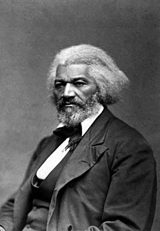
Legacy of Colonialism: Slavery
  American civil war 1861—1865 after which slavery was ended in the United States
  Reconstruction, after the civil war – was an experiment in multi-racial democracy with 16 African-Americans elected to Congress
  Failure to provide former slaves with the promised ‘40 acres and a mule’ resulted in millions of African-Americans being locked into bonded labour
  White backlash and Jim Crow laws: policies of racial segregation and discrimination in the southern states kept in force until 1965, when the Civil Rights Movement brought them to an end.
Frederick Douglass: an abolitionist, born into slavery. He became United States Ambassador to Haiti
Notes:
There were many rebellions and resistance by enslaved peoples before abolition. Some key rebellions:
Gabriel Prosser, Richmond, 1800 – first major uprising, wanted to create an independent Black state, recruited many slaves, estimates range into the thousands, and had it not been for storms and flooding which destroyed the roads and bridges, he could have succeeded. The plans were exposed and he and several others were hanged.
Denmark Vasey, Charleston, 1822 – spent time between America and Caribbean as slave, bought freedom in 1800 but was unhappy with his status and determined to free others. Planned a largescale revolt of slaves numbering in the thousands. The plot was discovered through an informant and many were hanged, exiled or convicted, including 4 white supporters.
Nat Turner, Virginia, 1831 – led a rebellion of enslaved people, but the fear this instilled in white people led to the massacre of hundreds of enslaved people, further restrictive measures towards the enslaved, and heightened anti-abolitionist sentiments.
Harriet Tubman – an escaped slave herself she helped others escape as a ‘conductor’ on the Underground Railroad in the 1840s, as well as playing many roles in the civil war.
Ida B Wells – prominent activist in the 1880s – refused to give up her seat in a whites only 1st class carriage, when forcibly removed she took legal action against the train company and won, though the High Court later overturned the ruling. She also travelled far and abroad and shed light on the lynchings which were prominent during those times.
Isaiah Montgomery – chose a separatist approach, recruited former slaves and created a Black only town – Mound Bayou in Mississippi which still exists today and is almost 100% Black.
American civil war 1861—1865 after which slavery was ended in the United States
Reconstruction, after the civil war – was an experiment in multi-racial democracy with 16 African-Americans elected to Congress
Failure however to provide former slaves with the promised ‘40 acres and a mule’ resulted in millions of African-Americans being locked into bonded labour
White backlash and Jim Crow laws: policies of racial segregation and discrimination in the southern states kept in force until 1965, when the Civil Rights Movement brought them to an end.

Slide 23
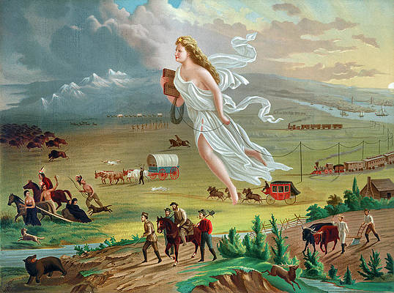
Legacy of colonialism: America’s white settlers
An opening up of the continent to British/European ideas: white racial superiority; ‘manifest destiny’ – a belief they were natural inheritors of the continent
A continuous flood of migrants through the 19th century, forcibly taking the land of the Native Americans and bringing the insights and technology of Britain’s Agricultural and later Industrial Revolutions
Exploitation of natural resources and destruction of ecosystems
A beacon of hope for so many British – a promise of freedom and economic possibility – but not for Native Americans or the enslaved
Notes:
White settlement in northern America caused an opening up of the continent to British and European ideas, including white racial superiority and the concept of ‘manifest destiny:’ a belief that they were the natural and rightful inheritors of the continent. The continuous flood of migrants throughout the 19th century contributed to the forcible takeover of land belonging to Native Americans. The settlers brought with them the insights and technological developments of Britain’s Agricultural and later Industrial revolutions. The imposition of a capitalist system by the white settlers in Northern America resulted in massive over-exploitation of natural resources. Two consequences were ‘the dust bowls;’ the result of unsustainable farming methods imported from Europe, and the excessive hunting of the bison, which was driven almost to extinction. It is important to note the contrast between the sustainable livelihoods of Native American civilisations and the violent destruction of ecosystems perpetrated by the white settlers. The prospect of migration to the United States was a beacon of hope for so many British, bringing with it the promise of freedom and economic possibility, but not for Native Americans or the enslaved. As a result of America’s white settlers growing to form the vast majority of the population, European customs, laws and politics came to predominate.

Slide 24
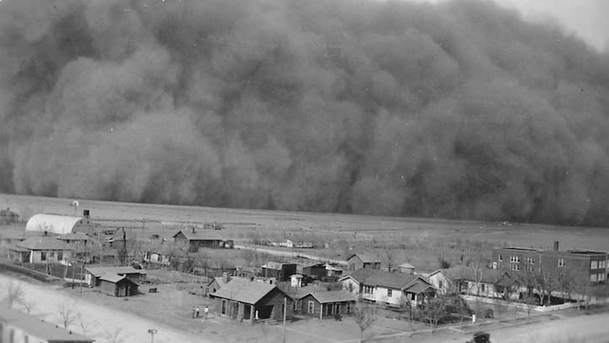
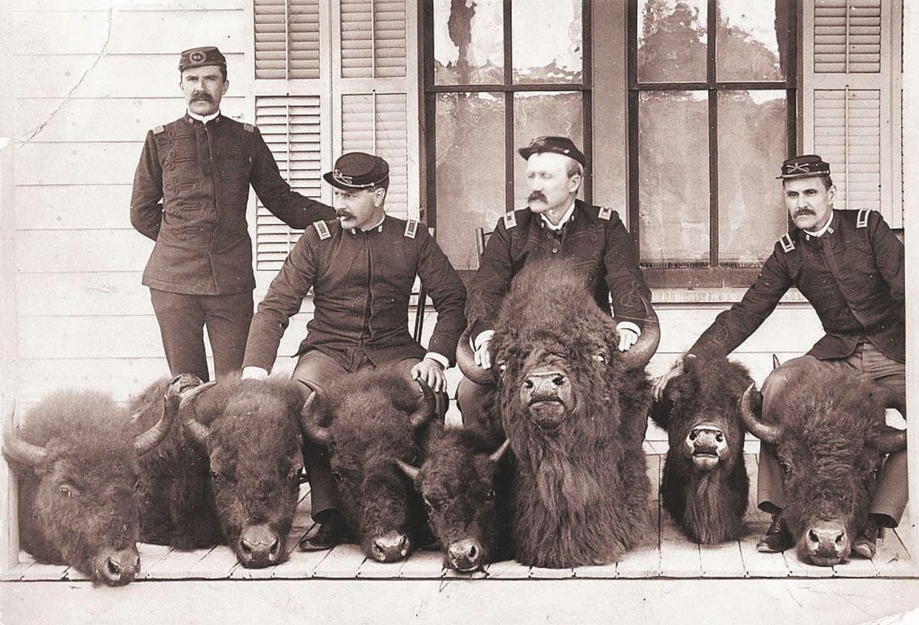
Legacy of Colonialism: Over-exploitation of natural resources
Dust bowls, the result of unsustainable farming methods imported from Europe
The bison was hunted almost to extinction by white hunters
Notes:
European colonisation of the Americas led to the ‘Columbian Exchange’: an unprecedented biological exchange between the Old and the New Worlds. Some examples:-
Rice from Europe – to South Carolina by 1690
Horses from Europe – the Plains Native Americans used these. Also cattle, sheep and pigs were brought over to North America and transformed farming.
Potatoes brought to Europe from South America and became a staple crop
Tobacco from North America – slave worked plantations produced this for export to Europe
Sugar-cane was brought to the Caribbean via south-east Asia by the British – and slave worked plantations were established to exploit this crop
The British brought diseases to the continent that the Native American population had no immunity to – such as smallpox, influenza and measles. This had a devastating effect on population numbers.

Slide 25
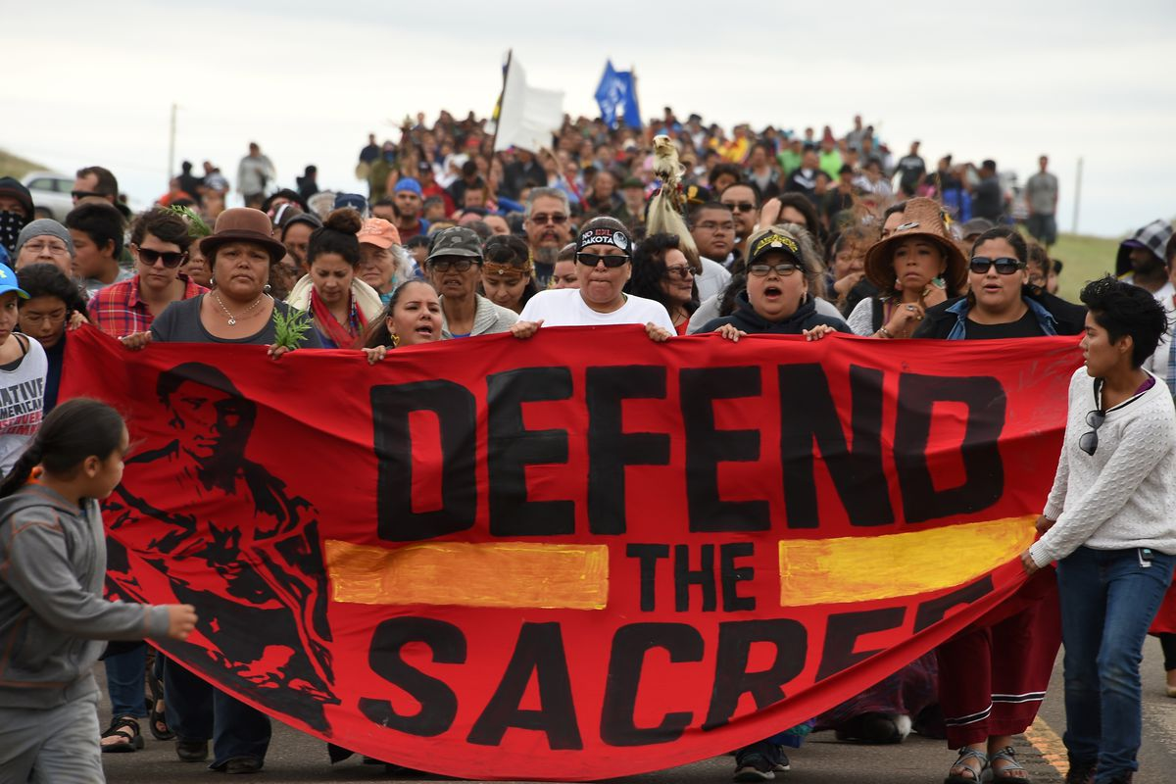
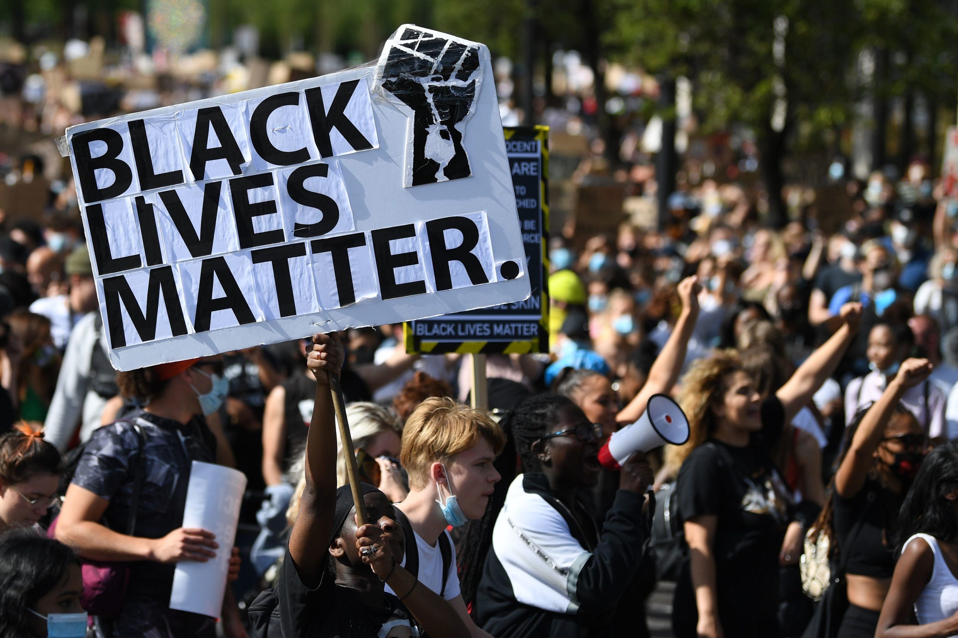
The ongoing fight for equality
Pattern of ill-treatment and taking of land from Native Americans established under British colonialism with Native American people still fighting for claim to their homelands and disproportionately impoverished.
British colonialism embedded slavery as integral to the economy and the society. Those with lineages to the slave trade, still persecuted by racist and oppressive cultures and structures in the US.
Dakota access pipeline protest, 2016 (Native Americans protesting against a breach of the Fort Laramie Treaty)
Black Lives Matter, 2013 - present
Notes:
Pattern of ill-treatment and taking of land from Native Americans established
Embedded slavery as integral to the economy and the society
The after-effects of America’s turbulent and destructive colonial past are still very much visible and noticeable in today’s society:
Native Americans have limited access to land, having ‘reservations’ set aside for them. It is an on-going struggle to have their cultures recognised and appreciated.
Institutionalised racism against previous enslaved peoples and all who form an ethnic minority.
The Civil Rights movement of the 1960s and Black Panther movement that historically contributed to the Black Lives Matter today.
George Floyd murder last Summer (2020) encapsulates the racial tensions and violence still prevailing in America today.

Slide 26
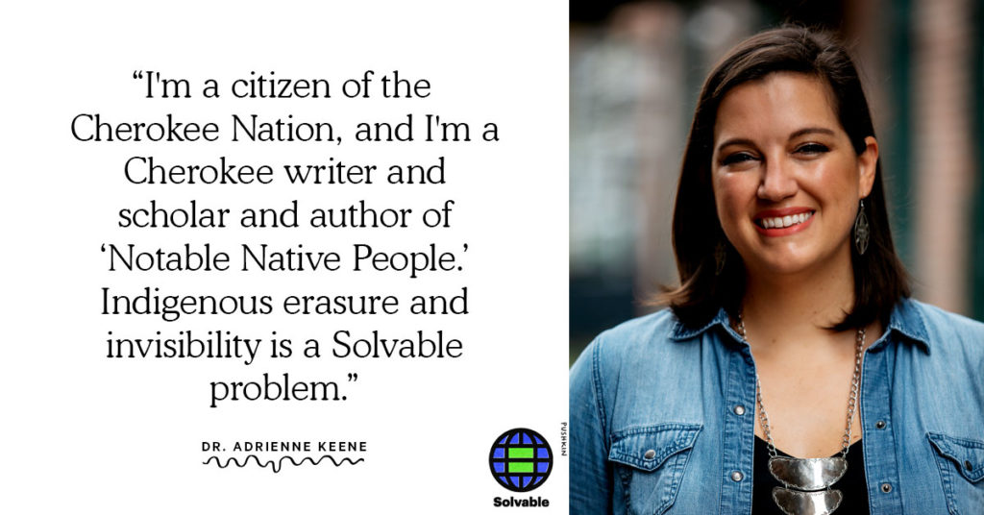
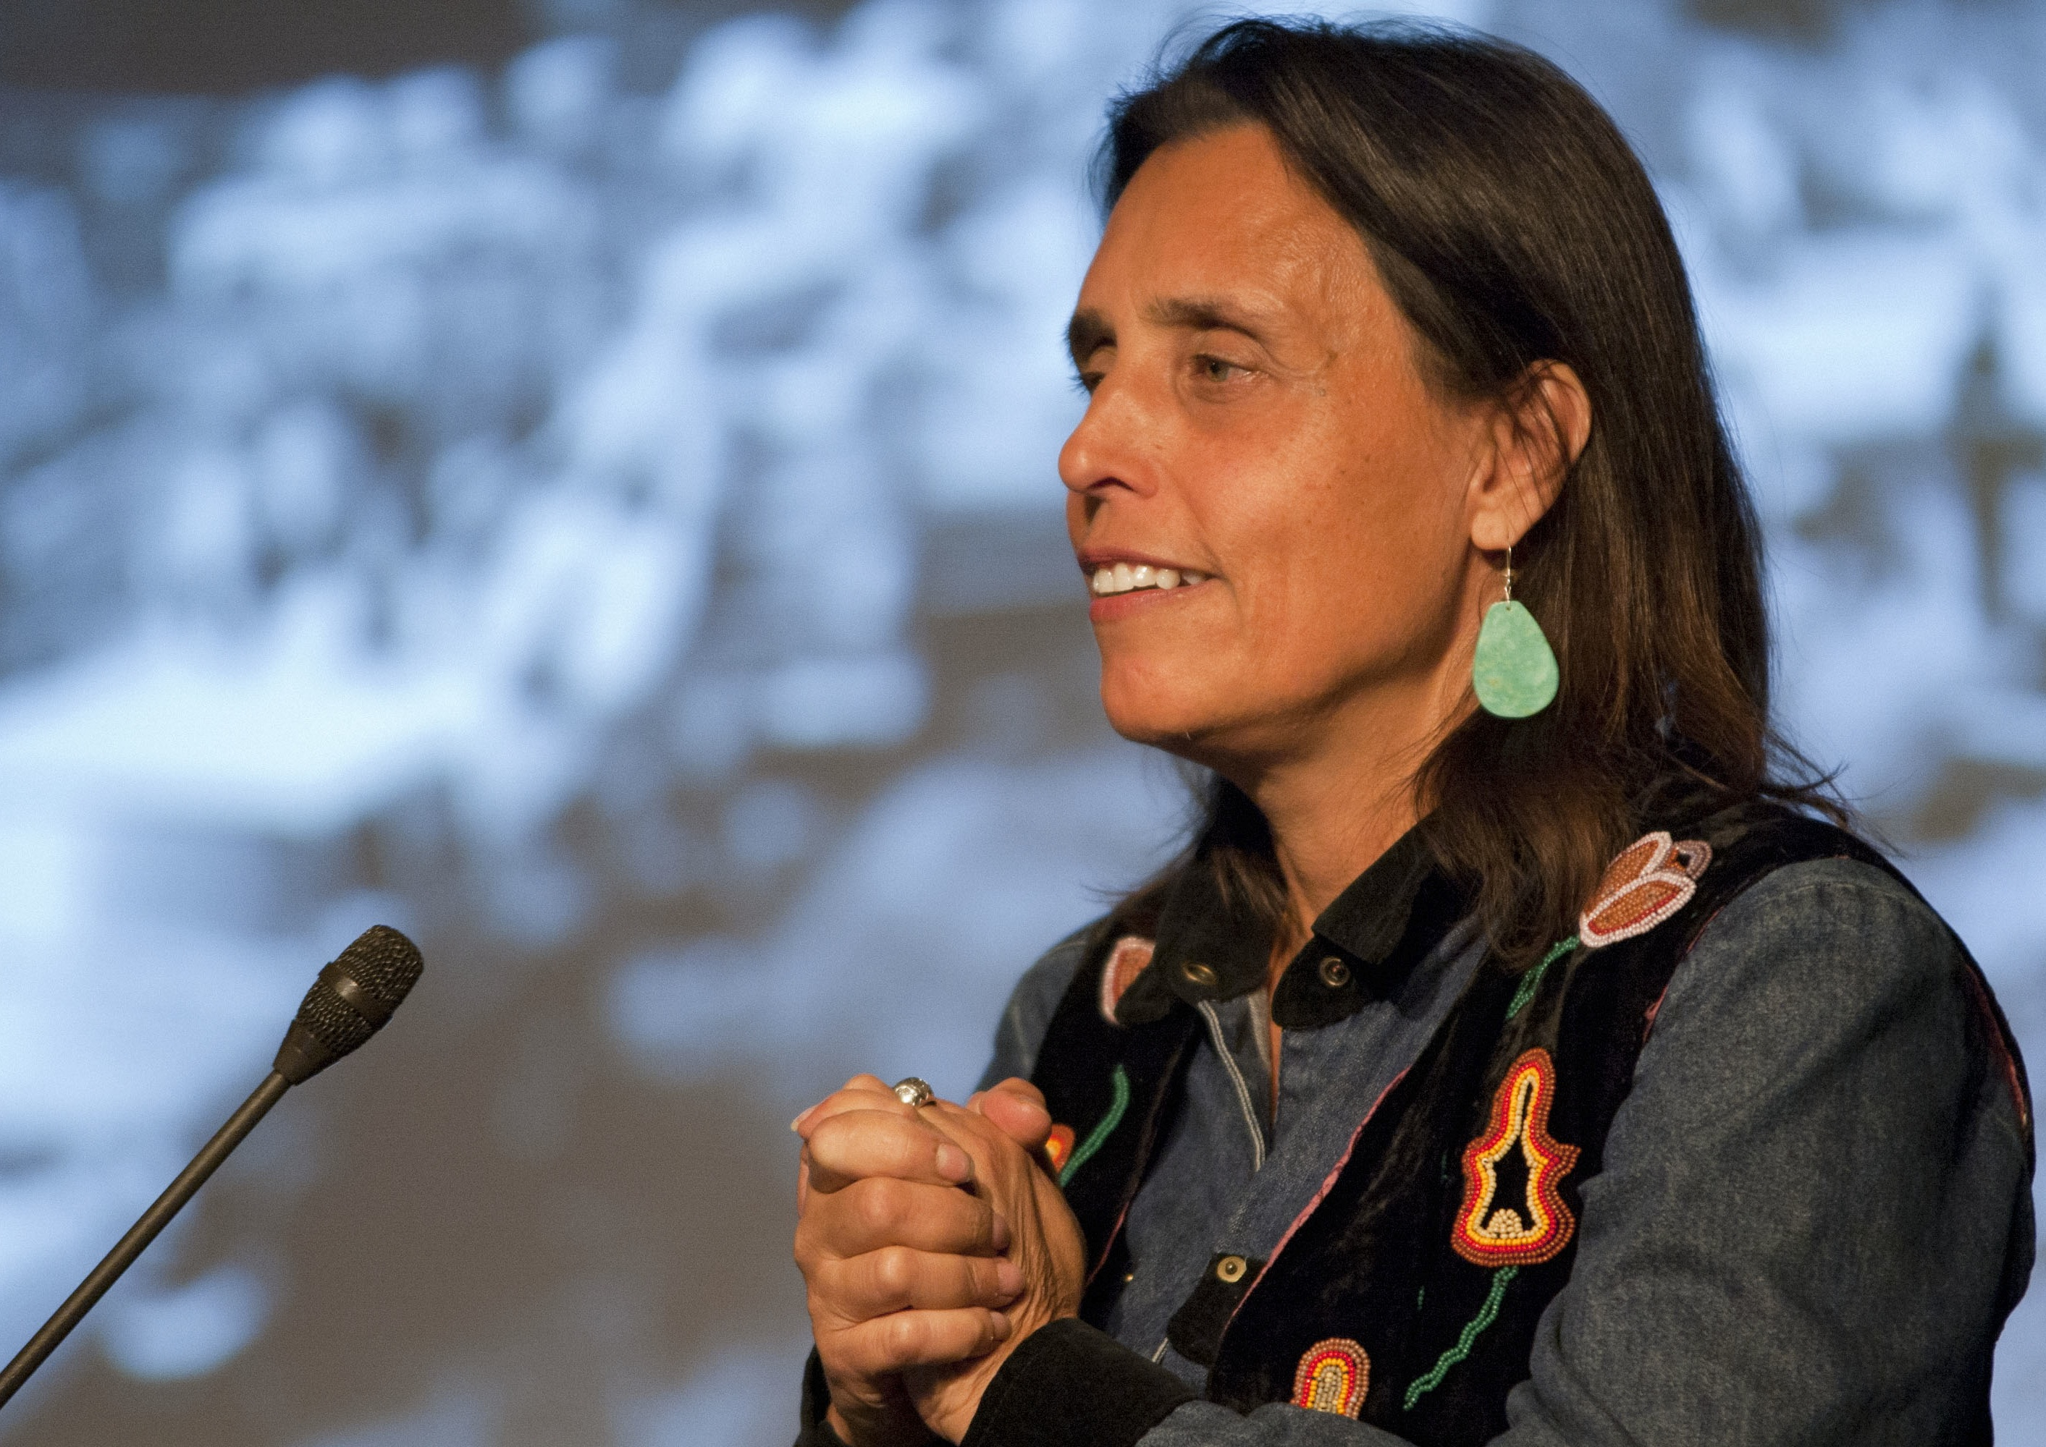
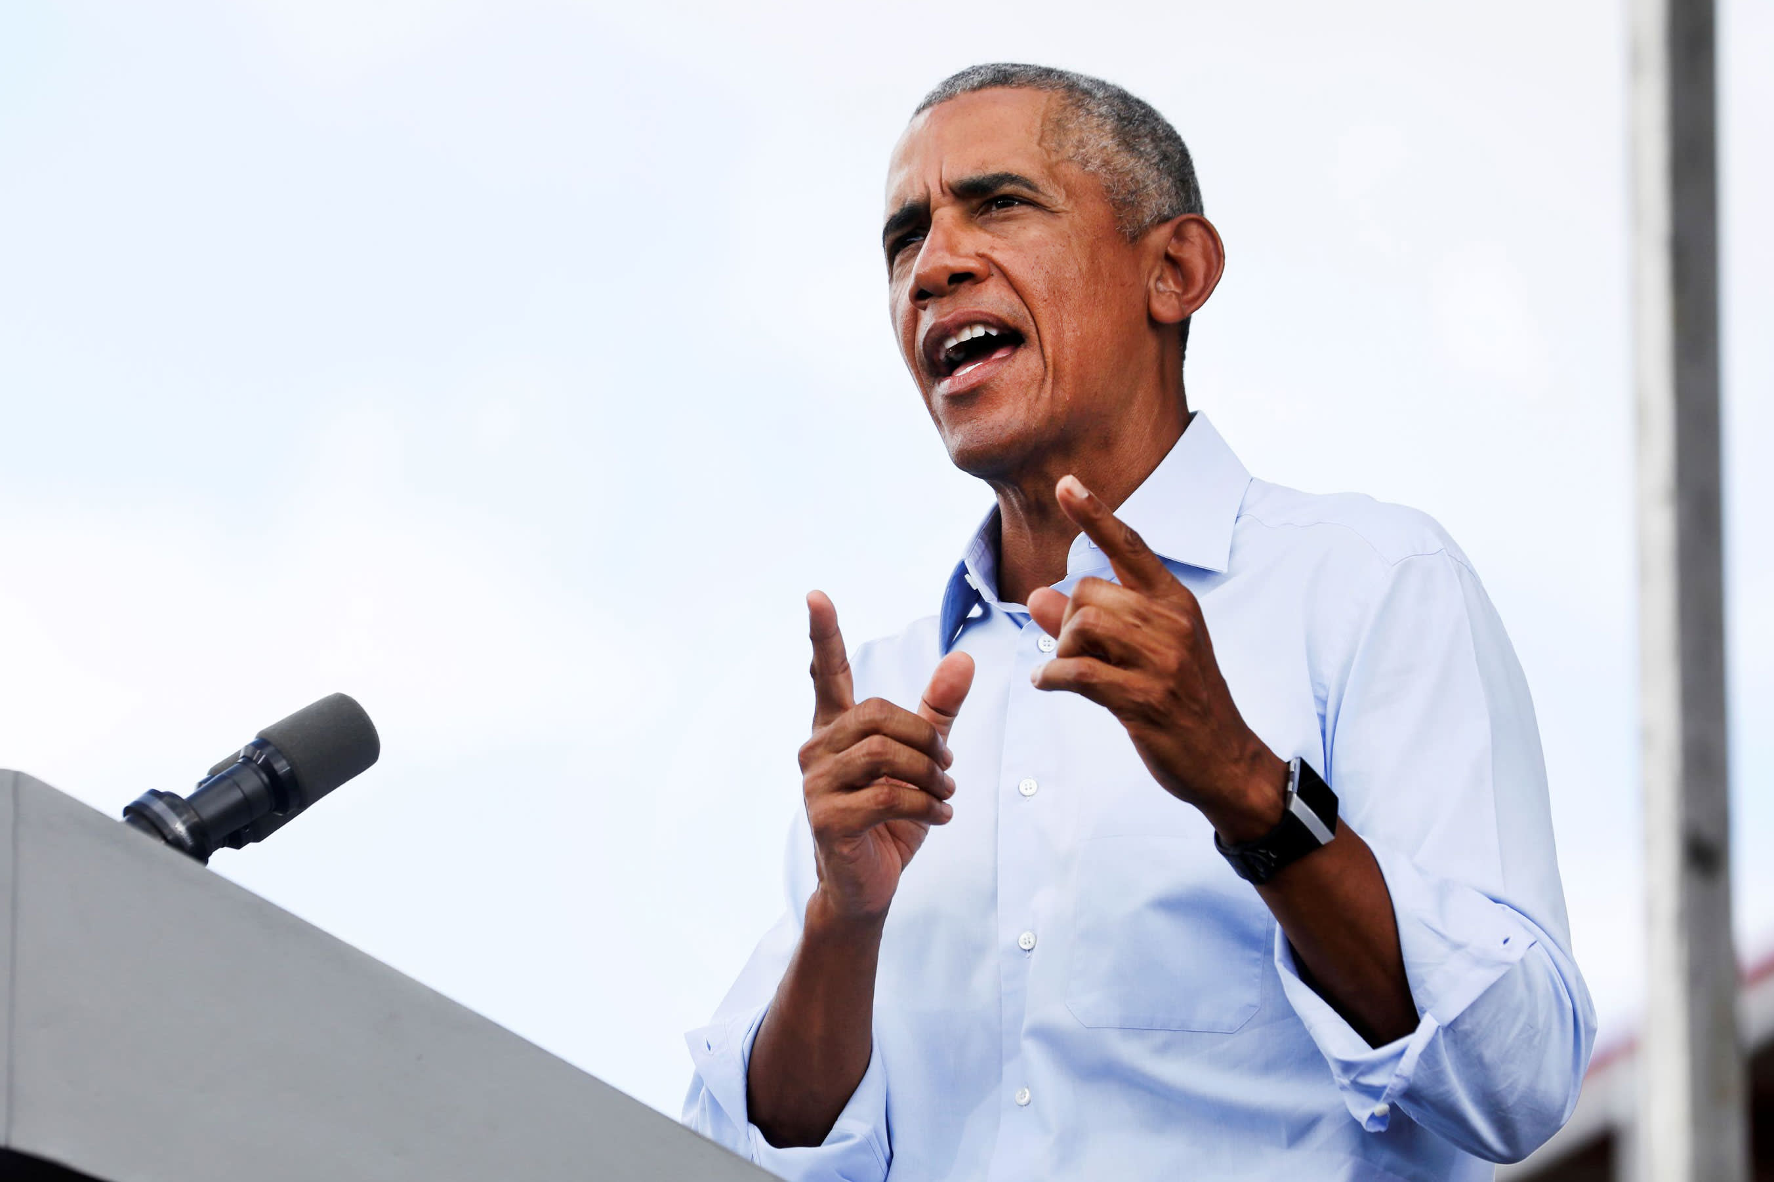
Dr. Adrienne Keene, academic, activist blogger and author of ‘Notable Native People’
Winona LaDuke, Ojibwe economist, environmentalist, writer and activist
Barak Obama, first black President of the US

