Slide 1

India
Experiences of British Colonisation
1600 -1947

Slide 2
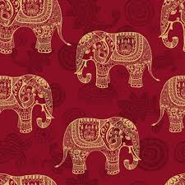
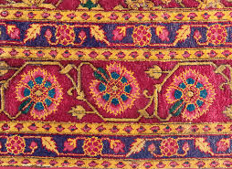
Contents
Geography of South Asia
Pre-colonial civilisation
Early civilizations in South Asia
The Mughal Empire
The East India Company
From traders to colonisers
Indian Resistance and the Battle of Plassey
British colonization of India
The 1857 revolt
British India: Divide and rule
Famines
WW1 and the Jallianwala Bagh Massacre in 1919
Indian resistance
Gandhi and non cooperation movements
WW2 and the Bengal Famine 1943
Independence 1947 and partition
The legacy of colonialism and partition

Slide 3
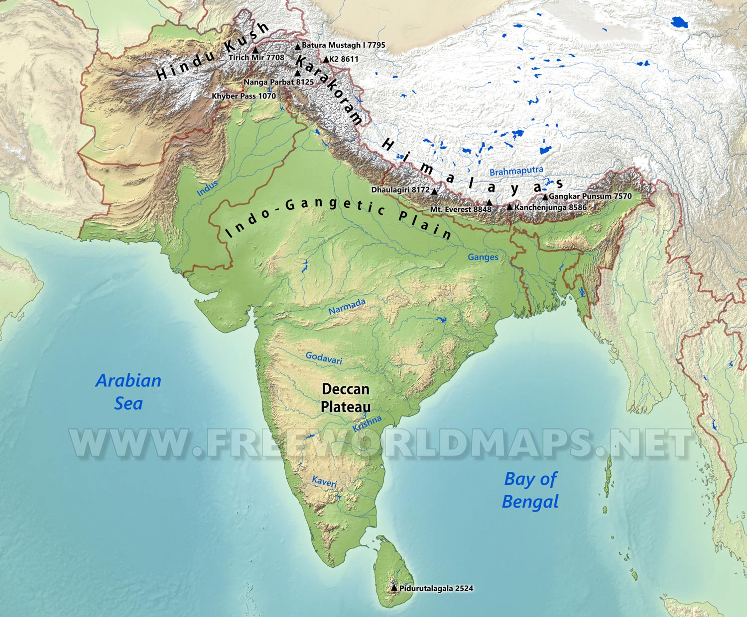
Geography of South Asia
South Asia is huge region and India alone is 13 times the size of the UK.
South Asia is a peninsular region. In the north the Himalayas have some of the world’s highest peaks.
There are largely hot summers which are followed by monsoon rains.
The British Empire in South Asia (‘British India’) extended through what are now the countries of Bangladesh, India, Myanmar, Pakistan and Sri Lanka.
Notes:
India is 13 x the size of the UK, the 2nd largest nation in the world. It has a population of 1.44 billion, making up around 17.7% of the world’s population.
India is a vast country encompassing islands and mountains and distances of 2000 miles from Jammu and Kashmir in the north to Tamil Nadu in the south, and almost the same from Gujrat in the west to Arunachal Pradesh in the East. In the north the Himalayas dominate, including some of the world’s highest peaks. The climate in India ranges from extreme heat in many parts of the country during the summer, to extreme cold, Arctic like conditions high in the Himalayas, with places like Gulmarg, Manali and Pahalgam seeing several feet of snow. Monsoon season sees heavy downpours. New Delhi can see pleasant mild days in October and November, and February, but also freezing weather at nights and heat levels reaching 110F in the summer. Mumbai has a more tropical climate with heat and humidity in April, May and October and monsoon season June to September. Chennai in Tamil Nadu can see high temperatures and humidity throughout the year, with distinct dry periods and monsoon between October and December.
The rivers Indus and Ganges run through fertile alluvial plains. The Brahmaputra in Bangladesh and the Irrawaddy in Myanmar are other significant rivers.
There are 29 states in India, with several official languages including Hindi 43.6%, Bengali 8%, Marathi 6.9%, Telugu 6.7%, Tamil 5.7%, Gujarati 4.6%, Urdu 4.2%, Kannada 3.6%, Odia 3.1%, Malayalam 2.9%, Punjabi 2.7%, Assamese 1.3%, Maithili 1.1%, and other 5.6%. Uttar Pradesh is India’s largest state, it’s population as of 2011 was 199,581,520 making it larger than most countries in the world, if it were a country, it would be the 5th largest after China, India, the USA and Indonesia. Religious groups include Hindus 79.8%, Muslims 14.2%, Christians 2.3%, and Sikhs 1.7%, as well as Buddhists and Jaens.
https://www.mapsofindia.com/maps/india/india-political-map.htm
https://www.indexmundi.com/india/demographics_profile.html

Slide 4
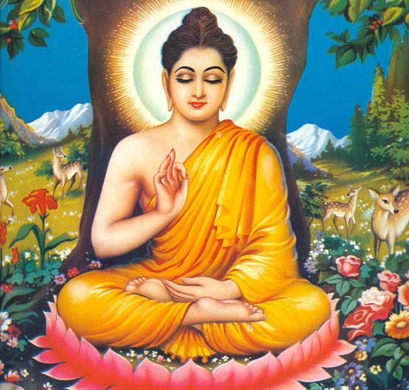
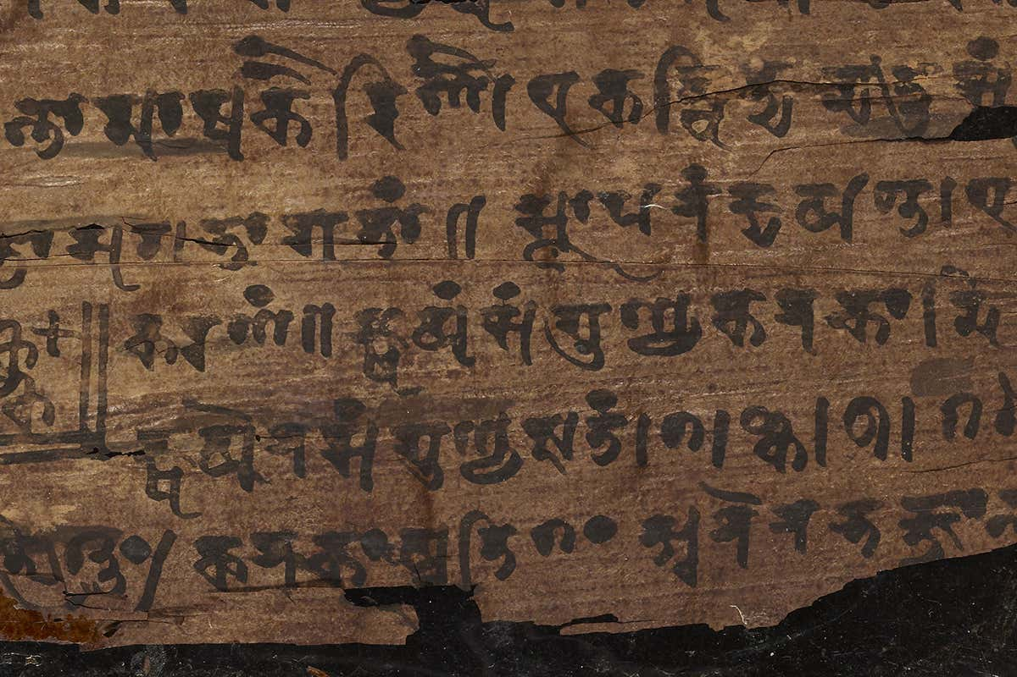
Early civilisations in South Asia
Ancient cities have been discovered in South Asia, dating as far back as 2500 BC, such as Mohenjo Daro and Harrapa in Singh and West Punjab
Early civilisations in South Asia generated many important developments, such as
Religions such as Buddhism, Jainism and Hinduism
The modern decimal system and the concept of ‘zero’
Sanskrit, which is one of the most ancient recorded languages, found in Indo-Aryan civilisations
Ancient medicine known as ’Ayurveda’, which is still practiced today
From top to bottom: Buddha; script of decimal system
Notes:
Early civilisations in South Asia generated many important developments. Some examples are religions such as Buddhism, Jainism and Hinduism, and ancient literatures like the Ramayama and Mahabarata.
In particular, the period between 250 and 500 AD was a time of extraordinary cultural brilliance. The modern decimal system and the concept of ‘zero’ are two revolutionary mathematical innovations that originated during this time. Another legacy of the same period is the ancient branch of medicine, ‘Ayurveda,’ which is still practiced today. Trade routes with other countries, now known as the Silk Road, were also well-developed at this time.
The rise of Muslim civilisations began in around the 8th Century and by the 11th Century they were firmly established in India. Their rise culminated in the Mughal Empire by the 14th Century.
https://artsandculture.google.com/exhibit/the-indian-spice-trade-in-search-for-knowledge-and-riches-national-centre-for-biological-sciences/eQLii3aIo8xmKA?hl=en
Mohanjo Daro and Harrapa are two ancient cities in Sindh and West Punjab. They were part of the first agricultural civilisations in the world and were largely peaceful. Sculptures of women show the imported roles they played, often depicted as powerful goddesses.
https://www.harappa.com/video/ancient-india-indus-valley-civilization-mughal-imperialism
https://www.bbc.co.uk/news/world-asia-india-46616574

Slide 5
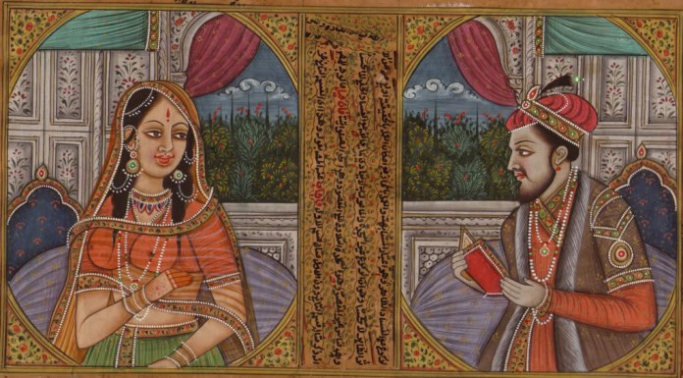
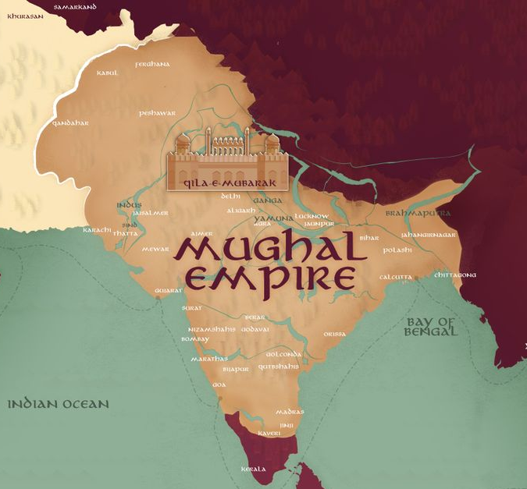
The Mughal Empire 1526 - 1857
The Mughal empire was founded by Babar in 1526 and became rich and prosperous
The Mughals set up effective administration systems, developed infrastructure and promoted the arts. There are numerous monuments that exist in India today from the Mughal period, including the famous Taj Mahal.
Artisans and weavers produced cotton and silk textiles, which were desired around the world.
Women, including Nur Jahan, were often patrons of the arts, music and architecture, building grand cities and majestic forts, mosques and tombs
At it’s peak, the Mughal empire included Afghanistan, Pakistan, Kashmir, Nepal, Bangladesh and India.
Notes:
At its height the Mughal empire included most of modern-day Afghanistan, Pakistan, Kashmir, Nepal, Bangladesh and India. The whole of India was united under one monarch, and the empire became rich and prosperous. The Mughals set up effective administration systems, developed infrastructure and promoted the arts. They fused many influences, including Persian, ancient west and Hindu epic literature, and produced textiles that were desired around the world. Under Mughal rule, women were often patrons of the arts, music and architecture, building grand cities and majestic forts, mosques and tombs. Agricultural taxes were the Empire’s main source of income, since the economy was mainly agricultural. An absence of war during the 17th Century allowed for India’s economic expansion, especially in textiles, for which there was European demand. India was one of the wealthiest global powers at the time, and far in advance of Europe. However, by the early 1700s, harsh religious policies by Mughal rulers had caused alienation among the Hindu population. This in turn created instability, which was capitalised on by European powers, leading to the eventual collapse of Mughal power.
https://www.bbc.co.uk/news/world-asia-india-45319055
https://www.vam.ac.uk/articles/the-arts-of-the-mughal-empire
https://ahlalbidah.wordpress.com/2014/08/13/brief-analysis-of-the-achievements-of-the-mughal-empire/
Rare Mughal silk carpet sold by Christies for 243k https://www.christies.com/en/lot/lot-6195423

Slide 6
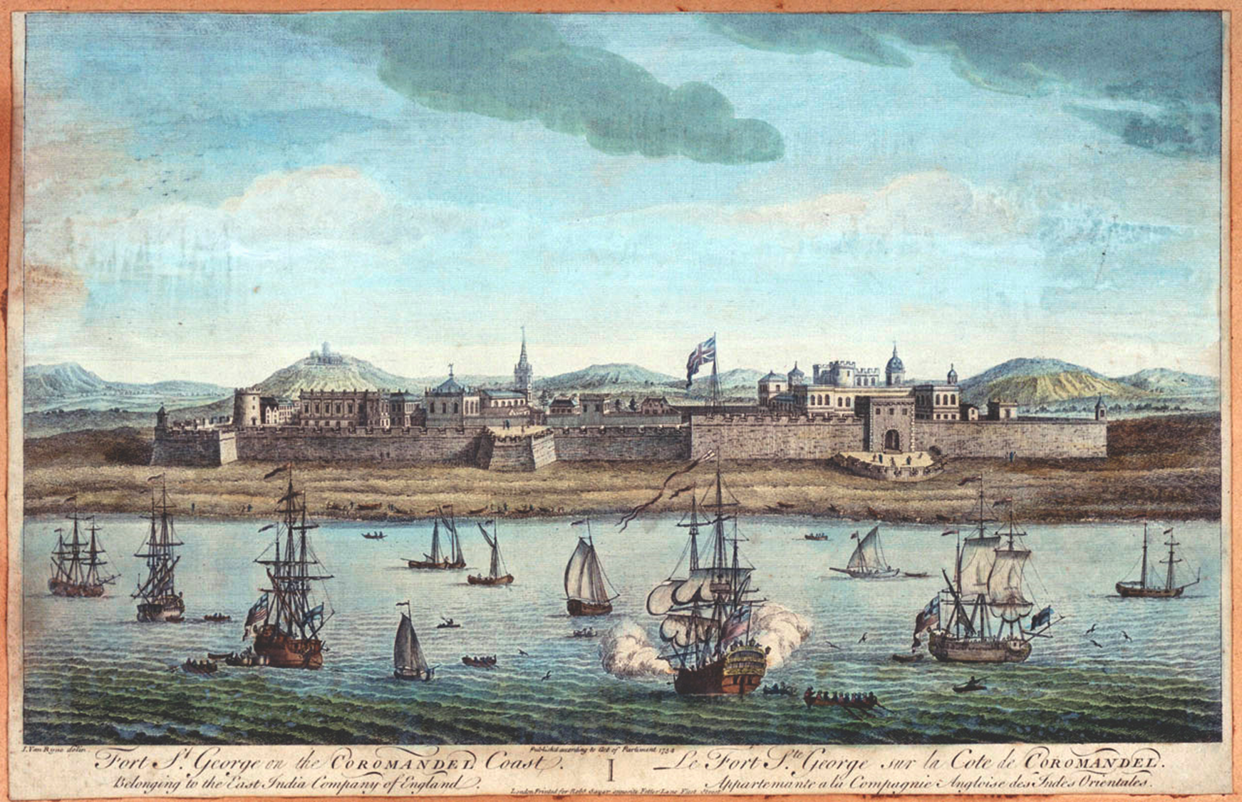
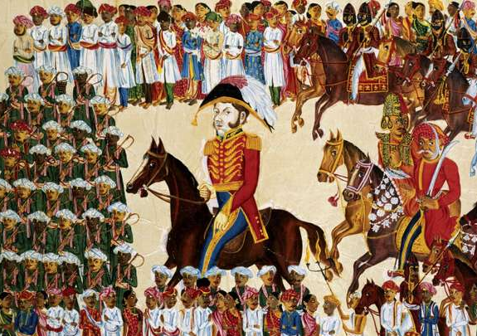
The East India Company
From traders…
In 1600, Queen Elizabeth I established the British East India Company to trade with the Mughal Empire in Asian spices, cotton, silk, indigo and salt.
The East India Company was owned by British merchants and aristocrats rather than being a government project
In the 1700s, the company then began developing its own military force to compete against other colonising empires and the declining Mughal Empire.
The use of military force helped the British East India Company establish a trade monopoly in India.
To colonisers.
Notes:
In 1600, Queen Elizabeth I established the British East India Company (EIC) to trade in Asian spices, cotton, silk, indigo and salt. For a long time, the EIC was formally subordinate to the Mughal emperor, and depended on indigenous traders and local rulers. At first, the EIC concentrated on spices, but later moved into the subcontinent to buy textiles. At this point the Mughal Empire was fracturing, making it easier for colonisers to take advantage.
During the 17th century, India’s cotton industry was at its height, and the EIC wanted India’s fine silks and cotton cloth.
The company developed its own military force to compete against declining Mughal power, and against the French for a trade monopoly in India.

Slide 7
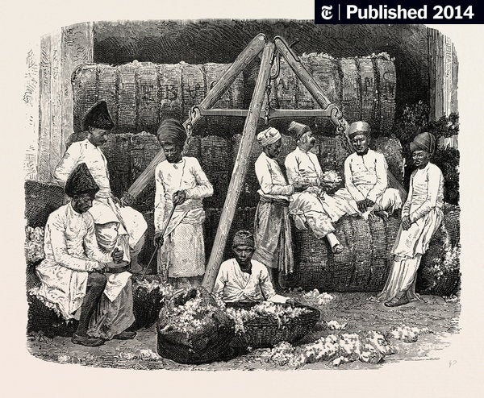
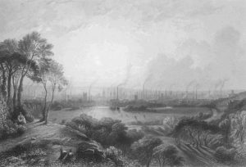
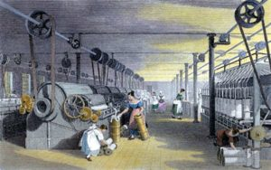
The East India Company and cotton
Through the 17th century India’s cotton industry was at its height, with large quantities of cloth being exported around the world.
The Industrial Revolution later in the 18th century, however, meant Britain could produce cotton cloth on a large scale. With British conquest, India was forced to grow raw cotton and buy finished cotton goods from Britain.
Indian weavers became impoverished. Exports of British textiles to India soared, with a billion yards per year entering India from 1870. By 1896 India produced only 8% of the cloth consumed domestically.
Clockwise: Cotton Production India, Manchester 1840, A Lancashire mill, circa 1835.
Notes:
Through the 17th century, increasing importation of high-quality cotton goods from India became a threat to textile producers in England. Britain responded by banning the import of Indian textiles, but not the import of raw cotton. By the late 18th century, Britain’s industrial revolution had taken off, and its control in India, through the EIC, was increasing. Through taxation and intimidation, Britain undermined India’s textile industry and pressured Indian farmers to grow raw cotton to be exported to Britain, woven into fabric in British mills, and then sold back to India at high cost. This was extremely profitable for Britain, but destroyed a major source of India’s wealth, causing the impoverishment of many Indian weavers. According to economists, Britain took £45 trillion from India between 1765 and 1938.

Slide 8
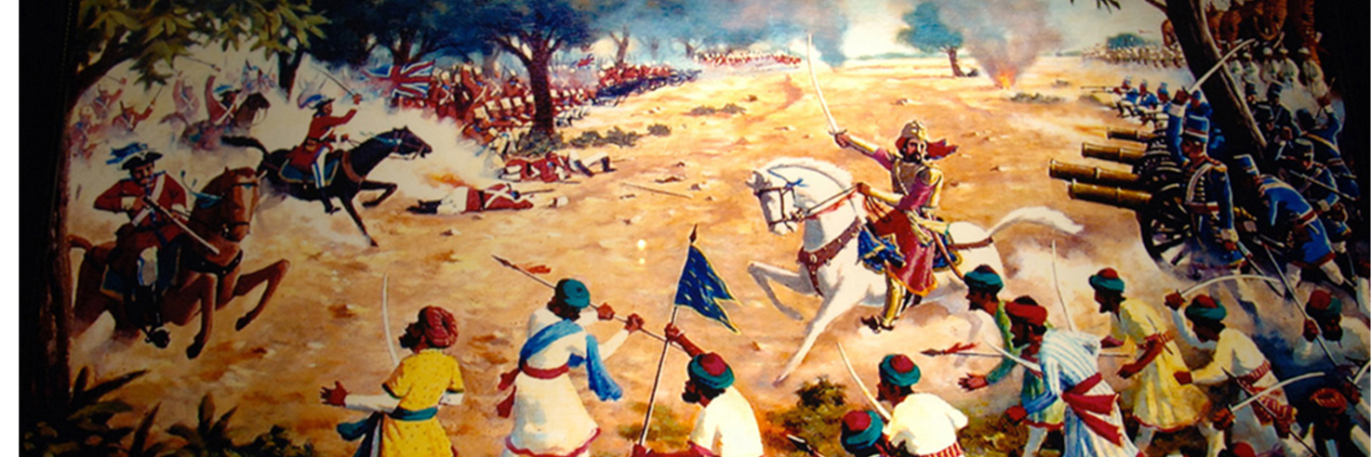
Battle of Plassey, 1757
The Battle of Plassey was a pivotal battle where the Nawab (rebels from the Bengali community) led a rebellion on Fort Williams to stop the expansion of British control
Due to the defecting of an Indian General, the British led by Robert Clive defeated the insurgence and came to dominate Bengal, one of the wealthiest regions in India. Much of Bengal’s wealth was looted and taken to Britain.
This battle also saw the company transform from a trading company to a hungry colonial power.
Notes:
The Battle of Plassey was a pivotal battle for control of the subcontinent. In 1757, the EIC prepared to battle with the ruling Nawab of Bengal, Siraj-ud-Daulah, in Plassey, about 150km north of Calcutta. The British had a fort (Fort William) in Calcutta, which they were attempting to extend against the orders of the Nawab. The Nawab responded by attacking Calcutta and holding prisoners in the fort. The British sent backup under Robert Clive, who bribed the Nawab’s commander-in-chief, Mir Jafar Ali Khan, with the promise of being made the next Nawab of Bengal. Mir Jafar took the bribe and refused to fight on the side of Siraj-ud-Daulah, who fled. Clive was then able to recapture Calcutta.
Mir Jafar’s betrayal allowed Robert Clive and the EIC to defeat Siraj-ud-Daulah at the Battle of Plassey. The British then came to dominate Bengal, one of the wealthiest regions in the world. Much of Bengal’s wealth was looted after the defeat of Siraj and sent to England.

Slide 9
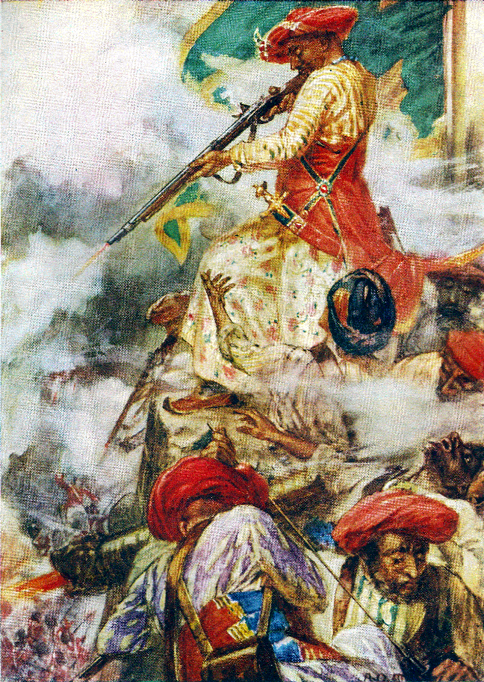
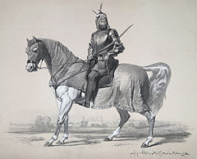
Indian resistance continued 1757 -1858
Over the next 85 years, the East India Company colonised and plundered Mysore, the Maratha Confederacy and the Sikh kingdom of the Punjab.
These wars were accompanied by racist attitudes towards Indian people. For example, during the Battle of Gujerat in 1849, the British slaughtered the Sikh opposition for sport.
Tipu Sultan confronts his opponents during the Siege of Srirangapatna.
Raja Lal Singh, who led Sikh forces against the British during the First Anglo-Sikh War, 1846
Notes:
After the Battle of Plassey, the EIC went on to defeat the French (at Pondicherry in 1761) and then an alliance of Mughal forces and the Nawab of Bengal (at the Battle of Buxar in 1764) after which it took over the collection of Mughal taxes. It was transformed from a trading company to a hungry colonial power. Long, drawn-out wars, often with successful Indian resistance, were fought against the Sultans of Mysore and the Maratha Confederacy of Hindu Princes. Later, wars against the Sikh kingdom resulted in the annexation of the Punjab (in 1849.) In this way the EIC colonised and plundered India over the course of less than 100 years.
These wars were accompanied by racist attitudes. For example, in the Battle of Gujerat in 1849, the British slaughtered the Sikh opposition for sport.

Slide 10
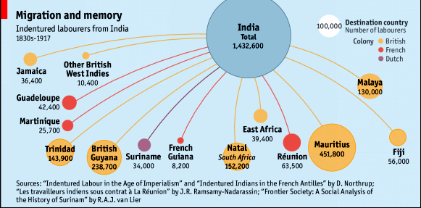
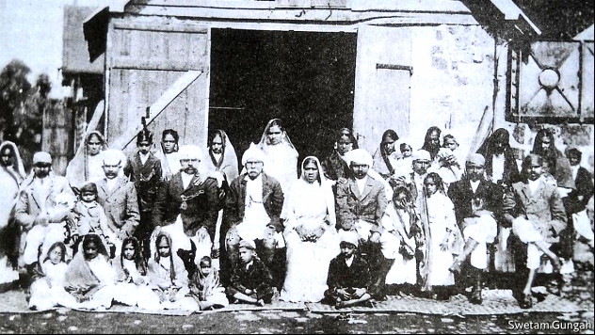
Indentured Labourers 1833 - 1917
Numerous revolts by enslaved people in the Caribbean pressured Britain to abolish slavery in 1833.
This led to a labour shortage on the sugar plantations there, and in colonies elsewhere. Labourers were recruited from India, presented with a ‘debt bondage’, now indebted to the British for passage to another colony.
These people were contractually required to repay the debt and this method continued the supply of labour to the Caribbean and other British colonies.
Notes:
Britain formally abolished slavery in 1833. This led to a labour shortage on sugar plantations in the Caribbean, and in colonies elsewhere. Widespread poverty in India due to the undermining of the textile industry meant that many Indians were desperate for work. The British established a system of ‘debt bondage.’ This meant that labourers would be provided their passage to another colony, but that this would create a debt that they were obliged to repay by working on the sugar plantations. Under this scheme, two million Indians were sent to the Caribbean. This is why there are significant populations of Indian heritage in these countries today.

Slide 11
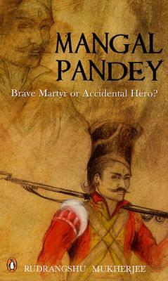
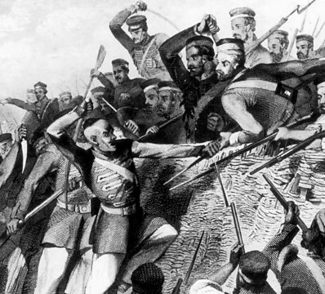
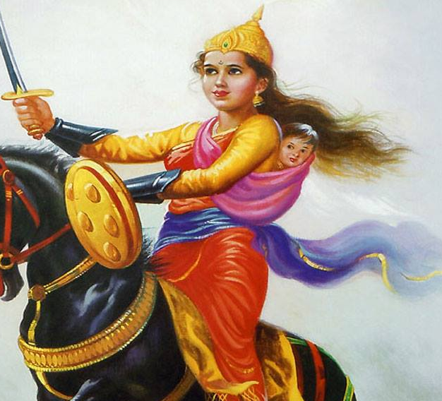
The revolt of 1857
In May 1857, Indian soldiers in Delhi revolted against the East India Company.
Although large parts of the Northwest were captured, the revolt was suppressed.
Tens of thousands of suspected rebels were murdered in the aftermath in a bloody unleashing of revenge. This is also known as the first war of independence.
In response to this revolt, the British government took over control of India from the East India Company, which it abolished and official British colonial rule in India began.
Mangal Pandey and Rani Lakshmi Bai (Queen of Jhansi) are both symbols of resistance to British Colonial rule.
Notes:
In May 1857, some Indian soldiers of the EIC mutinied at Meerut, near Delhi. This sparked other mutinies and civilian rebellions as part of a patriotic revolt against British oppression.
The rebels were resentful of British social reforms and harsh land taxes and were sceptical about so-called improvements brought about by British rule. Although the rebels captured large parts of the Northwest provinces and Oudh (Awadh), the EIC retook Kanpur and Delhi and repressed the rebellion. Tens of thousands of suspected rebels were murdered in the aftermath in a bloody unleashing of revenge.
The revolt is significant in marking the beginning of the Indian independence movement. As a consequence of the revolt, the British government took over the running of the country from the EIC, and reorganised the army, financial systems and administration. Although Indians were promised some British subject rights, many of these were ignored.
In 1885, the Indian National Congress was founded and was to be at the helm of the Indian independence movement.

Slide 12
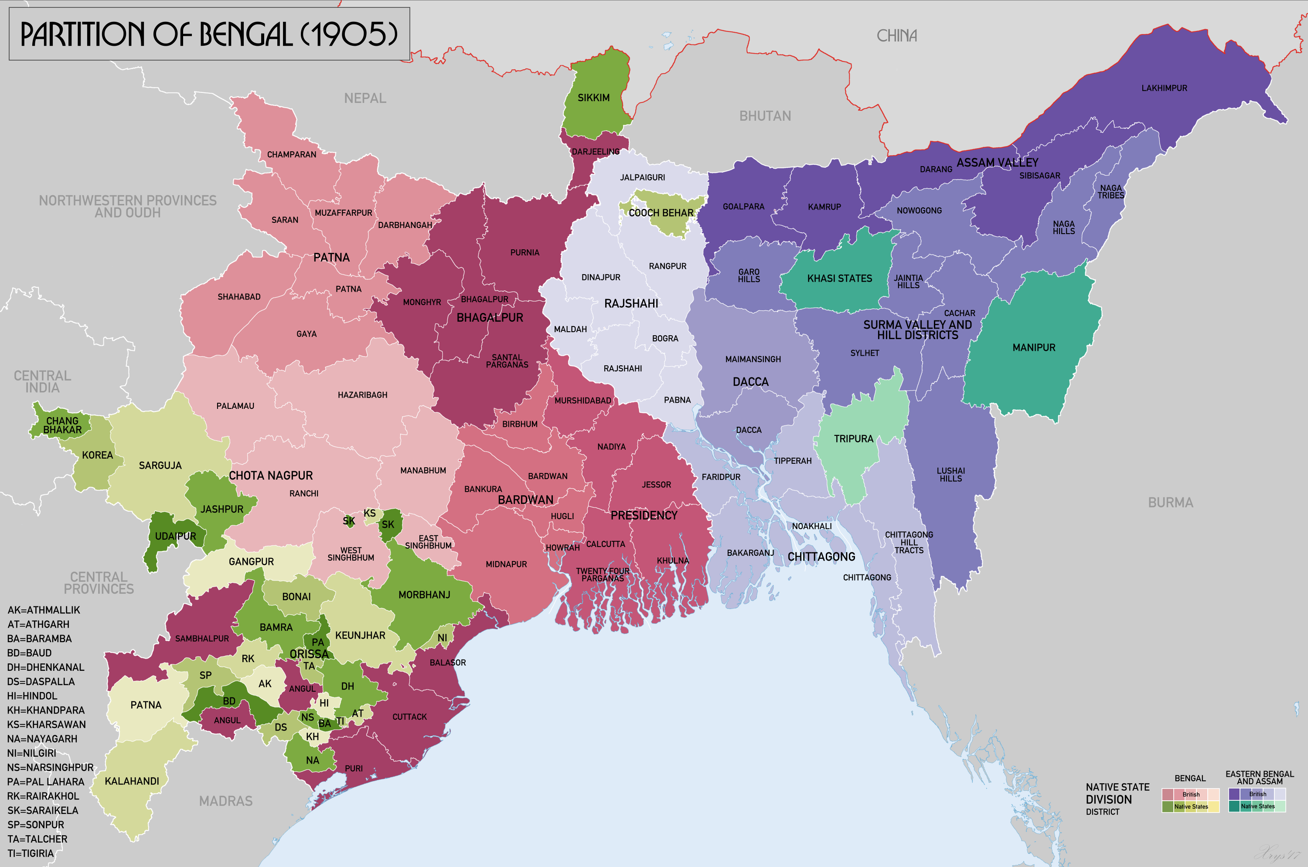
British rule in India
The British Empire continued to reap wealth from India during its direct rule.
Railways were built to facilitate the trading of textiles and to aid military control. Many Indians died constructing railways due to poor working conditions.
‘Divide and Rule’
India is made up of many religious and ethnic communities who fought together in the 1857 revolt. Britain knew that they had to divide this united front if they wanted to retain control, which led to the ‘divide and rule’ strategy.
In 1905, Lord Curzon divided Bengal and many Hindu and Muslims communities with the aim of undermining unity and cooperation that could threaten their rule.
Notes:
The British Empire continued to reap wealth from India during its direct rule. The princely states were ruled indirectly, and native princes were co-opted as part of British rule. British rule was managed by a British-dominated civil service, which used English as its language of administration, and a huge army. By training Indians as civil servants to help run the country, the British created an educated class which eventually provided the bedrock of Indian nationalism.
Railways were built to facilitate the trading of textiles and to aid military control. The British were indifferent to the welfare of Indian railway construction workers and so many died. Britain made India buy British trains using Indian money, even though Indian engineers already had designs for trains. Altogether the railways made British investors massive sums of money at the expense of Indian taxpayers who paid for them to be built.
Throughout Mughal rule, the different religious communities in India (Hindu, Muslim, Sikh, Buddhist, Christian, Jews, Zoroastrian, Jains and others) had largely lived in harmony, and so were accustomed to co-operating. During the revolt of 1857, they were united by their resentment of British rule. In the aftermath of the revolt, the British realised that if they were to maintain power in India, they would have to divide this united front. The British therefore began to implement a policy called ‘divide and rule,’ whereby they attempted to position Hindus, Muslims and Sikhs against each other. In opposition to this, a nationalist movement developed, based on the belief that being Indian was what united people more than their religion.
In 1905, the British organised the Partition of Bengal into a Muslim east and a Hindu west. Their aim was to impose a religious divide on the province (as part of the ‘divide and rule’ strategy) which until then had been strongly united by Bengali nationalist sentiment. This partition only lasted for a few years due to pressure from Bengali nationalists. In consequence, the Indian National Congress became a nationwide mass movement, the All-India Muslim League was formed and the ‘Swadeshi’ movement to boycott British textiles gained momentum.

Slide 13
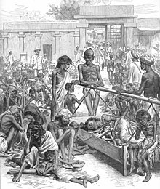
Famines
Indian agriculture was affected by colonial pressures to grow cash crops, especially cotton to supply Britain’s industry as well as opium for trade with China. Established systems to deal with food shortages were undermined.
During the British occupation there were several famines in Bengal (in 1770, 1873, 1876 and 1943).
Overall, it is thought some 30 million Indians starved to death during British rule, a large proportion during the late 19th century.
These tragedies encouraged support for Indian nationalism.
Notes:
Britain put pressure on India to grow cash crops which undermined indigenous systems to deal with food shortages. During the British occupation there were several famines in Bengal, some caused not by shortage but by poor allocation of food. When, in response to a famine in 1873, the Governor of Bengal, Sir Richard Temple, orchestrated a relief effort saving many lives, he was criticised by British officials for its cost. In the subsequent famine of 1876-78 in Bombay (Mumbai) Temple curtailed relief funding, leading to excessive mortality.
Overall, some 30 million Indians starved to death during British rule. These tragedies encouraged support for Indian nationalism.

Slide 14
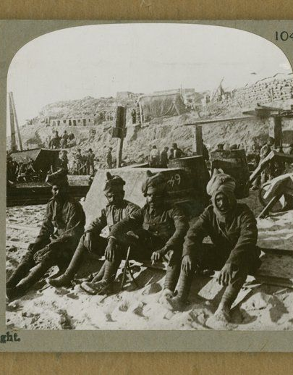
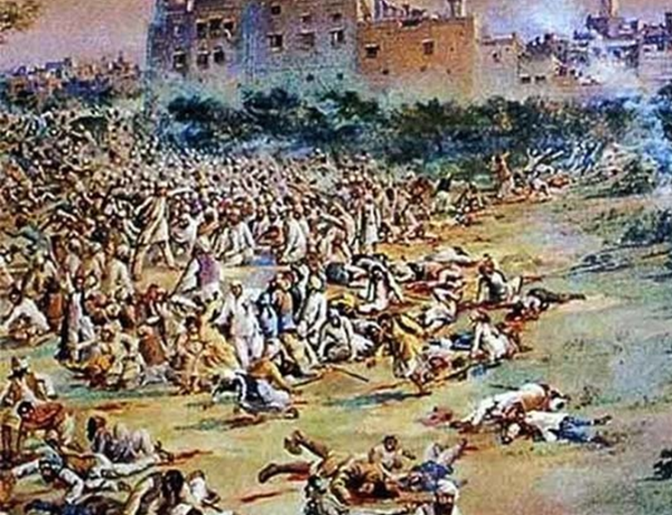
WW1
Britain could not have endured the First World War without the incredible scale of recruitment from the colonies, in particular from India.
1.5 million Indian soldiers fought for Britain, with many key nationalist leaders such as Gandhi as they believed that this would give Indians greater political freedoms.
Around 90,000 Indians died fighting in Europe, the Middle East and German East Africa.
The war almost bankrupted India. Most Indians experienced more miserable living standards with heavy taxes and their grain exported to Britain.
Jallianwala Bagh Massacre, 1919
Many Indians came back from the war and the British had reneged on their promises of freedoms and independence which led to mass protests. On 13th April 1919, without warning, General Dyer ordered soldiers to open fire on an unarmed peaceful protest within a walled garden massacring over 1000 people and injuring many more.
This horrific attack instigated the Non-Cooperation Movement of 1920 - 22, a significant step towards the end of British rule.
Notes:
One and a half million Indians were recruited in World War One and about 90,000 died fighting in Europe, the Middle East and German East Africa. The war almost bankrupted India. Most Indians experienced more miserable living standards, heavy taxes, and food shortages because their grain was exported to Britain.
The British were aware of the growing opposition to their control over India, and so they tried to curtail revolutionary activities through the Defence of India Act in 1915, which gave the authorities the power to imprison people without trial.
Indian leaders largely supported the war, expecting independence in return. Britain had no intention of fulfilling this expectation.
https://www.theguardian.com/world/2018/oct/27/armistice-centenary-indian-troops-testimony-sacrifice-british-library
On 13th April 1919, during the Hindu and Sikh festival of Vaisakhi, celebrations took place in a big garden in the city of Amritsar called Jallianwala Bagh. The peaceful gathering was also to protest the arrest and deportation of two independence activists, Saifuddin Kichlu and Satyapal. Brigadier-General Dyer ordered the British-Indian army to open fire on the unarmed crowd in the garden, killing 1000 people. The brutality of this event sent shock waves across India, leading to the Non-Cooperation Movement.

Slide 15
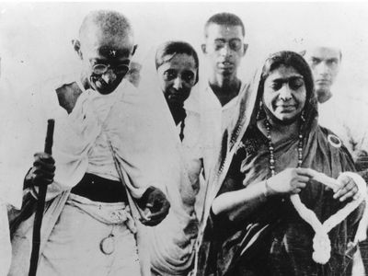
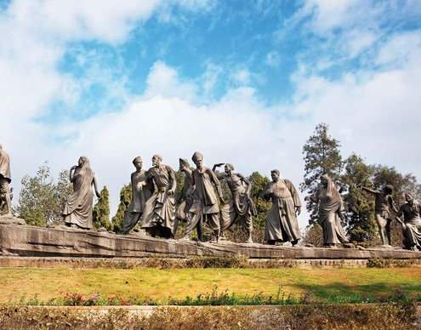
Satyagraha/Salt Marches and resistance
A series of taxes in 1882 prohibited Indians from producing or selling their own salt and they were required to buy expensive, heavily taxed and often imported salt.
Gandhi began a large demonstration against the salt tax by marching through Gujrat, setting out on March 12, 1930. On 6th April many picked up handfuls of salt along the shore, breaking the law as they were ‘producing’ salt.
More actions like this took place with thousands arrested, including Nehru (future PM) and Gandhi himself.
By the end of 1930 over 60,000 were in jail due to these protests. Eventually the Gandhi-Irwin Pact was signed as a truce in 1931.
Notes:
1930, the Indian National Congress tasked Gandhi with organising a campaign of civil disobedience, aiming to achieve Independence from Britain. In March 1930, Gandhi and 79 trusted volunteers marched from Ahmedabad, Gujarat, to the coastal town of Dandi, to protest the British salt monopoly and the salt tax. On the last day of the march, Gandhi broke the salt laws by collecting natural salt deposits, for which he was arrested in May 1930. Gandhi encouraged millions of Indians to also disobey British laws. The wider movement against the salt tax continued for a year and thousands of non-violent protesters were beaten and jailed. Eventually a truce was agreed, and Gandhi was released in 1931. Gandhi continued to encourage the boycott of British goods throughout the 1930s.
https://youtu.be/xCKGmIBxwYw

Slide 16
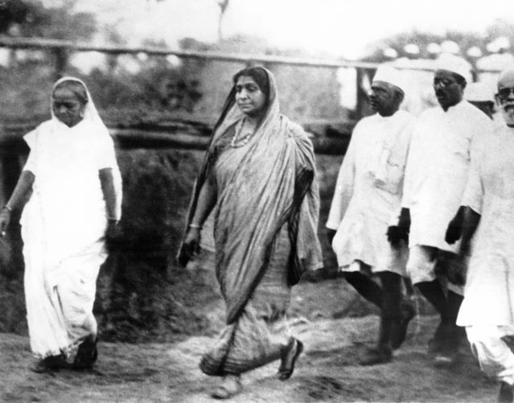
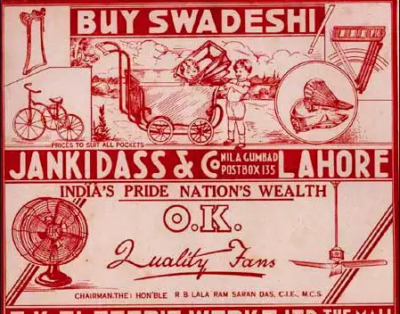
Non-cooperation movement 1920 - 1922
After the Jallianwala Bagh massacre, Gandhi (a member of the Indian National Congress) helped launch a movement known as ‘satyagraha,’ meaning ‘truth force.’
As part of satyagraha, Indians refused to do work that supported the British government and economy. He persuaded Indians to only buy Indian goods and throw away their English clothes.
Gandhi wanted the movement to be non-violent, and so, after violent clashes between protestors and the police in the village of Chauri Chaura in 1922, he called it off.
After this collective action, the Indian National Congress led a mass national movement, encompassing millions of people of all social classes and background.
Notes:
Mohandas (Mahatma) Gandhi was a member of the Indian National Congress, and he launched a movement known as ‘satyagraha,’ meaning ‘truth force.’ As part of satyagraha, Indians refused to do work that supported the British government and economy. He persuaded Indians to only buy Indian goods and throw away their English clothes. Gandhi wanted the movement to be non-violent, and so, when protesters clashed with police and some people died, he shut it down. Nonetheless, the Indian National Congress now led a mass national movement, encompassing millions of people of all social classes and backgrounds.

Slide 17
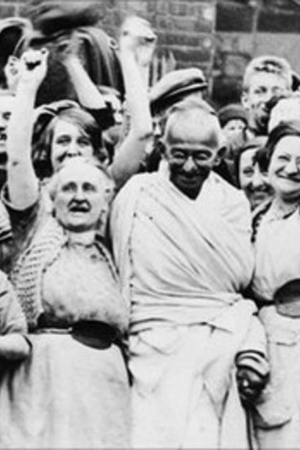
Gandhi in Lancashire
As Indian nationalist sentiment continued to grow, Gandhi took the lead in raising awareness of the issue with cotton production.
In September 1931, Gandhi visited the cotton mills in Lancashire to talk to mill workers, who wanted him to see the effect the Indian movement for independence was having on their work.
Gandhi wanted to tell them about the impact the cotton laws and industry were having on the Indian people. He was welcomed by the workers even though their agendas differed.
Notes:
As Indian nationalist sentiment continued to grow, Gandhi took the lead in raising awareness of the issue with British cotton workers. In 1931, Gandhi visited the cotton mills in Lancashire to talk to mill workers, who were being negatively impacted by India’s movement to reclaim its textile industry. Gandhi wanted to explain how important this movement was to resolving poverty in India. He was welcomed by the workers with understanding, even though their agendas differed.

Slide 18
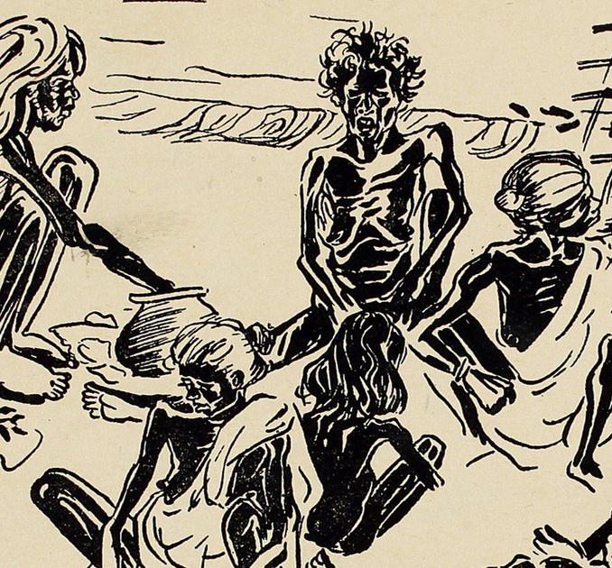
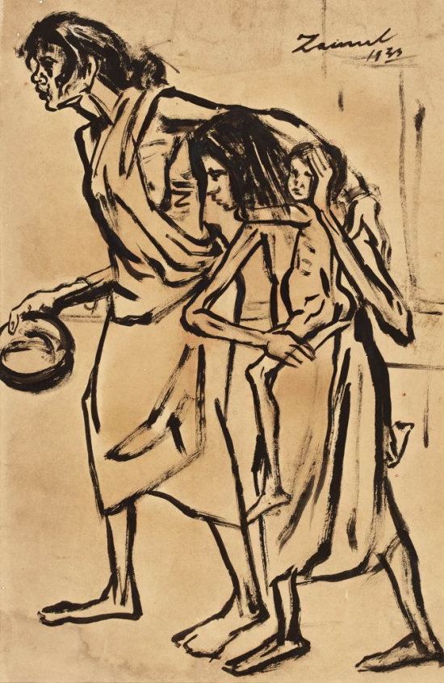
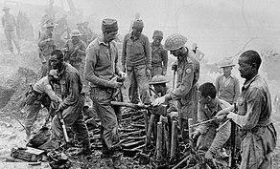
WW2
Bengal Famine, 1943
This famine was caused by policy failure and unjust allocation rather than food shortages. Winston Churchill diverted produce for British soldiers. It is estimated over 3 million people died during this period
In 1939, India was signed into WW2 with no consultation with Indian leaders.
India contributed the largest number of soldiers to British Imperial forces, the biggest volunteer force in history of around 2.5 million men by 1945
87,000 Indians lost their lives, 34,000 were wounded and 67,000 became prisoners of war.
While Indians were fighting for democracy abroad, members of their own democratically elected Congress Party were locked up in prison back home.
Paintings by Zainul Abedin and Chittaprosad.
Notes:
One and a half million Indians were recruited in World War One and about 90,000 died fighting in Europe, the Middle East and German East Africa. The war almost bankrupted India. Most Indians experienced more miserable living standards, heavy taxes, and food shortages because their grain was exported to Britain.
The British were aware of the growing opposition to their control over India, and so they tried to curtail revolutionary activities through the Defence of India Act in 1915, which gave the authorities the power to imprison people without trial.
Indian leaders largely supported the war, expecting independence in return. Britain had no intention of fulfilling this expectation.
During World War Two, a famine in Bengal killed 2-3 million people. This famine was created and exacerbated by colonial policies. Some of these were: destroying rice crops in Burma (Myanmar) (that Bengal had come to depend on) to deny food to the invading Japanese, prioritizing food allocation to civil servants and the armed forces and so depriving ordinary citizens of the depleted food supply and failing to provide good healthcare, meaning that over half of the famine-related deaths in 1944 were caused by disease and unsanitary conditions.
https://www.theguardian.com/world/2018/oct/27/armistice-centenary-indian-troops-testimony-sacrifice-british-library
On 13th April 1919, during the Hindu and Sikh festival of Vaisakhi, celebrations took place in a big garden in the city of Amritsar called Jallianwala Bagh. The peaceful gathering was also to protest the arrest and deportation of two independence activists, Saifuddin Kichlu and Satyapal. Brigadier-General Dyer ordered the British-Indian army to open fire on the unarmed crowd in the garden, killing 1000 people. The brutality of this event sent shock waves across India, leading to the Non-Cooperation Movement.

Slide 19
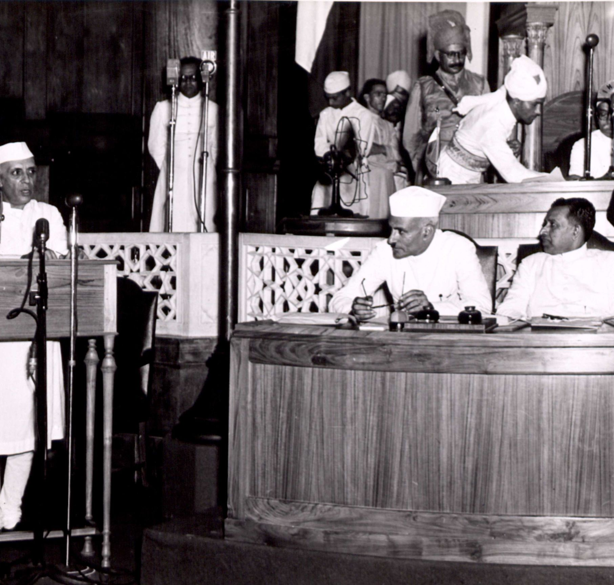
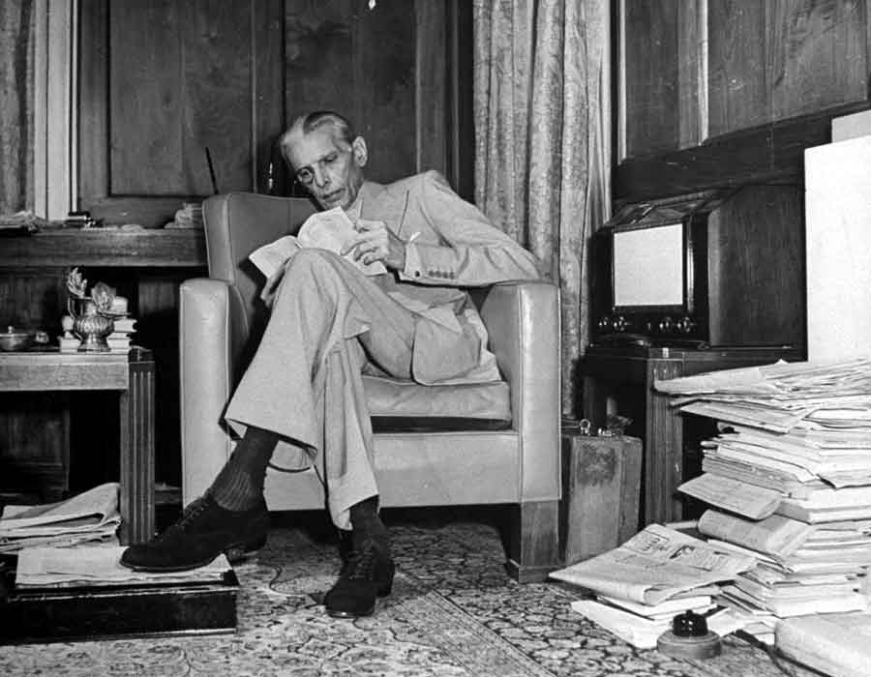
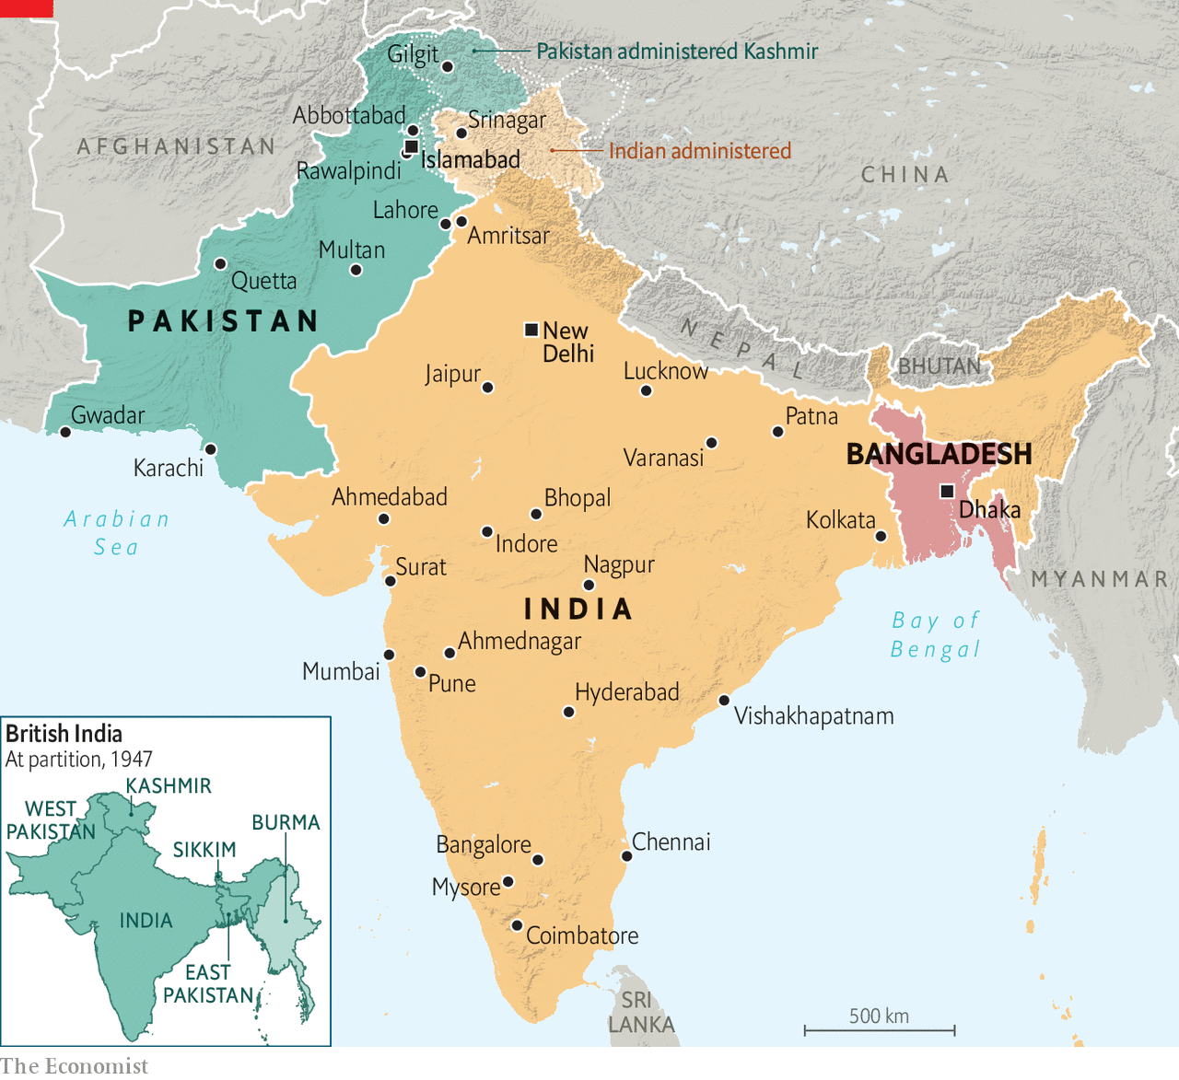
Independence 1947
During World War II, the Indian National Congress led the Quit India Movement – a campaign demanding immediate British exit. In this the people of India were united, wanting freedom from British rule.
There was some conflict among India’s leadership, mainly on religious and ethnic lines. These divisions had been stoked from the ‘divide and rule’ policy implemented by Britain.
The vision for independence was of a democratic, self-reliant, secular India.
Independence was finally achieved on 15th August 1947
Notes:
During WW2, the Indian National Congress led a movement called the Quit India Movement. This was a campaign demanding immediate British exit from India. There were widespread demonstrations during the war, to which Britain responded by authorising the RAF to kill several thousand protesters. This only strengthened the Independence movement.
There was, however, some conflict among India’s leadership. While the Indian National Congress wanted an independent, multi-ethnic united India, the Muslim League, under Jinnah, was concerned for the rights of the Muslim minority and wanted separate autonomy for states that had Muslim majorities. This was not a demand for the partition of the country, but a desire to have a protected place for the Muslim minority.
Independence was finally accomplished on 15th August 1947. This was due to the strength and stamina of India’s struggle for freedom from British colonial violence, and to the strategy of non-violent non-cooperation. The vision for Independence was of a democratic, self-reliant, secular India.
https://www.newyorker.com/magazine/2015/06/29/the-great-divide-books-dalrymple

Slide 20
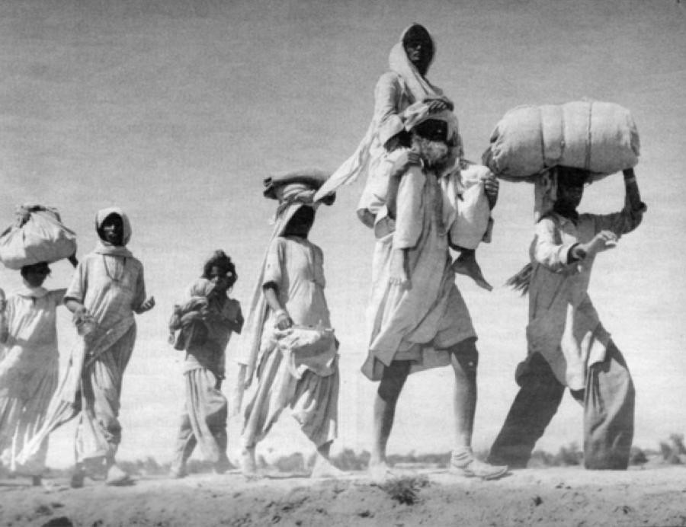
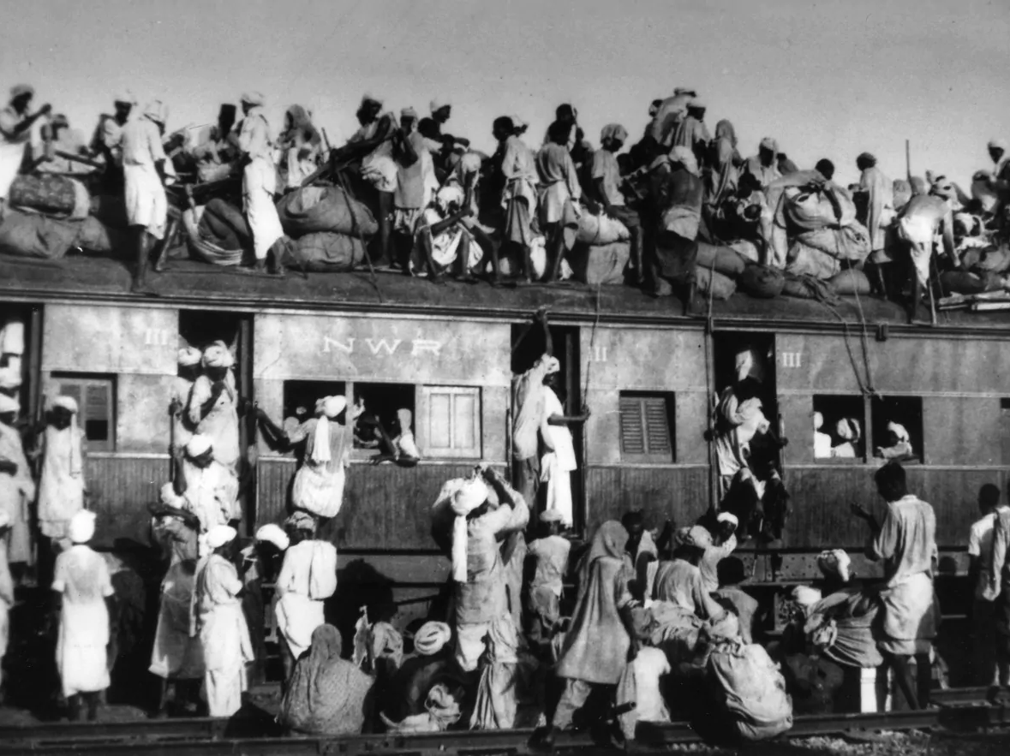
Partition 1947
Cyril Radcliffe, having never lived in India himself, created border lines splitting the regions of Punjab and Bengal, and a divided nation was created.
The whole process was tragically mis-managed leading to mass migration and atrocities with 6 million Muslims fleeing to Pakistan and 4 and ½ million Hindus and Sikhs going to India.
About 15 million people were displaced by the partition and communal violence, resulting in about 2 million deaths as the refugees attempted to move to their allocated lands on both sides of the new borders.
The impacts of partition is still felt today across families and communities in South Asia and around the world
Notes:
Britain’s divide and rule policy had left its mark on Indian politics and influenced tension between Hindus and Muslims surrounding partition. The Muslim League demanded an independent Pakistan, and Britain tasked Cyril Radcliffe, who had never lived in India before, with drawing the borders between India and Pakistan. The border lines cut through the middle of large regions including Bengal and the Punjab, which had regional languages, cultures and traditions. Pakistan was created in two parts, East and West, separated by over a thousand miles. Even Jinnah was not happy with the partition, as it did not achieve his goal of protecting all Muslims.
The speed of the transition and the failure of the British to provide sufficient security resulted in a huge tragedy. About 15 million people were displaced by the partition, and roughly 2 million dies in communal violence as they were forced to move to their allocated lands on both sides of the new borders. This violence had been building for months before partition, stoked by the legacy of British policy of divide and rule.
https://www.bbc.co.uk/news/resources/idt-sh/partition_how_it_affected_me

Slide 21
Perspectives on the legacy of partition I
Raza Karim, International Lawyer and activist, Lahore, Pakistan
On Partition he says there were ‘delusions that Pakistan would be a brand new place, completely different from the experience of colonial India’ … ‘What we confronted was a huge vacuum, a human vacuum, an economic vacuum, a vacuum of governance as well, and that we had to grapple and muddle through somehow.’
Sarah Ansari, Professor of History at Royal Holloway
The communal violence was a product of how Britain had ruled India for decades, in the process of ruling India they needed to have allies to work with which created divisions and tensions. They also deliberately compartmentalised Indian society, accentuating differences, which directly contributed to suspicions and violence.
Gurharpal Singh, Professor of Sikh and Punjab Studies, SOAS
Comments on the challenges for the administrations that came after 1947: ‘Challenges were different in the two states, of course Pakistan did not exist and had to be created out of virtually nothing and the administrative structure there was very weak… and India had much more resources and much more experience in dealing with the situation. The relative experience of the immediate impact of partition was very different.’ He says the catastrophic events have shaped the history of both countries and are very much embedded in the national discourse of both.
Hear some of the people affected by partition tell their stories here.
Notes:
The legacy of partition for many was the loss of family, community, home and work, as well as the immense trauma they experienced throughout this period of massive violence. Many families and communities are still dealing with this trauma today. Many of those fleeing their homes ended up living in refugee camps for long periods of time and were never reunited with members of their family from whom they were separated.
Business School's Lakshmi Iyer did a formal study on the colonial legacy in India and found it lacking. From the abstract as gathered by Foreign Policy's Joshua Keating: "Controlling for selective annexation using a specific policy rule, I find that areas that experienced direct [British] rule have significantly lower levels of access to schools, health centers, and roads in the postcolonial period. I find evidence that the quality of governance in the colonial period has a significant and persistent [and often negative] effect on postcolonial outcomes."

Slide 22
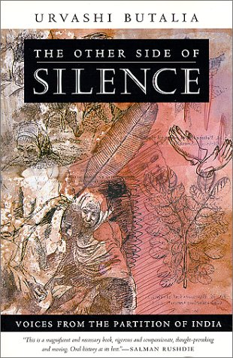
Perspectives on the legacy of partition II
On speaking to people and observing the events after violence erupted between Hindus and Sikhs when Indira Gandhi was assassinated:
“I began to realize that Partition was not, even in my family, a closed chapter of history—that its simple, brutal political geography infused and divided us still. The divisions were there in everyday life… “
“It took the events of 1984 to make me understand how ever-present Partition was in our lives, too, to recognize that it could not so easily be put away inside the covers of history books. I could no longer pretend that this was a history that belonged to another time, to someone else.”
“If I was reading them right, it would seem that Partition was now over, done with, a thing of the past. Yet, all around us there was a different reality: partitions everywhere, communal tension, religious fundamentalism, continuing divisions on the basis of religion.”
Urvashi Butalia in The Other Side of Silence
Notes:
https://archive.nytimes.com/www.nytimes.com/books/first/b/butalia-silence.html?simple=True
‘If I was reading them right, it would seem that Partition was now over, done with, a thing of the past. Yet, all around us there was a different reality: partitions everywhere, communal tension, religious fundamentalism, continuing divisions on the basis of religion. In Delhi, Sikhs became targets of communal attacks in 1984; in Bhagalpur in Bihar, hundreds of Muslims were killed in one of India's worst communal riots in 1989; a few years later, the Babri Mosque was destroyed in Ayodhya by frenzied Hindu communalists (supported, openly and brazenly, by political parties such as the Bhartiya Janata Party, the Rashtriya Swayamsevak Sangh, the Vishwa Hindu Parishad and the Shiv Sena), and later, thousands of Muslims were again targeted in Surat, Ahmedabad and Bombay. In each of these instances, Partition stories and memories were used selectively by the aggressors’

Slide 23

The legacy of Colonialism
The creation of separate states and Pakistan itself was a state split into two non-contiguous regions, West and East Pakistan.
Economic under-development: Dadabhai Naoroji, the first Indian to become a British M. P., promoted the ‘wealth drain theory’ that Britain systematically drained India of wealth over the period of colonialism
At independence, the adult literacy rate in India was barely 15%.
Recurrent famines killed millions: Life expectancy in India at the end of Empire was 32 years.
Multi-party democracy and a free press – but this was not experienced by the population during colonialism.
Religious and ethnic divisions as generated by colonial ‘divide and rule’ policy that are still tense today
Notes:
One legacy of British Colonialism was the creation of the separate states of India and Pakistan. India’s struggle for independence fostered a secular democracy with a strong sense of Indian identity, which gained most of the subcontinent’s wealth. Pakistan was poorer, encompassed a variety of distinct identities and lacked the administrative experience that India inherited. Although Pakistan was founded as a separate state for Muslims it remained a Dominion in the British Commonwealth. In 1971 East Pakistan gained independence from Pakistan and became the People's Republic of Bangladesh.
Another colonial legacy was economic underdevelopment. Over the colonial period, Britain systematically drained India of wealth. When the East India Company began trading with India in the 17th century, India was a wealthy country; in 1600, India produced 22.5% of global GDP while Britain produced 1.8%. This was reversed during British colonial rule.
Healthcare, literacy and life expectancy were poor in India throughout British rule, due to the violent and neglectful policies of the British. For example, life expectancy in India by the end of British colonialism was only 32 years.
Two other significant colonial legacies are religious divisions generated by colonial policies that erupted during Partition, and the vast trauma caused by Partition and the violence used by the British against the population to maintain control.
A positive legacy resulting from Indian resistance to British colonialism was the development of a non-violent mass movement through the Indian National Congress, which mobilised opposition so successfully as to make India ungovernable as a colony. This both provided the foundation for the establishment of independent India as a secular democracy and set an extraordinary example internationally of non-violent direct action as an effective political strategy.
https://www.bbc.co.uk/sounds/play/b090wg29

