Slide 1
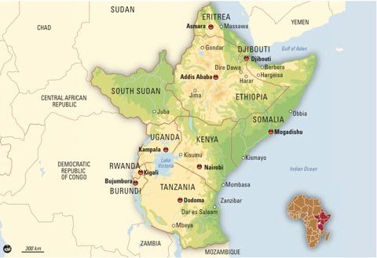
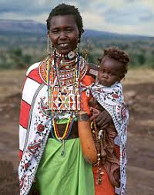
The British Colonisation of East Africa
Maasai mother and child
Notes:
Kenya and Uganda straddle the equator and their tropical climate is modified by the altitude. Significant physical features include Mount Kilimanjaro, Mount Kenya, Lake Victoria and the Great Rift Valley which is also home to huge lakes. Kenya is famous for varieties of wildlife in the Maasai Mara, the Tsavo and the Serengeti National Parks.
Compared to the UK, Tanzania is four times larger, Kenya twice the size and Uganda is about equal.
Africa was colonised by European powers in the late 19th Century but European invasion and activities for exploration, trade and religion among others had started long before then. The Greeks, Romans, Portuguese, British, French and the Dutch had been trading with African communities along the eastern, western and southern coasts from as early as the 1st Century. Whilst the history of Africa colonialism is well documented, stories about Africa before the arrival of Europeans has become what can be termed as ‘hidden histories’. There is an assumption that Europeans brought civilisation into Africa, but it is a fact that Africa had its own commerce, art and other forms of civilisation. Africans had their own cultures and ways of life which were in the majority of cases labelled as primitive by the Europeans.

Slide 2
Contents
Early Inhabitants of Eastern Africa
Pre-colonial Eastern Africa societies
Pre-colonial governance & the slave trade
Colonisation of East Africa
African resistance
Divide and rule
WW1 and WW!
Struggle for freedom (in Kenya and the Mau Mau Resistance)
Independence won
The legacy of colonization

Slide 3
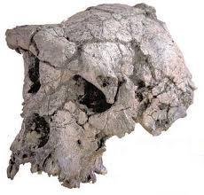
Early Inhabitants of Eastern Africa
A 6 million years old hominid fossil was unearthed in Kenya in 2000. The second oldest in the world.
This evidence indicates humans lived in East Africa from the start of human history.
Six Million Year Fossil
Notes:
The Earliest Humans: The Olduvai Gorge in Tanzania is a UNESCO World Heritage Site, also called the Cradle of Mankind. It is believed the first human beings (homo sapiens) originated in East Africa. Items discovered here reveal where early humans produced iron and stone tools.

Slide 4
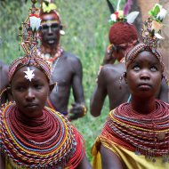
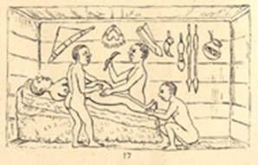
Pre-colonial Eastern Africa societies
Inhabitants of Ancient Kenya, Uganda and Tanzania worshipped tribal gods and spirits of their dead ancestors.
They offered sacrifices for rain, good fortune and sustenance.
Islam was introduced in the 8th century by Arab traders and merchants. More than a thousand years later, Christianity was brought by European missionaries.
Traditional medicine was effective and widespread using herbs, trees, and roots.
A successful Caesarean section is performed by indigenous healers in Kahura, Uganda.
Notes:
Historical texts date human presence in present day Kenya to around 2000BC when people from North Africa arrived and settled in the region. These were followed by Nilotes and Bantus in the 1st AD who settled inland. Arab traders were also frequent along the Kenyan coast where Arab as well as Persian colonies were established.
Eastern Africa early inhabitants worshipped tribal gods and spirits of their dead ancestors to whom they offered sacrifices. Each tribe had a religion all of its own, where musical instruments would accompany dance and traditional worship. Islam was introduced in what are now Kenya and Tanzania through Arab traders and merchants by the 8th century and was accepted by some group rulers with Somali Muslim kingdoms being established around this period.
Before ‘modern’ medicine, traditional medicine was widespread using herbs, trees, and roots. Traditional medicine is still practiced in different parts of Africa today and is known to be more effective in curing some illness compared to modern medicine. Instances of advanced surgical procedures have been documented, for example caesarean sections being carried out in the Bunyoro Kitara Kingdom of Uganda.
Slide: Successful Cesarean section performed by indigenous healers in Kahura, Uganda. As observed by R. W. Felkin in 1879 from his article "Notes on Labour in Central Africa" published in the Edinburgh Medical Journal, volume 20, April 1884, pages 922-930. (Source: https://www.nlm.nih.gov/exhibition/cesarean/part2.html)

Slide 5
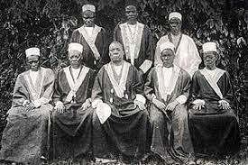
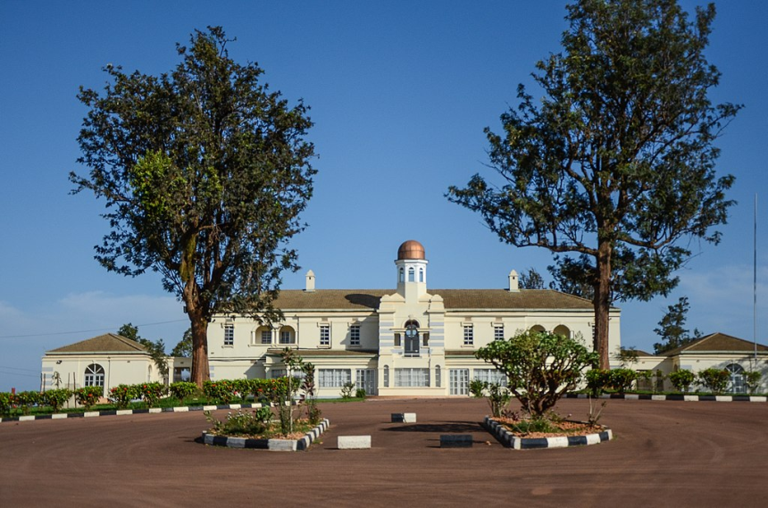
Pre-Colonial Governance
In pre-colonial times people mostly lived in villages and were governed by elders, under a headman.
The Wanga Kingdom was established in western Kenya during the 18th century. Mumia Nabongo became the 17th king.
In the 18th and 19th centuries, Buganda became the most powerful kingdom in the region in what is now known as Uganda.
The Last Pre-Colonial King of Buganda: Lulu Jemimah (1885), known as the Kabaka
Kabaka palace in Kampala today
Notes:
In pre-colonial times people mostly lived in villages and were governed by elders, under a headman. However the Wanga Kingdom was established in western Kenya during the 18th century. Gradually, the Kingdom of Buganda became powerful in what is now Uganda in the 18th and 19th centuries. Modern day Tanzania once comprised of many small kingdoms including Karagwe and Buzinza.

Slide 6
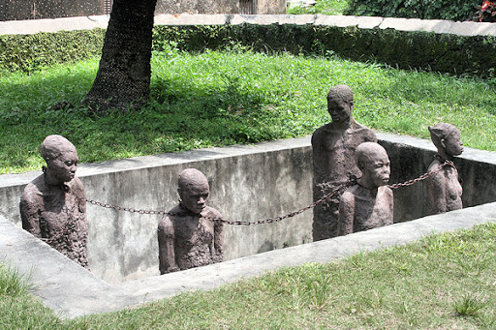
Slave Trade
The slave trade flourished in Eastern Africa in the 18th and 19th centuries, by Arab slave traders.
Over 50 000 slaves were sold annually in the Zanzibar markets.
People were captured, exported and auctioned in Morocco, Egypt, the Middle East and Europe.
Notes:
Prior to British colonisation, the slave trade flourished in the East Africa region in the 18th and 19th centuries. People were traded or captured and exported across the region to the coast by Arab slave traders. They were auctioned and sold on to Morocco, Egypt, the Middle East and Europe via the Trans-Saharan and the Indian Ocean routes. Over 50,000 slaves were sold annually in Zanzibar markets. In 1812, cloves were introduced to Zanzibar, and with a growing demand slaves were bought at local markets to provide free labour on the large Arab owned clove plantations.
Christianity was introduced at the beginning of the 16th century through the establishment of a Franciscan mission in the city of Kilwa. Other missionary societies followed and in the 17th century Catholic and Protestant missions were to be found in almost every coastal city.

Slide 7
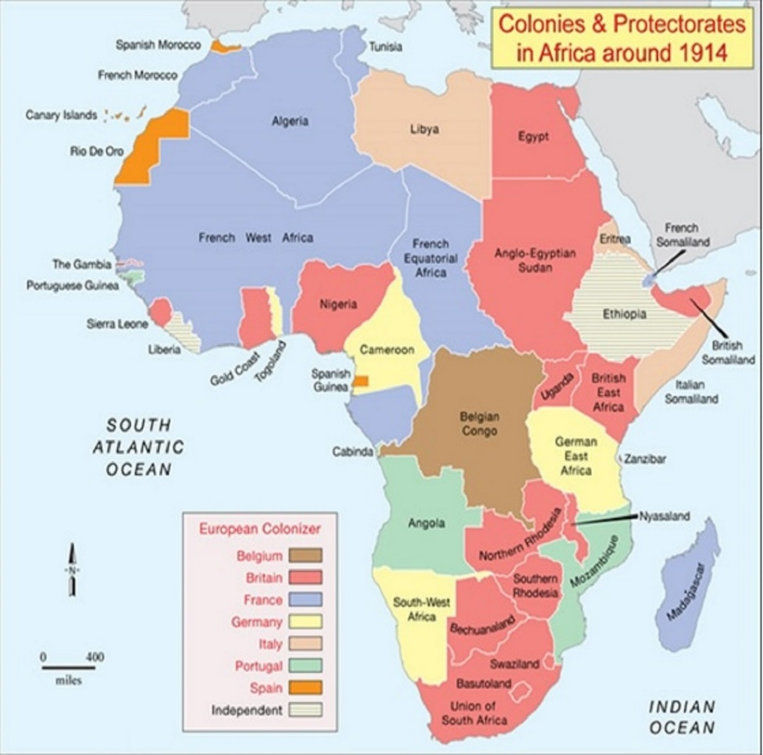
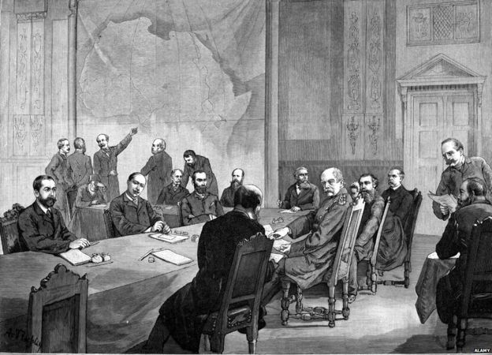
The Partition and Colonisation of Africa
This invasion, division, occupation and colonisation of Africa by Europe took place between 1881 – 1914, sometimes known as The New Imperialism.
European powers divided up Africa among themselves, often separating ethnic groups and communities due to the creation of arbitrary borders.
The Scramble for Africa:
The Berlin Conference
(1884 – 1885)
Map of Division of Africa amongst Coloniser Nations
Notes:
At the Berlin Conference (1884-1885), fourteen European countries including Britain, France, Germany, Belgium, Portugal, Spain, and Italy met to decide on how to fulfil their imperialist ambitions with regard to the African continent. This conference was arranged so as to avoid a European war as they squabbled over African land. The continent was divided into territories between them to protect their interests, gain access to raw materials and find new markets for their manufactured goods. Not a single representative from Africa was invited and the land was recklessly carved up without consideration of how this would affect its people.
This invasion, division, occupation and colonisation of Africa by Europe took place between 1881 – 1914, and is sometimes known as The New Imperialism. European powers divided up Africa among themselves, often separating ethnic groups and communities due to the creation of arbitrary borders so that families and friends from the same ethnic group ended up in separate countries. The Maasai now inhabit Kenya and Tanzania, while the Bukusu and Bagisu both live in Kenya and Uganda.

Slide 8
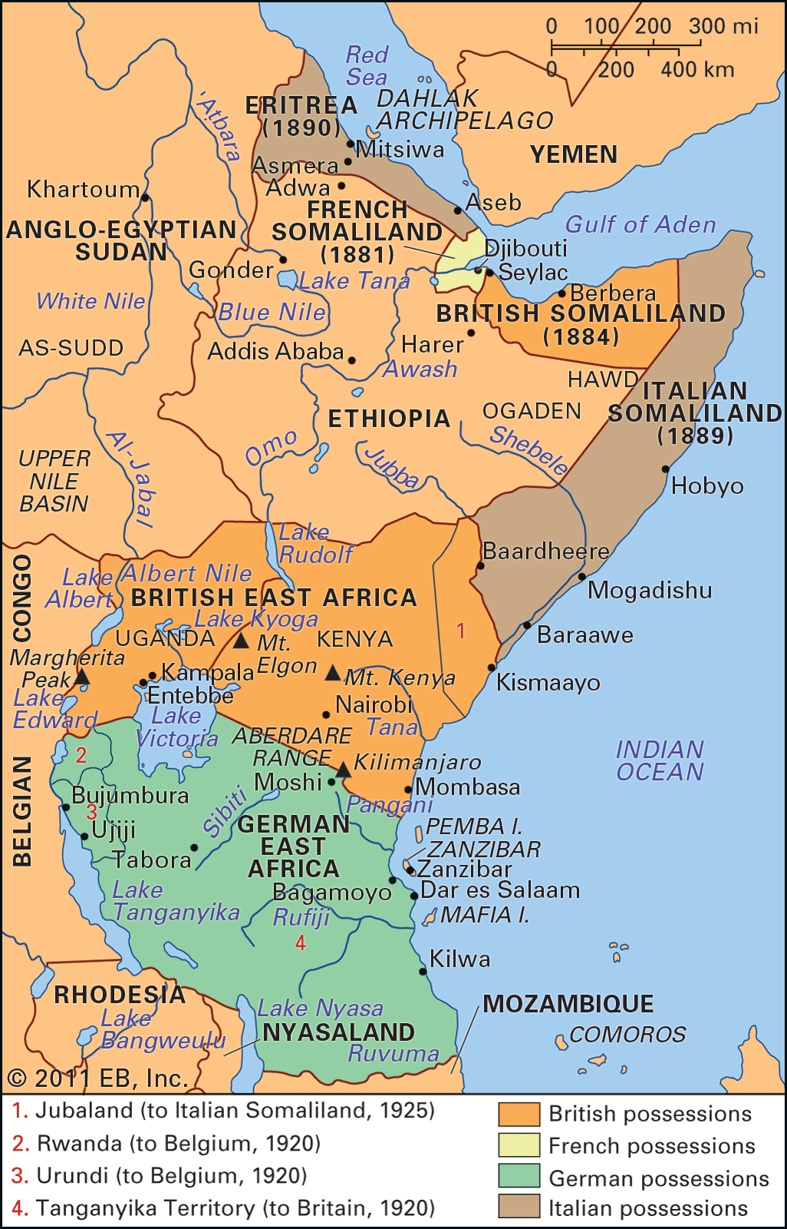
Colonisation of East Africa
The Somali nation was divided by Britain, France and Italy, whilst Uganda became a British protectorate in 1894.
The British Government founded the Eastern African Protectorate in 1895 and Kenya was officially declared a British colony in 1920.
Many Indians were brought by the British to build the Kenya Uganda Railway Line and also to trade. In the 1890s, 32,000 Indians arrived as indentured labourers. Although most returned to India, some settled and made a new life.
Africans and the Asians were banned from direct political participation until 1944.
Notes:
British penetration of the area began at Zanzibar in the last quarter of the 19th century. In 1888 the Imperial British East Africa Company established claims to territory in what is now Kenya. Following the Berlin Conference in 1885, Uganda became a protectorate in 1894 whilst Kenya formally came under British control and was called British East Africa from 1895. Earlier, British explorers looking for the source of the Nile together with Christian missionaries had opened up the region to British colonial interest.
Due to a lack of British manpower in these countries, the British administration used indirect rule, coercing and bribing local leaders such as tribal kings, chiefs, and village headmen to advance their control.
German East Africa, which today comprises of Rwanda, Burundi, and Tanzania, imposed direct rule on Africans, with a centralised form of administration regardless of pre-existing political arrangements. African people were forcibly made to provide labour in plantations for cash crops such as sisal, tea, coffee, cotton.
During the ‘Scramble for Africa’, the Somali nation was divided through the imposition of colonial boundaries by Britain, France and Italy. British Somaliland was formed in 1888, through treaties with the local sultanates.

Slide 9
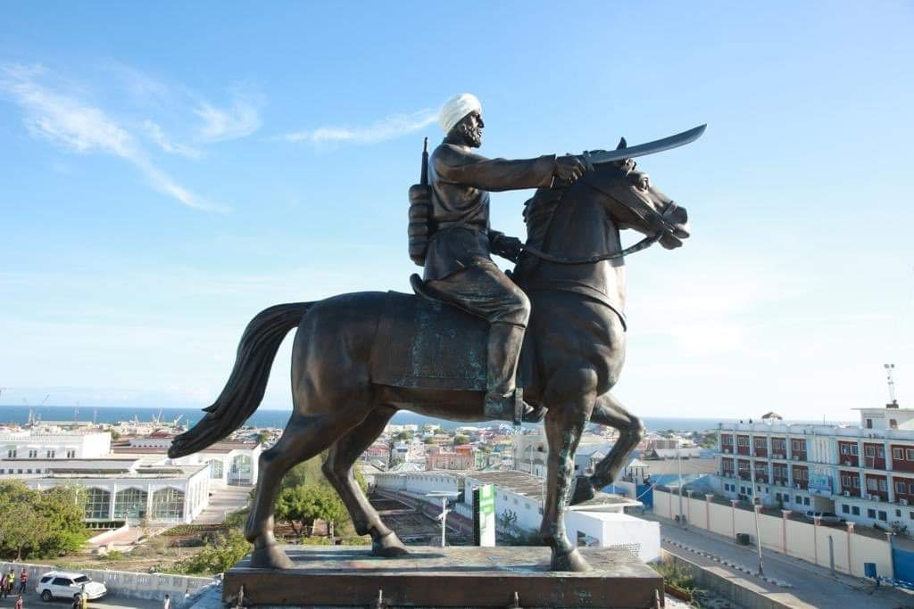
African Resistance
The Maji Maji Rebellion (1905 – 1907) was instigated by Kinjeketile Ngwale. He sprinkled 'sacred/ holy water' (Maji Maji) on the people to protect them from harm.
Forced labour in cotton plantations and heavy taxes were causes
Between 250,000 and 300,000 Africans died mostly from the resulting famine.
.
In British Somaliland Mohammed Abdullah Hassan, a Dervish leader, united Somalis to lead a revolt lasting more than 20 years against British colonisation and Christian missions.
Notes:
The system of forced labour imposed in German East Africa provoked significant resistance in the form of an armed revolt - the Maji Maji Rebellion (1905-1907), led by Muslims and animists who being forced grow cotton for export. Between 250,000 and 300,000 Africans died, mainly from famine that resulted from the conflict.
In British Somaliland Mohammed Abdullah Hassan, a Dervish leader, led a revolt lasting more than 20 years against British colonisation and Christian missions. He succeeded in uniting Somalis by transcending clan divisions. A series of British military expeditions were defeated though causing much damage to the country. The British finally prevailed in 1920 by bombarding the Dervish capital Taleh from the air, killing members of Hassan’s family.
Between 1895 and 1902, thousands of Indians were brought as indentured labourers into East Africa to build the Kenya-Uganda Railway Line. Some subsequently settled there though most returned home. Indians also came from British India as traders and artisans. In 1904 cotton was introduced to Uganda and by 1914 huge amounts were being exported.

Slide 10
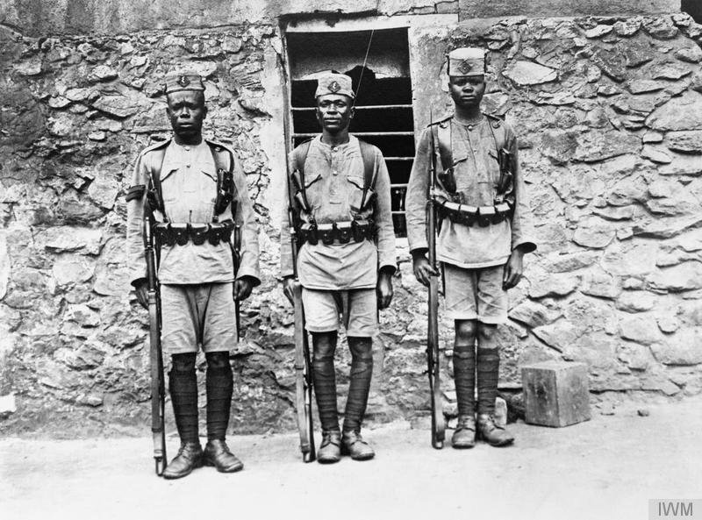
World War One: 1914 - 1918
First World War was a conflict between European nations. British East Africa and German East Africa were involved in a guerrilla war over 4 years.
Human porters moved war equipment due to poor infrastructure with over 100,000 porters dying through illness, exhaustion, or malnutrition
East Africa experienced famine due to the combat. The war lasted four years with over half a million African deaths
Over 98,000 Kenyan men, called "askaris" , joined the King's African Rifles (KAR).
Notes:
The catastrophe of World War One, a war between imperial European nations, impacted on their colonies across the globe. World War One was fought in the regions where Germany had colonies neighbouring those of Britain. The British mandatorily conscripted Africans into armed service from 1915 to enlarge the King’s African Rifles. For African people, it was not their fight and they were second class subjects of empire. This was reflected in their treatment, in comparison to their white counterparts both in combat and death during the First and Second World Wars.
However, military service offered an income, a uniform and a chance to gain respect. In 1914 the East Africa Carrier Corps was established with a compulsory conscription quota that chiefs and headmen were required to fulfil. This Corps proved essential to carry food and equipment to support troops in what became a protracted guerrilla campaign fought mostly in German East Africa. Over the 4 years of war the British side had 150,000 troops and over a million porters/carriers of whom 100,000 died of exhaustion, illness and malnutrition.
With so many men being conscripted or seized, African women had to carry the burden of planting and harvesting crops. Food and livestock was often looted and communities dislocated so that famine and disease took their toll too. The region was de-populated by the war, particularly in what was now Tanganyika, with some half a million civilian deaths, mostly due to malnourishment and disease. This was an economic and social disaster for the Africans of the region.
At the end of the war, German East Africa became a British mandate in 1919 under the League of Nations. The colony was renamed Tanganyika Territory in 1920. Although Africans had fought for Britain through the war or contributed as porters, any hopes for more self-rule were denied. The King’s African Rifles were not invited to take part in the Victory Day parade in London in 1919. Whereas memorials were erected for European soldiers, none were built for the African dead.

Slide 11
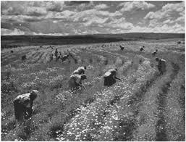
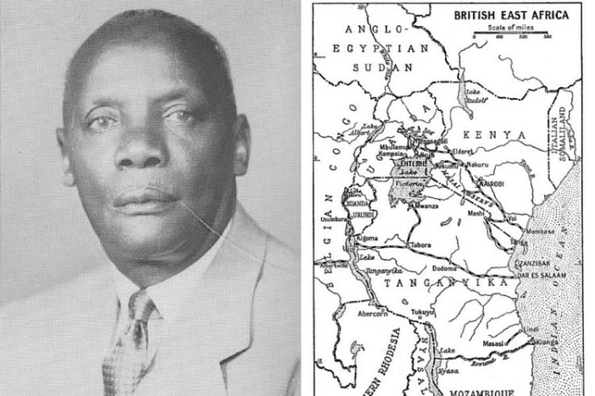
Africans forced from their land
Under the Settlement scheme in Kenya after the war, white soldiers were given farmland and the Africans were pushed off the fertile highlands.
The British imposed taxes in the 1920s and 1930s to force Africans to work for settler farmers and in plantations throughout East Africa.
Harry Thuku, a pioneer of African nationalism
Notes:
In 1920, Kenya was officially declared a British colony and a soldier settlement scheme encouraged British settlers there whilst Africans were pushed off the fertile highlands. In response, African political organisations were formed to challenge the loss of land. Twenty Africans were shot dead at a protest in Tanganyika in 1922, further fuelling a desire for self-rule.
The British imposed taxes in the 1920s and 1930s to force Africans to work for settler farmers and in plantations throughout East Africa. In Kenya, Kikuyu squatters often became based on settler farms to provide labour. They had few rights and were subject to flogging/punitive sanctions. There was support for white settler farmers by the colonial governments with investments in roads, railway, veterinary services but a complete neglect of African farming.
In Uganda, large amounts of tea and coffee were being grown by the 1920s. Missionaries promoted Christianity and provided schools, so that literacy became increasingly common. Traditional African practices were undermined, while British cultural ideas about morality, family structure and gender roles were promoted.
Indians from Gujarat were involved in trade and commerce before the British colonised the region. The small Indian population came to dominate commerce between the wars and gained control of most of Uganda’s cotton ginneries.
Through the 1920s and 1930s the Somali people successfully resisted paying taxes and to contribute to what the British hoped would be the economic self-sufficiency of the protectorate. The geography was too poor and wild to produce cash crops. Meat for export to the colony of Aden was produced, but little else of value to the British.
The 1920s and 30s saw the growth of African nationalism. Land alienation, punitive taxation, the forcible growing of cash crops to the neglect of food supplies, and the experience of the racial hierarchy of the colonial government and administration all contributed to African resentment. The experience of Kenya was very different to that of Uganda and Tanganyika as it had a significant white settler population so that Native Reserves were established and the best agricultural lands in the so-called ‘White Highlands’ were set aside for whites.
I

Slide 12
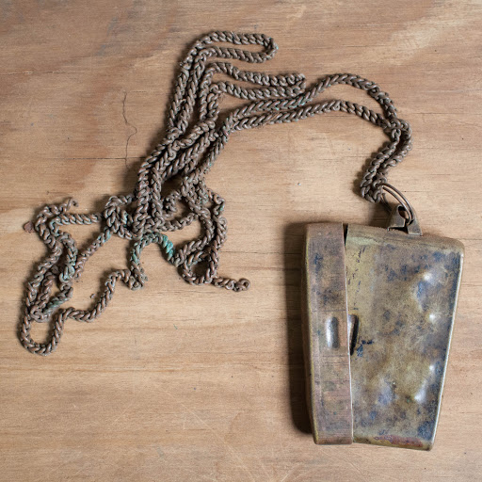
The Kipande and ‘divide and rule’
To control African movement and labour in Kenya, men were forced to wear a Kipande from 1919, coinciding with the return of white soldiers who wanted cheap labour on their farms
The Kipande had a small red book inside a metal container worn around the neck with a heavy metal chain with details about the wearer and their work history.
Kipande
Notes:
To control African movement and labour, the Kipande was introduced to Kenya in 1915 and implemented in 1919, coinciding with the return of white soldiers who were rewarded with land and required cheap labour on their farms. The Kipande was made up of a small red book inside a metal container worn around the neck with a heavy metal chain. It was issued by the Labour Exchange Office, part identity document but also part written record from previous employers.
The British also exploited and controlled the Kenyans using the divide-and-rule strategy, separating people along ethnic lines. This impeded the development of a national, social and political consciousness and continues to affect society in present day. Africans were banned from direct political participation until 1944.
The government emphasised ethnicity so much that details of one’s tribe were given prominence in the kipande. European settlers tried to prevent workers from different communities from mixing. This tended to fuel ethnic division by playing different communities off against each other even as they encouraged tribal labelling. (https://www.standardmedia.co.ke/article/2000084459/the-kipande-s-dark-past)

Slide 13
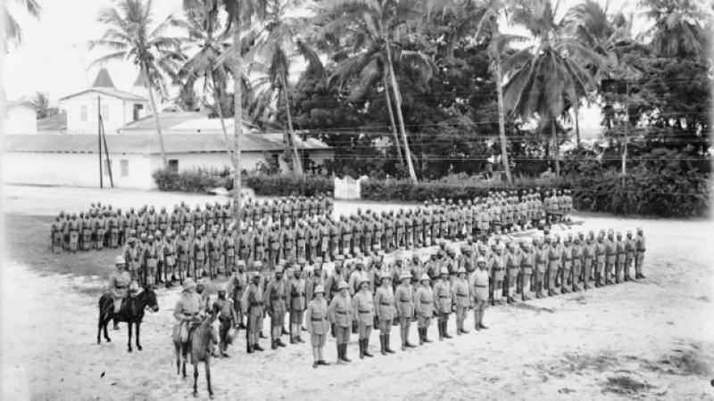
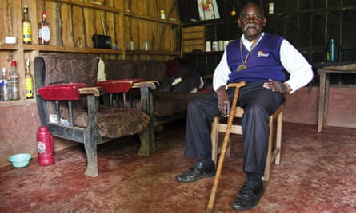
World War Two: 1939 - 1945
During World War Two, Kenya was an important British military base for successful campaigns against Italy in Italian Somaliland and Ethiopia.
Over 98,000 men, called Askaris, were recruited as part of the King's African Rifles (KAR).
'We were abandoned': the Kenyan soldier forgotten by Britain: Eusebio Mbiuki fought in the second world war but was paid three times less than white soldiers.
Notes:
During World War Two, Kenya was an important British military base for successful campaigns against Italy in Italian Somaliland and Ethiopia. Over 98,000 men, called Askaris, were recruited as part of the King's African Rifles (KAR). Uganda exported wood for the war effort. The war changed the perspectives and hopes of many African soldiers. Thus men trained in fighting, with new ideas of democracy came home to contribute to the independence struggle.
'We were abandoned': the Kenyan soldier forgotten by Britain: Eusebio Mbiuki fought in the second world war but was paid three times less than white soldiers. Source: https://www.theguardian.com/world/2019/feb/13/we-were-abandoned-the-kenyan-soldier-forgotten-by-britain
Promises made to Kenyan soldiers who took part in the war were not kept. These include families being looked after whilst the men were at war, employment and compensation for war injuries. This mis-treatment contributed later to the Mau Mau outbreak.

Slide 14
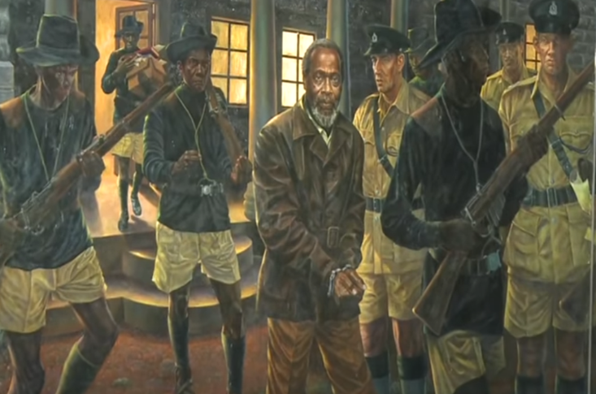
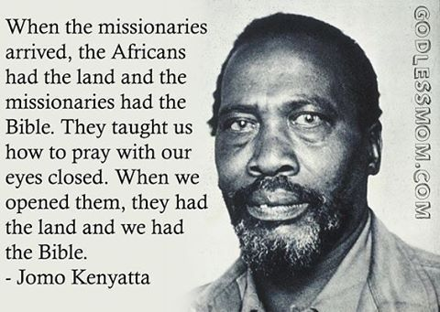
The struggle for Independence in Kenya
1944 - Kenyan African Union (KAU) party was formed to campaign for African independence.
In 1947 Jomo Kenyatta becomes KAU leader.
Jomo Kenyatta is jailed from 1952-1961 and the KAU is banned.
Notes:
Some of the relatively few Africans who acquired a mission education emerged to lead the struggle for independence. These included Jomo Kenyatta (Kenya), Milton Obote (Uganda) and Julius Nyerere (Tanganyika). These men helped to form political parties as an expression of African nationalism and means of pressing for independence. In 1944 the Kenyan African Union (KAU) party was formed to campaign for African independence with Kenyatta its leader from 1947.
In 1945, after World War Two, these leaders were encouraged by the formation of the United Nations and the 5th Pan-African Congress held in Manchester. The inspirational Kwame Nkrumah, future Prime Minister of the Gold Coast (modern day Ghana), advocated the use of all possible means to fight colonialism.

Slide 15
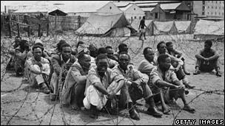
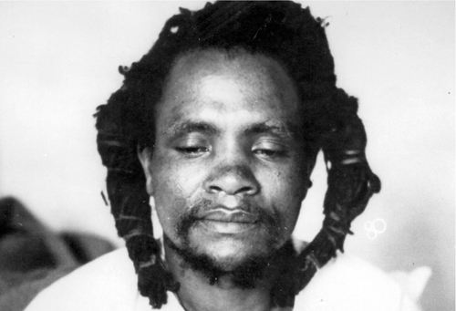
Mau Mau Resistance Movement
Mau Mau resistance movement fought for independence from 1952 – 1956.
a State of Emergency was declared in 1952 and the British set up detention centres/concentration camps holding over 80,000 Kikuyus.
Dedan Kimathi, Mau Mau leader, was captured by the British in 1956 and executed in 1957 at Kamiti Prison.
Notes:
Unlike Tanganyika and Uganda, Kenya had a significant white settler population who resisted land reforms and the movement towards independence. Jomo Kenyatta was jailed from 1952-1961 and the KAU was banned.
The Mau Mau Uprising (1952 to 1956), involved over 100,000 of the Kikuyu people, who had lost land to white settlers. It was the largest and most successful freedom-fighter movement in British Africa. Kenyans regarded it as a major step on the road to independence. The Mau Mau used armed conflict and terror. Martial law was declared by the British, protected villages set up while over 80,000 Kikuyu were held in detention/concentration camps with the British using torture. In 1957, they captured and executed leading freedom fighter, Dedan Kimathi.
Officially the number of Mau Mau and other rebels killed was 11,000, including 1,090 prisoners hanged by the British administration. However, unofficial figures suggest a much larger number were killed in the counter-insurgency campaign. Just 32 white settlers were killed in the eight years of emergency.
Without a significant white settler population, the progress of Tanganyika and Uganda towards independence was smoother.

Slide 16
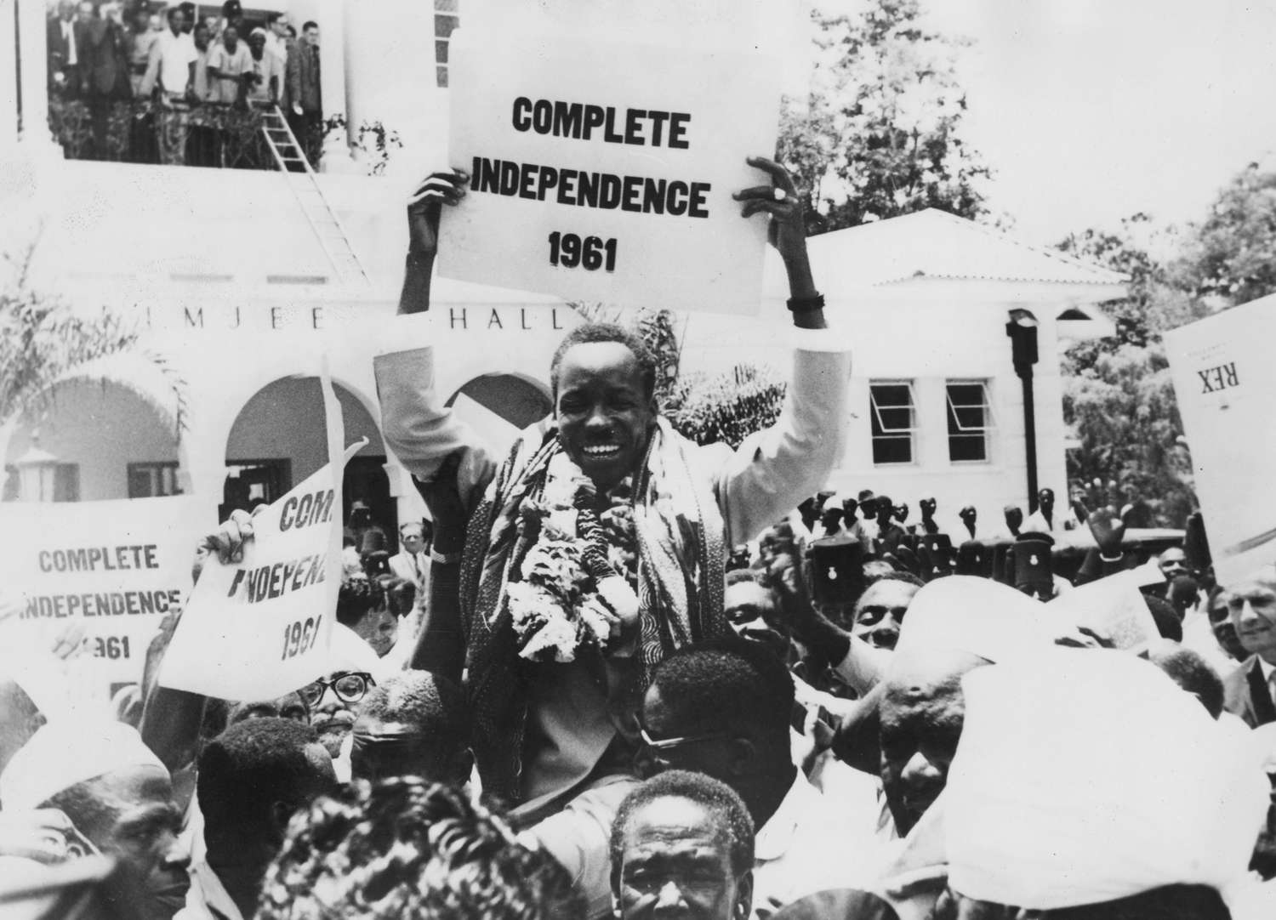
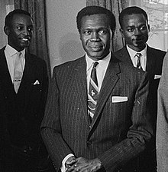
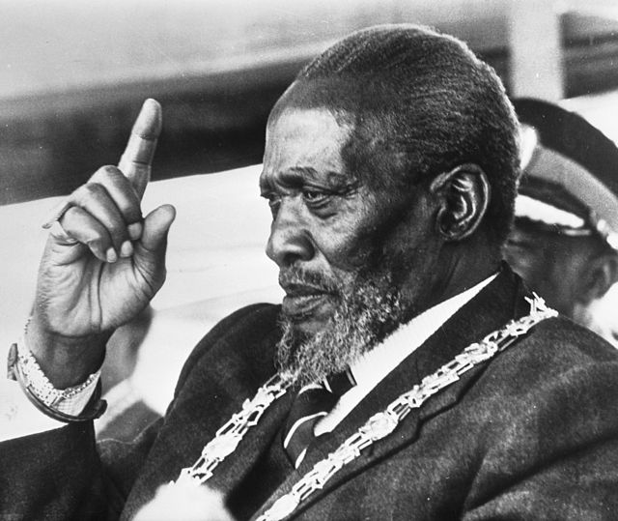
Independence won
African political parties were formed in all 3 countries to agitate for independence
Julius Nyerere had led non-violent protests against colonial rule in Tanganyika
Britain’s East African colonies gain their independence - Tanganyika (1961), Uganda (1962) and Kenya (1963) with Nyerere, Milton Obote and Jomo Kenyatta respectively as their leaders.
In Kenya, many white settlers opted to sell their farms and leave the country rather than live under African rulers.
President Obote
President Kenyatta
Notes:
A 'wind of change' was blowing through Africa in the 1960s with many countries finally achieving independence. On the 1st July 1960, the State of Somaliland voluntarily united with the Trust Territory of Somalia (the former Italian Somalia) to form the Democratic Republic of Somalia. The first president was a Somali politician – Aden Abdulle Osman Daar (1908–2007), popularly known as Aden Adde.
African political parties were formed in all 3 countries to agitate for independence. Julius Nyerere led non-violent protests against colonial rule resulting in Tanganyika’s independence in 1961. In 1964, Tanganyika united with Zanzibar to form Tanzania with Nyerere as president.
Uganda became independent from Britain in 1962. Buganda continued to enjoy considerable autonomy with Buganda's King Kabaka Mutesa as the first president and Milton Obote as prime minister.
Kenya gained independence in 1963 and Jomo Kenyatta became Kenya's first Prime Minister. Upon Kenya achieving independence, many white settlers opted to sell their farms and leave the country rather than submit to African rule.

Slide 17
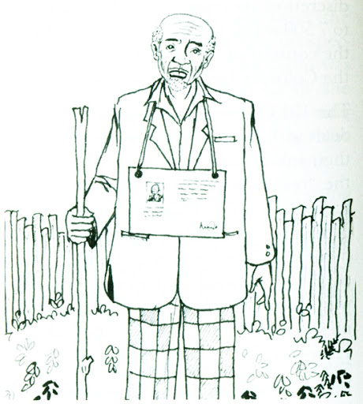
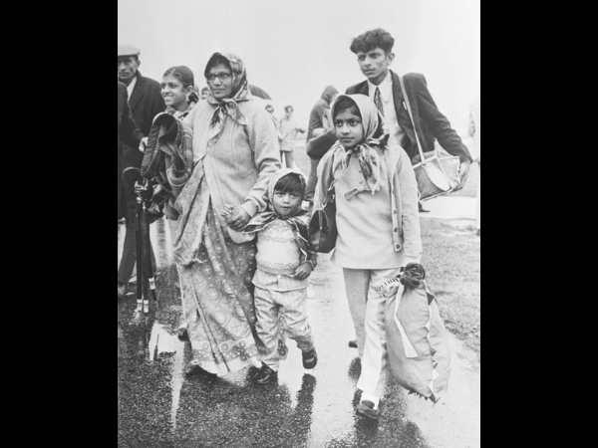
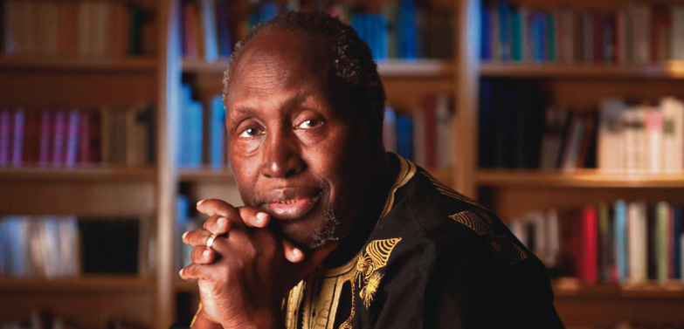
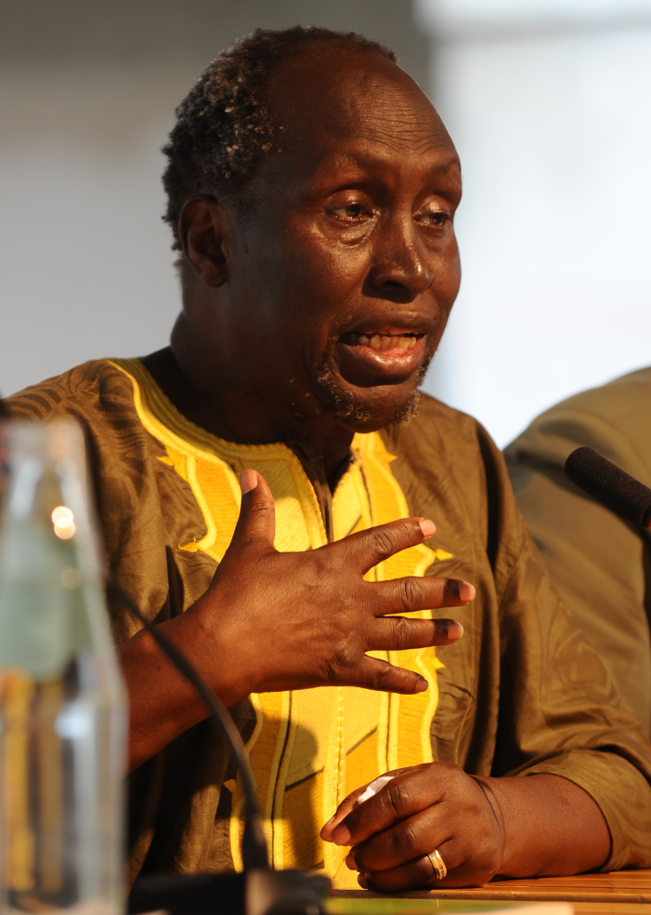
Legacy
Mkakisha Mbelenga: ‘The British school children should know the negative impact that Britain had on Kenya during colonialism. The issue of land alienation led to so many Kenyans losing their lands and being concentrated in Native Reserves where they suffered badly and were denied prosperity and reduced to poverty.’
Why does needy Africa continue to let its wealth meet the needs of those outside its borders and then follow behind with hands outstretched for a loan of the very wealth it let go? Where is the future of Africa?” ― Ngũgĩ wa Thiong'o, Wizard of the Crow.
In 2012, the High Court in London ruled that three Kenyans detained and tortured during the Mau Mau rebellion had the right to sue the UK government. So far almost £20 million has been paid to 5,228 Kenyans.
Asians having to flee Uganda
During the emergency period, from 1952, men were moved from their land and locked up at night in the villages (ngati) together with their animals so that Mau Mau did not have any source of food.
Notes:
Land alienation
Mkakisha Mbelenga: The British school children should know the negative impact that Britain had on Kenya during colonialism. The issue of land alienation led to so many Kenyans losing their lands and being concentrated in Native Reserves where they suffered badly and were denied prosperity and reduced to poverty. The land transfer at independence led to so many, especially from Central Kenya being resettled in other parts of the country or through their initiative bought land in other places in the country where land was available or was up for sale by the government. In recent years, those communities who were originally from these areas have viewed those from Central Kenya as grabbers. This may be due to not understanding the history behind these resettlements. Such misunderstandings led to the 1997 clashes in the Rift Valley and Coastal regions of Kenya and the post-election violence of 2007/2008 where hundreds lost their lives.
Land alienation was also a direct cause of the Mau Mau rebellion. In 2012, the High Court in London ruled that three elderly Kenyans detained and tortured during the rebellion had the right to sue for damages. Since then, over 41,000 Kenyans have sued the British government for compensation against colonial rule, during the Mau Mau uprising in the 1950s, alleging maltreatment and physical abuse, inhumane and degrading treatment, detention, and torture during the final days of the British empire. The UK government has so far paid £19.9m to 5,228 Kenyans.
“Why did Africa let Europe cart away millions of Africa's souls from the continent to the four corners of the wind? How could Europe lord it over a continent ten times its size? Why does needy Africa continue to let its wealth meet the needs of those outside its borders and then follow behind with hands outstretched for a loan of the very wealth it let go? How did we arrive at this, that the best leader is the one that knows how to beg for a share of what he has already given away at the price of a broken tool? Where is the future of Africa?” ― Ngũgĩ wa Thiong'o, Wizard of the Crow.
Source: https://www.goodreads.com/quotes/tag/colonialism
British colonial policies of segregation of the races and divide and rule contributed to divisions within the region after independence. Asians fell foul of Africanisation policies in both Kenya and Uganda. In 1972, Idi Amin, who had overthrown Obote in a coup d’état in 1971, ordered the expulsion of 60 000 Asians. Around half migrated to the UK, leaving their homes and their businesses behind and arriving in a new country with little or no possessions.

Slide 18
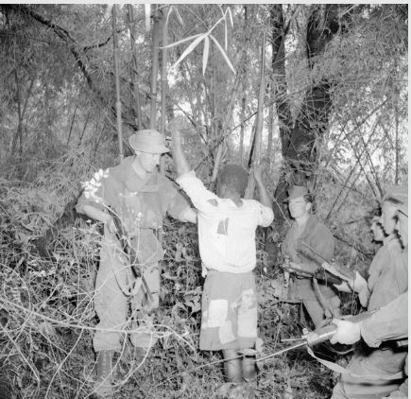
Colonial Legacy – Britain Pays Compensation to Mau Mau (2013- )
A young boy, suspected to be a member of the Mau Mau, captured by British colonial soldiers
In 2012, the High Court in London ruled that three Kenyans detained and tortured during the Mau Mau rebellion had the right to sue the UK government. So far almost £20 million has been paid to 5,228 Kenyans.

Slide 19
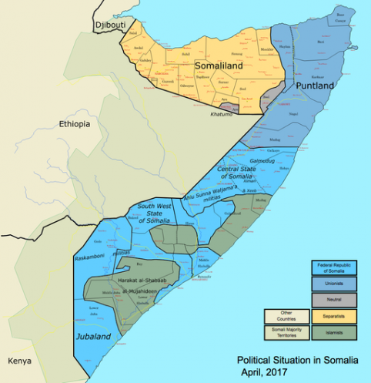
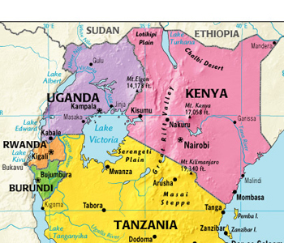
Eastern Africa – Kenya, Uganda, Tanzania & Somaliland

