Slide 1

Australia
Experiences of British Colonisation

Slide 2
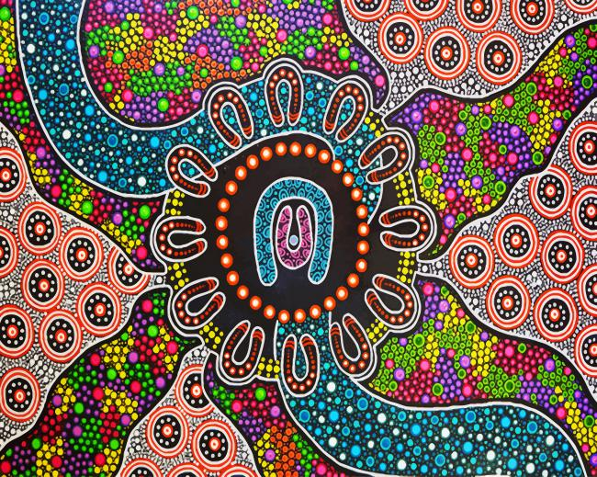
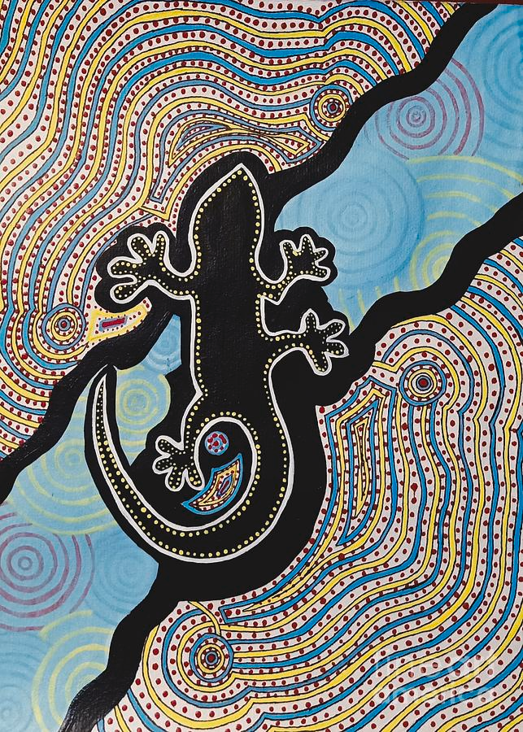
Contents
Geography of Australia
Pre-colonial civilization
Indigenous peoples of Australia
Indigenous caretaking of the environment
British Colonisation of Australia
James Cook’s ‘Discovery’
British settlement & attitudes
Eyewitness accounts
Aboriginal resistance & segregation
Self governing Australia
Aboriginal rights today & Australia Day

Slide 3
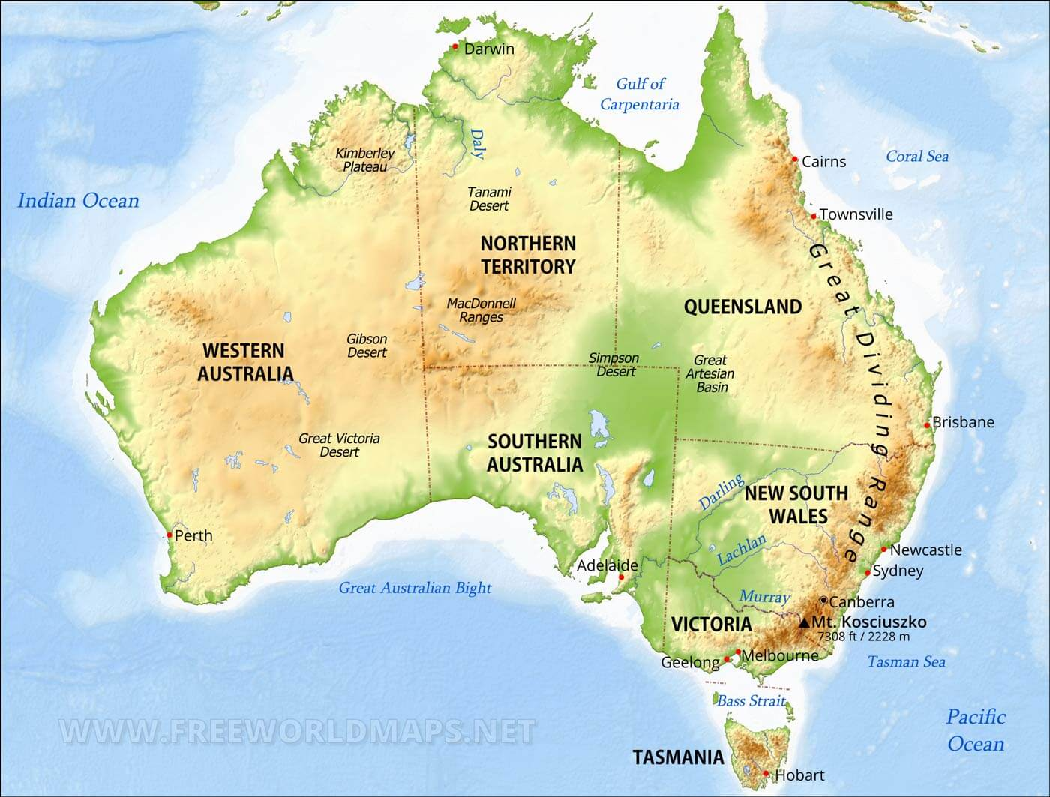
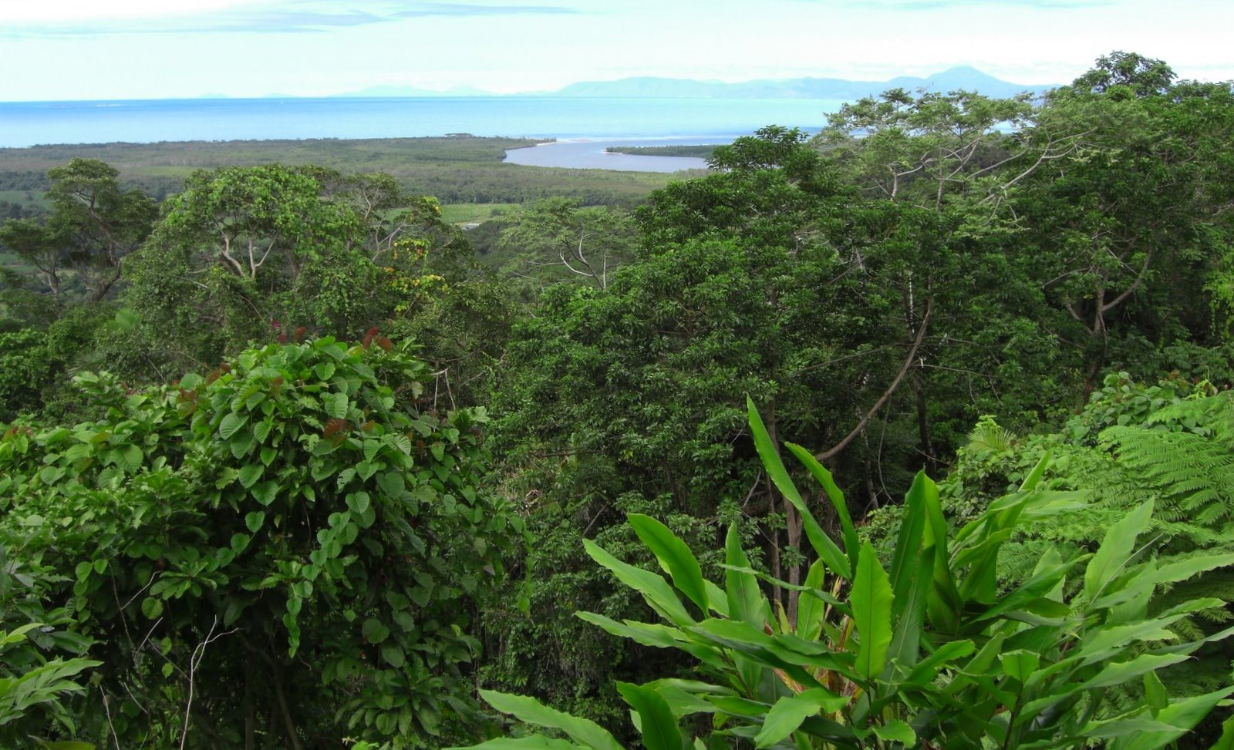
Geography of Australia
A huge continent more than 30 times the size of the UK.
Described as “a paradise on earth”
Varied landscapes, with stretches of deserts and rich rainforests
Notes:
Australia is not only a vast country but also a continent. It is more than 30 times the area of the UK. English settlers considered it “a paradise on earth, for here laid one of the fairest domains ever created by nature. Permanent life-giving rivers meandered through its extensive plains; lush grasslands and forests flourished on its rich soil. The white men could scarcely believe their luck, as they penetrated further into undulating pastures and negotiable bushlands”. (quoted in Cannon, 1993)

Slide 4
Indigenous peoples of Australia
This map shows the large number of different indigenous peoples living on the land before European arrival.
There were around 500 different ethnic groups of Aboriginal people speaking over 250 Aboriginal languages.
Ethnic groups varied in their traditions and practices of art forms such as chanting, dancing and performing rituals.
Notes:
Today we think of Australia as a predominantly white culture, adopting many British values and traditions. Britain’s influence on the country is apparent through the union jack on Australia’s national flag, and it would be easy to assume that Australia’s history began in Britain. However, the country’s origins extend far beyond British settlement, so what did Australia look like before it was colonised by Britain? This is a map showing the 500 or so different ethnic groups that lived on the land.
In 2020, only about 3% of the Australian population was of Aboriginal descent.

Slide 5
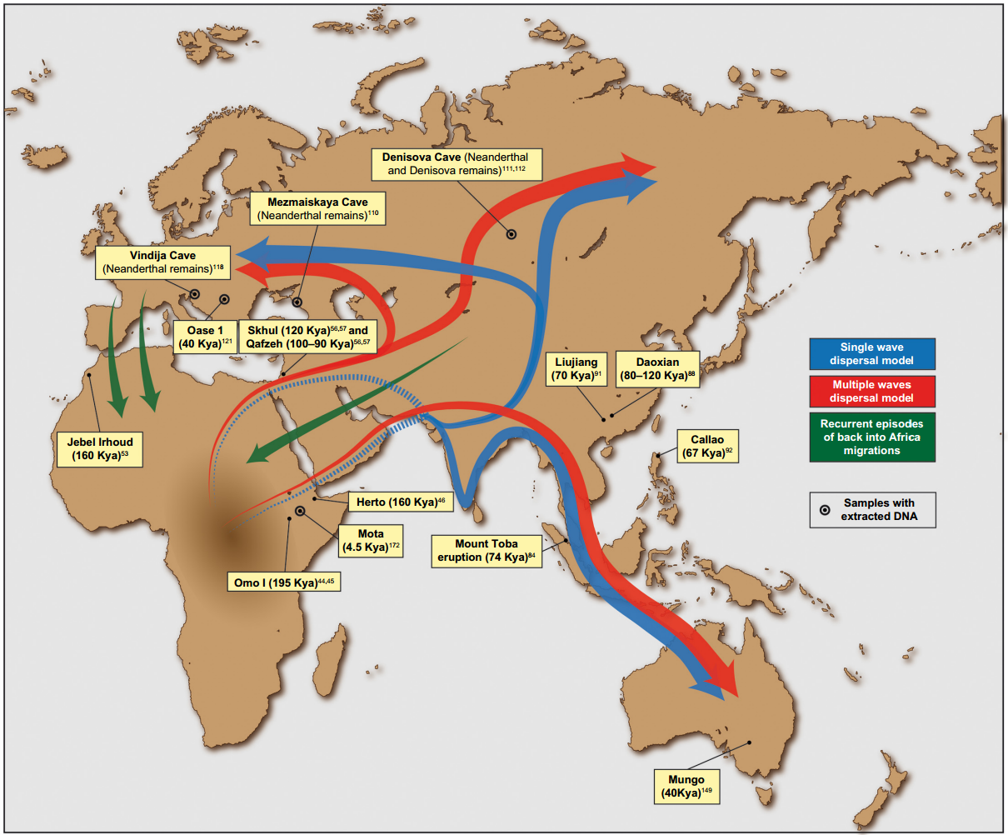
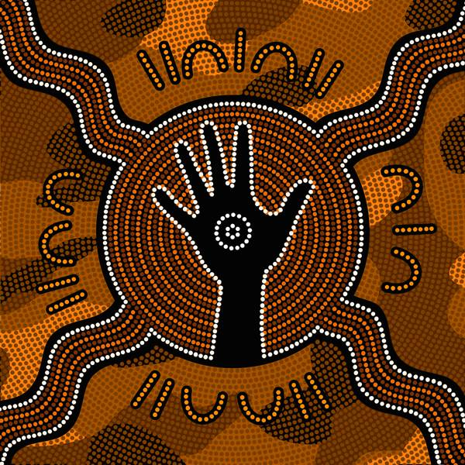
Indigenous peoples of Australia
It is believed that there were between 500,000 – 750,000 people living on the mainland and islands of what is now known as Australis.
These groups predate the arrival of white settlers by roughly 50,000 years.
Map showing early human migration patterns; note that Aboriginal Australians travelled there from Southeast Asia.
Notes:
It is estimated that the population reached about 750,000 before the arrival of colonialists. In fact, Australia’s history precedes white settlement by approximately 50,000 years, when humans made the first land breach from south-east Asia to Australia.
Aboriginal Australians are believed to have migrated to the continent from Asia thousands of years ago. Multiple theories suggest that outside of Africa, the Aboriginal population may be the oldest humans on earth having lived in Australia for 50,000 years. Divided between the Aboriginal Australians and the Torres Strait Islanders, there were around 750,000 people divided into 500 different ethnic groups or nations, speaking over 250 Aboriginal languages. They were hunter gatherers with a rich and vibrant culture, including art forms such as chanting, dancing and performing sacred rituals as well as singing, acting and mime. Storytelling forms an important part of their culture, with tales commonly engraved and painted onto flat stones and wooden boards. More well- known aspects of Aboriginal expression include ceremonial headdresses and the boomerang, which is still today seen as an emblem of Australia.

Slide 6
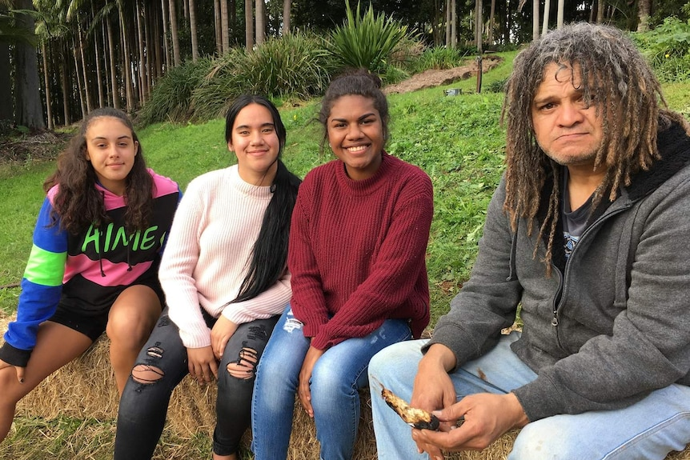
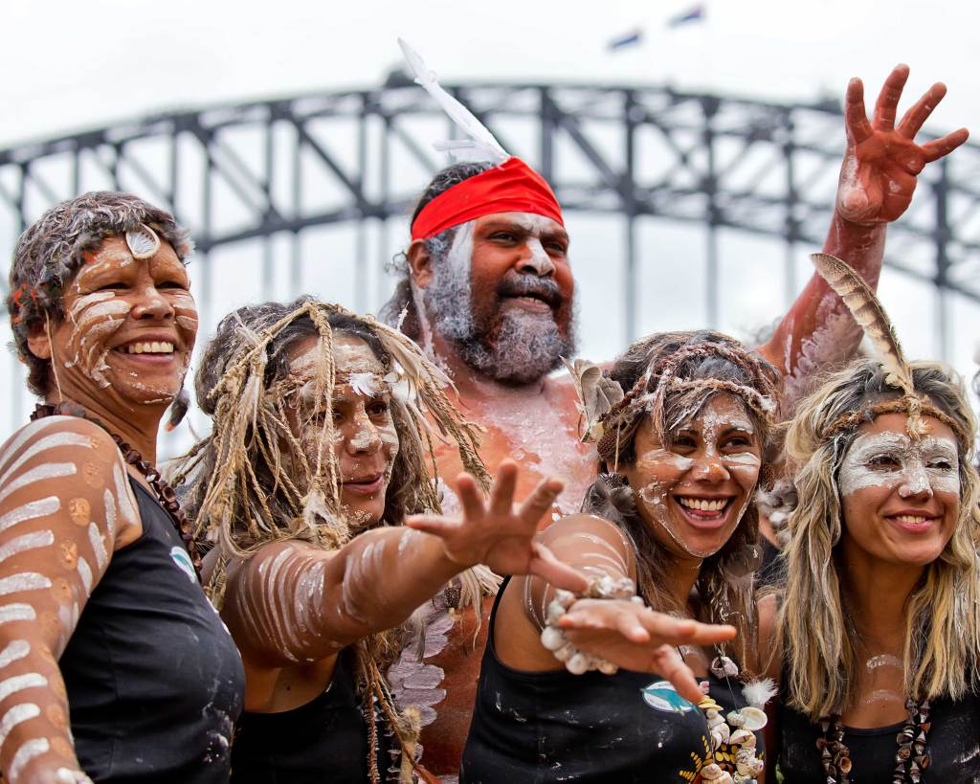
What should we call the indigenous people of Australia?
Aborigines
Indigenous Australians
Aboriginal Australians
Aboriginal and Torres Strait Islander peoples
First Nations
First Peoples
First Australians
Notes:
Aboriginal comes from the Latin. Ab means before and origo means beginning or original. It expresses that Aboriginal people have lived in Australia from the beginning of time.
Throughout the colonialist years, the indigenous peoples of Australia were called ‘Aborigine.’ This term lumped peoples of diverse cultures together, which many indigenous peoples found insulting, and for many the term ‘Aborigine’ has colonial connotations. “Aboriginal people are a diverse group of individuals, and the […] term ‘Aborigine’ is now no longer used as it has negative connotations imposed during colonization and can perpetuate prejudice and discrimination”. Maria Tomasic, president of the Royal Australian and New Zealand College of Psychiatrists.
For this presentation the indigenous population will be referred to as Aboriginal Australians, though terms such as First Peoples, First Nations and First Australians are now regularly used.

Slide 7
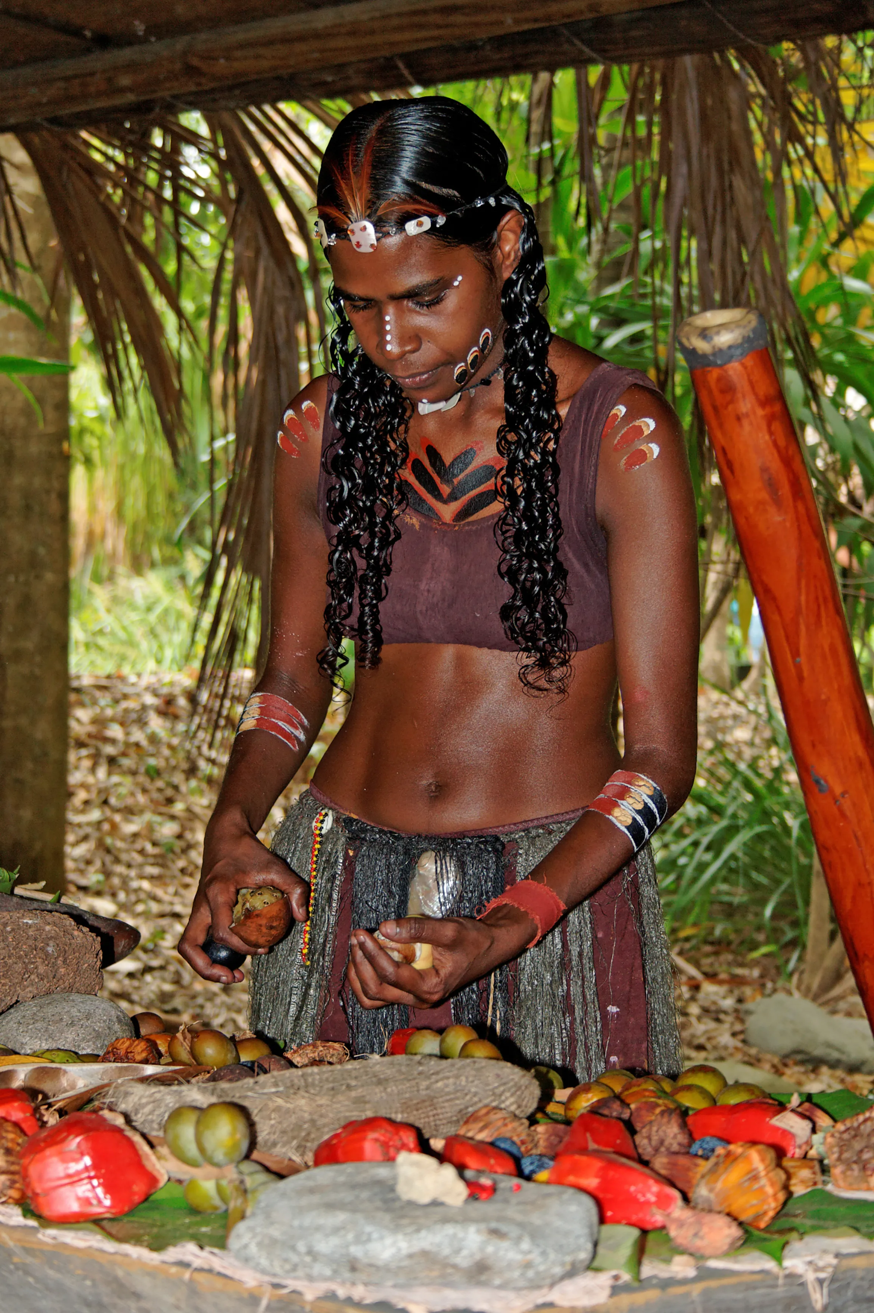
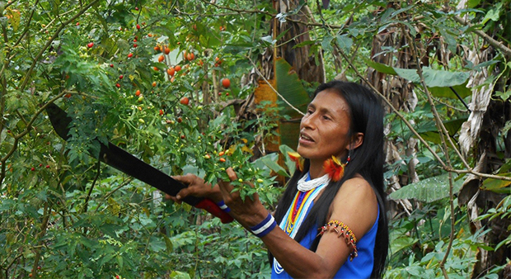
Indigenous caretaking of the environment
Aboriginal philosophy, known as the Dreaming, is based on the inter-relation of people with all things in nature.
It is deeply embedded in indigenous culture that communities should be caretakers of the environment
This involves protecting their lands, respecting wildlife and utilizing traditional knowledge passed down through generations
.
Notes:
For thousands of years, Indigenous communities have been caretakers of the environment, protecting their lands, respecting wildlife and utilizing traditional knowledge of sustainable practices passed down through generations. Today, they continue to safeguard some of the most biodiverse areas on the planet.
Another significant aspect of Aboriginal culture is their ‘dreaming relationship’ with the natural world, which is based on the inter-relation of people with all things in nature. According to Aboriginal philosophy, mythical beings shape the land and populate it with animals, plants and humans. These mythical beings retain control of all power and fertility which can be released into the human realm if they are worshipped correctly. Thus, through dreams, the living and spiritual can interact. The spirits of past ancestors can be passed down culturally through art, dance and stories and form a vital part of Aboriginal identity.

Slide 8
James Cook’s ‘Discovery’
In 1770, James Cook arrived in Australia and proclaimed that he has ‘discovered’ Australia
Initial contact with aboriginal peoples was friendly and then first conflict began in X – happened time and time again.
In 1778, the first British convicts were sent to Botany Bay as a cheap way of disposing of criminals.
Violence and diseases such as smallpox brought to the area by Europeans unfortunately killed many of the Aboriginal peoples.
Notes:
James Cook was an 18th century explorer most known for ‘discovering’ Australia. However, it is important to remember that whilst Cook was the first British man to sail to Australia, he did not first discover the island as the continent was already home to extensive Aboriginal settlement. The British viewed the land as empty and, with Cook’s arrival, began setting up penal colonies, sending convicts there from 1778. British jails were overcrowded, and this was a cheap way to dispose of criminals (mostly convicted of mostly petty crimes) and to provide free labour to develop this new world. The gruelling journey to Australia took around 8 months, and many did not survive the voyage. On arrival, conditions were harsh and there was a shortage of food. Initial contact with the Aboriginal population appeared friendly, but friction soon developed, and later open conflict began.

Slide 9
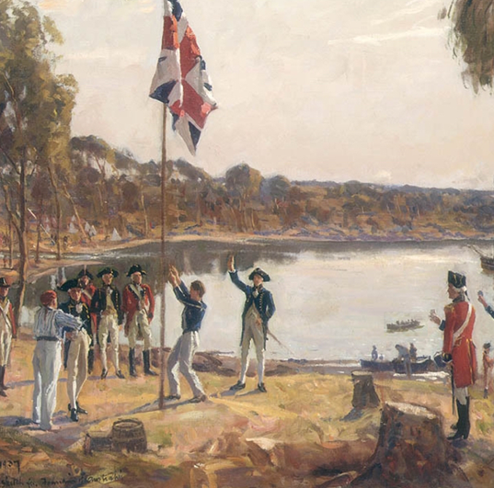
British Settlement
During the 1830s and 1840s, further settlers were encouraged by low employment rates in England
2.5 million British citizens moved to Australia and New Zealand during the 19th century
The 1851 goldrush in Victoria caused another 500,000 migrants to come to Australia
Larger and larger areas of land were seized and granted to the British settlers.
Notes:
During the 1830s and 1840s, there was an increasing number of free settlers travelling to the continent due to high unemployment levels in England. The Australian colonial Government encouraged and paid for these migrants to enter Australia to supplement convict labour. Over the 19th century, 2.5 million British travelled to Australia and New Zealand in search of a new life.
On the 8th of August 1851, a rich deposit of gold was found in Victoria, prompting a ‘Goldrush’ – a flood of 500,000 migrants from countries including China, Germany, Poland and Britain searching for work in Australia’s gold fields.
Agriculture was also increasing in prominence across Australia. Newly liberated convicts were granted 30 acres of land, stimulating the agricultural industry, a grant later extended to free migrants. By 1860, 1.2 million acres were being farmed, boosting the continents economy.

Slide 10
British Attitudes
British colonists believed that the land was “Terra Nullius” or land belonging to no one.
They also assumed that European culture was superior.
Although Aboriginal peoples had territories and association with the land, the British took it as their own..
Notes:
On arriving in Australia, the British believed the land to be ‘Terra Nullius’ – land belonging to no-one – and failed to recognise the rights of the Aboriginal populations. The British viewed European culture as superior and assumed complete possession of Aboriginal land, treating the Aboriginal peoples as an inhuman and substandard race. Starting in 1794, mass killings were first carried out by British soldiers, then by police and settlers – often acting together – and later by native police, working under the command of white officers, in militia-style forces supported by colonial governments. These tactics were employed, without formal repercussions, as late as 1926.

Slide 11
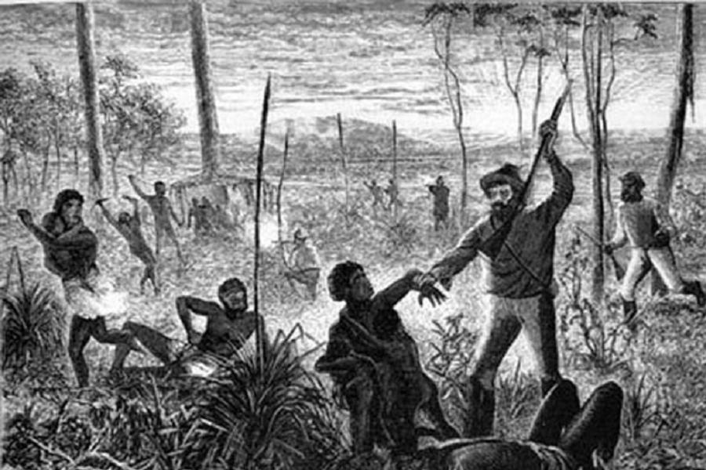
Impact on Aboriginal population
The indigenous peoples were almost destroyed, and the ownership of their land was entirely transferred to English colonial settlers
As well as overt violence, the British also brought diseases such as smallpox, to which the Aboriginals had no resistance
Between 1788 and 1900 the indigenous population was reduced by 90%.
Notes:
The indigenous peoples were almost destroyed, and the ownership of their land was entirely transferred to the English colonial settlers and their descendants. The British also engaged in repeated systematic forms of economic warfare including the killing of livestock and burning of Aboriginal homes and crops. Thus, the Aboriginals were viciously forced by the British into abandoning their culture and assimilating to a colonial lifestyle. As well as overt violence, on arrival in Australia the British also brought with them diseases such as smallpox. Whilst the British had developed a resistance to the disease, the Aboriginal population was vulnerable to smallpox, meaning that thousands of aborigines died from British-brought epidemics. Between 1788 and 1900 the indigenous population was reduced by 90%.

Slide 12
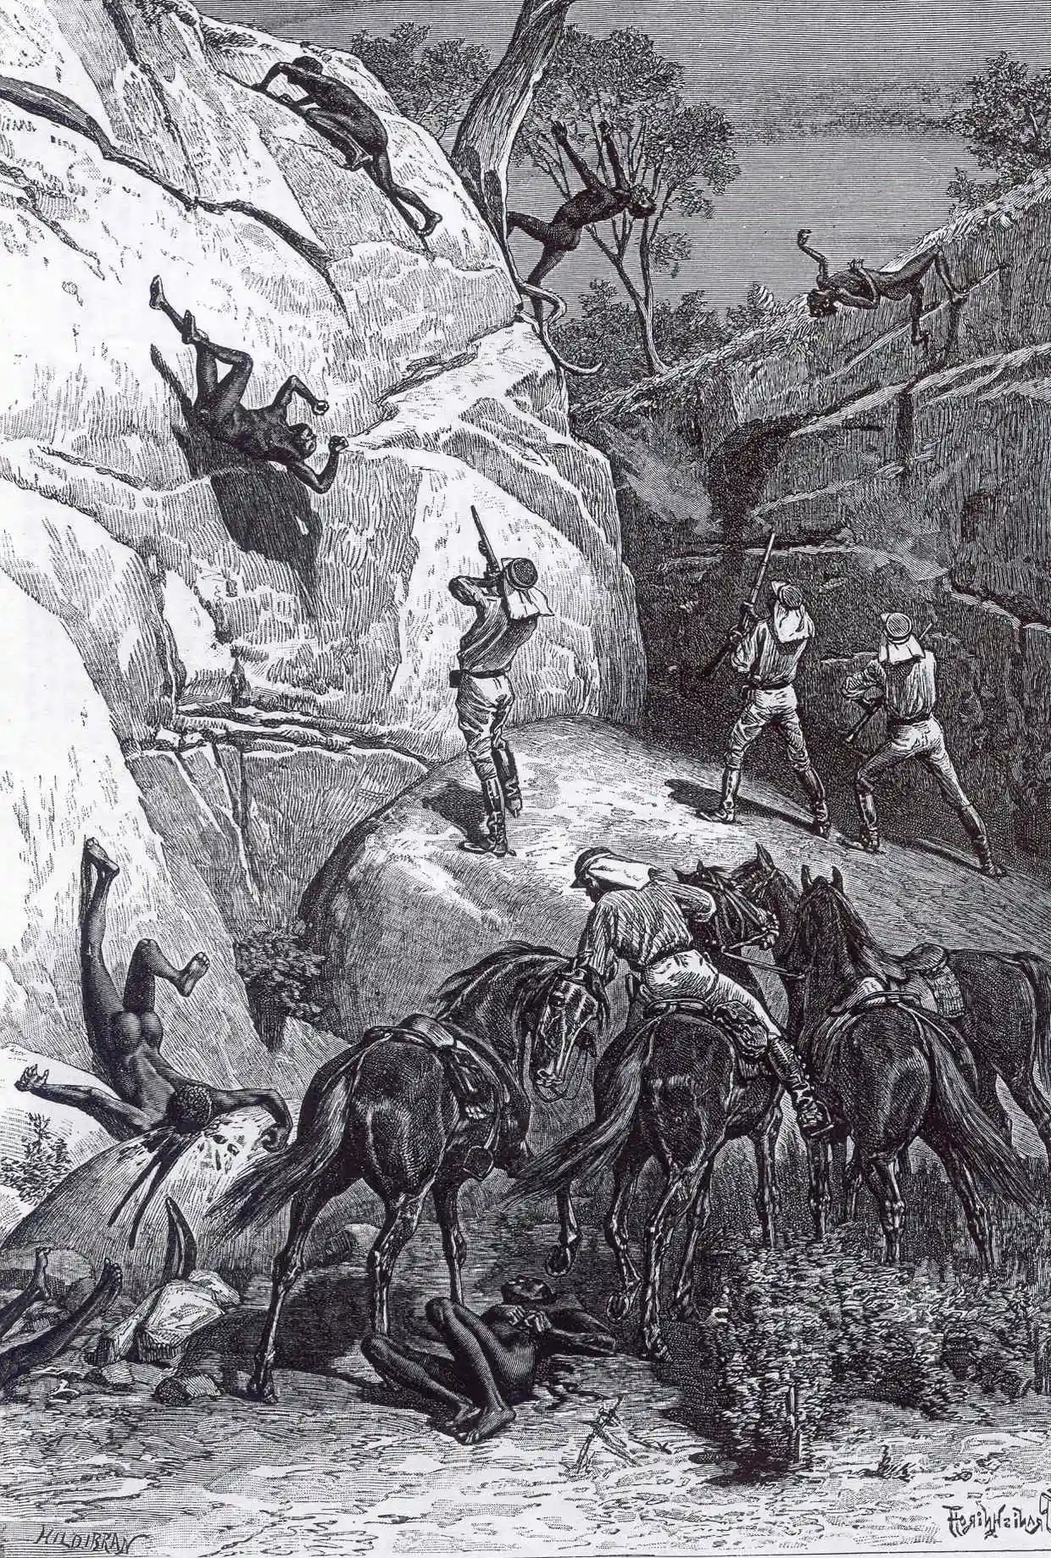
Eyewitness Account (1)
“Why do you white people come in
ships to our country and shoot down
poor blackfellows who do not
understand you—you listen to me!
The wild blackfellows do not
understand your laws, every living
animal that roams the country, and
every edible fruit that grows in the
ground are common property.”
– Yagan, 1843
Notes:
In 1843, Yagan, an indigenous man, told the advocate general of Victoria the following: “Why do you white people come in ships to our country and shoot down poor blackfellows who do not understand you—you listen to me! The wild blackfellows do not understand your laws, every living animal that roams the country, and every edible fruit that grows in the ground are common property.”

Slide 13
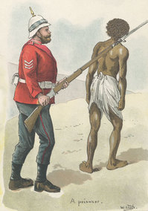
Eyewitness Account (2)
“We were hunted from our ground, shot, poisoned, and had our daughters, sisters and wives taken from us. . .What a number were poisoned at Kilcoy . . . They stole our ground where we used to get food, and when we got hungry and took a bit of flour or killed a bullock to eat, they shot us or poisoned us. All they give us now for our land is blanket once a year.”
– Dalaipi, late 19th century
Notes:
Dalaipi, an Aboriginal person living in Queensland in the late 19th century said: We were hunted from our ground, shot, poisoned, and had our daughters, sisters and wives taken from us. . .What a number were poisoned at Kilcoy […] They stole our ground where we used to get food, and when we got hungry and took a bit of flour or killed a bullock to eat, they shot us or poisoned us. All they give us now for our land is blanket once a year. (quoted in Broome, 2002, p. 55)

Slide 14
Aboriginal Resistance
Aboriginals fought to retain land and culture
Frontier war: ‘Guerrilla war’ until the 1820s where the rebel used their mobility and surprise to try and resist the larger less-mobile army
1838 Myall Creek Massacre – landmark event because some of settlers punished and hanged
Population down to 60,000 by the 1920s due starvation and the massacres.
“There is this notion that our people just lay down and died”
– Boe Spearim, creator of the Frontier War Stories Podcast
Notes:
The Aboriginal Australians heavily resisted British colonial rule. The British domination of Australia was violent, unjust and barbarous and up to 200,000 Aboriginal Australians lost their lives. Many fought to retain their land and culture, but others were forced to adapt to a British lifestyle.
A frontier or ‘guerrilla war’ took place in Australia until the 1820’s, in which Aboriginal Australians used bush craft and guerrilla campaigns to resist the British, however they were ultimately overwhelmed by the force of colonial weapons. In a period of ‘pacification by force’ up to the 1880’s, large numbers of Aboriginal Australian’s were killed, and many others forced into labour work. The British massacred thousands and seized Aboriginal land and resources, plunging the remaining numbers into poverty.
Whilst Aboriginal massacres took place nationwide, the Myall Creek Massacre is one of the most notable. On the 10th of June 1838, 28 innocent Aborigines were murdered by the British, with women, children and old men the majority of the victims. Whilst 7 out of the 12 colonists involved were hanged indicating some form of justice for the Aboriginals, these massacres were emblematic of events happening all over Australia where no justice was served.
It is estimated that by the 1920s the Aboriginal population had been reduced to 60,000. Despite the friendly appearance of some initial encounters, the British-Aboriginal relationship was dominated by violence and hostility.

Slide 15
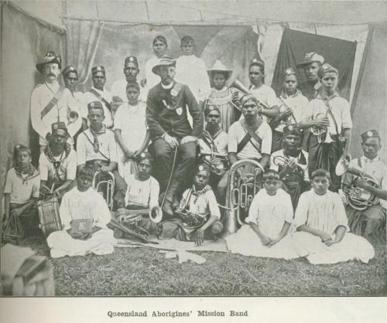
Segregation
Aboriginal survivors of the frontier conflict were moved into reserves or missions, which are religious buildings made to spread the word of God.
Laws to segregate and control Aboriginal movement were put in place by the colonists.
Through the 1915/1918 Acts, 33% girls were removed from their families to be trained as domestic servants and boys to serve on farms these separations were devastating to families.
Notes:
Survivors of the frontier conflict were forcibly moved from their lands to reserves or missions, and by 1869 around 50% of the Aboriginal population in Victoria were living on missions or on a reserve. From the end of the 19th century, many laws were enforced throughout Australia to segregate and control Aboriginal movement, with the 1909 New South Wales Aborigines Protection Act the main legislation governing Aboriginal lives for the following 60 years.
Laws were instigated between 1915 and 1918 authorising the removal of Aboriginal children from their families. This did great damage to Aboriginal communities. Girls were trained as domestic servants and boys to serve on farms. Often having their names changed, children were put into adoptive families and forbidden to speak their native language; they received almost no education and were continually exploited. Throughout the continent, entire communities of Aboriginal Australians were loaded into cattle trucks and taken hundreds of miles from their homes. Between 1910 and 1970, Government policies of assimilation saw between 10 and 33% of Aboriginal children being forcibly removed from their homes. These children became known as the ‘stolen generations.’ The act gave government officials the authority to move Aboriginals out of their towns and ban them from associating with white Australians.

Slide 16
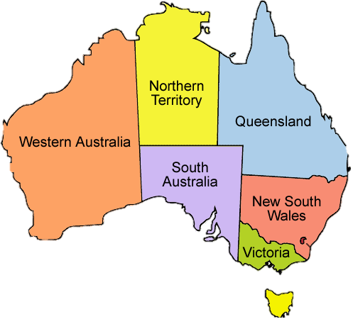

Self governing Australia
Pressure for rights and democracy for settlers; not for the Aborigines
In 1859, Australia became a self governing domain of Britain, 6 colonies were established, all ruled by Queen Victoria
1901 federation; The commonwealth of Australia was formed and became a dominion of the British Empire.
Notes:
White Australia continued to grow and develop, and in 1859, 6 distinct colonies (Queensland, New South Wales, Victoria, Tasmania and Southern Australia) were established. They were virtually independent of each other, but each had a parliament that was governed by Britain, subject to British laws, and had Queen Victoria as their sovereign leader. In 1901, the Federation of Australia joined the 6 colonies and formed one united continent: the commonwealth of Australia. Through this process, Australia became a self-governing dominion of the British Empire. The Aboriginal population however, had been neglected, and held no rights or power in this new dispensation.

Slide 17
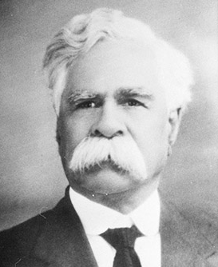
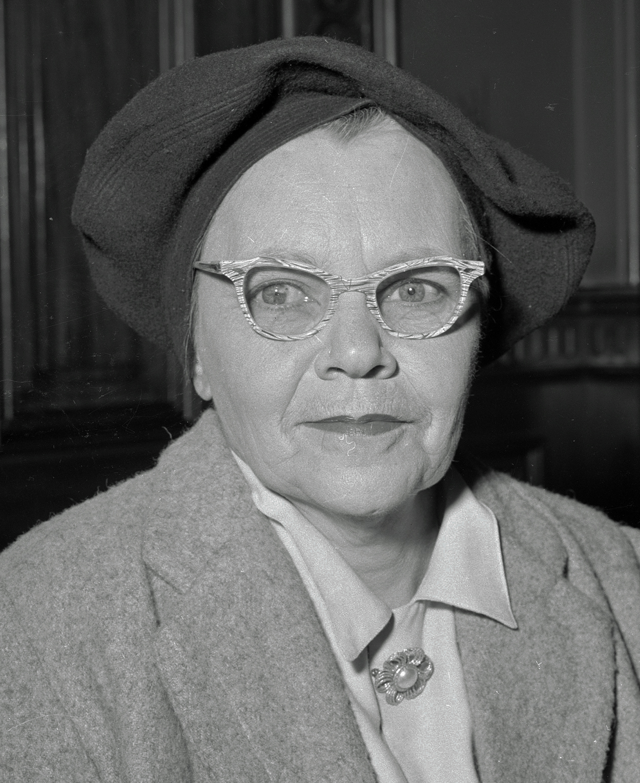
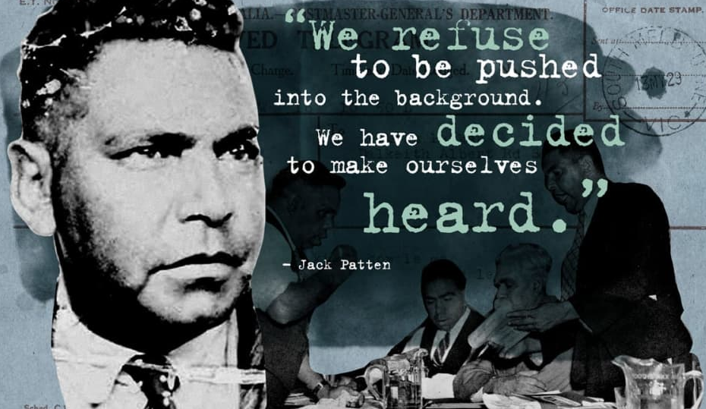
Aboriginal rights 20th C
In 1901, rights for aboriginal people are not included in the new constitution
In 1938, a Day of Mourning protest for indigenous representation took place on Australia day for indigenous representation in parliament
In the 1940s, the policy of assimilation continued to break up aboriginal families
In 1965, aboriginal Australians gained the equal right to vote and complete citizenship.
Top left: William Cooper, top right: Pearl Gibbs, bottom: Jack Pattern; Aboriginal rights campaigners
Notes:
During the process of British colonisation, the Aboriginal population experienced a lack of basic human rights. The omission of Aboriginal and Torres Strait Islander people in the nation's constitution in 1901 has led to more than a century of debate over how best to recognise Australia's Indigenous people.
On 26th of January 1938, a "Day of Mourning" protest to mark Australia Day took place at Australian Hall in Sydney. It came after years of campaigning by Aboriginal leaders (such as William Cooper, Jack Patten and Pearl Gibbs) for Indigenous representation in Parliament and the right to vote.
The 1940 policy of assimilation aimed to absorb the Aboriginal population into the white community through removing children from families and undermining the Aboriginal society, an act which was devastating for both Aboriginal culture and communities. With self-government, Aboriginal Australians had restricted voting rights in federal elections, but most Aboriginals didn’t have complete citizenship or voting rights until 1965, only 55 years ago.

Slide 18

Reconciliation with Colonial Legacy
“For Aboriginal and Torres Strait Islander people, Australia’s colonial history features oppression, devastating land and language dispossession, violence, and racism.
Since the mid-20th century, Australians have taken big steps towards a just, equitable and reconciled nation. This journey reminds us that reconciliation is a work in progress. Generations of people have fort for meaningful change.
In 1991, the Council for Aboriginal Reconciliation was established to promote a national reconciliation process.
Over this time, reconciliation has encouraged a greater focus on the relationship between Aboriginal and Torres Strait Islander peoples and non-Indigenous Australians. It promotes national debate on prejudice, discrimination and racism. It prompts questions about our national identity and the place of Aboriginal and Torres Strait Islander histories, cultures and rights in our nation’s story.”
from the ‘Narragunnawali’ peoples website
Notes:
For aboriginal and Torres Strait Islander people, Australia’s colonial history features oppression, devastating land and language dispossession, violence, and racism.
Since the mid-20th century, Australians have taken big steps towards a just, equitable and reconciled nation. This journey reminds us that reconciliation is a work in progress. Generations of people have fort for meaningful change.
The Council for Aboriginal Reconciliation was established in 1991 with the goals of ‘promoting reconciliation’, ‘Undertaking a public awareness campaign’ and ‘establishing a network of Australians for reconciliation network’. This Council lead a significant amount of community organizing, campaigning and educating about the experiences of aboriginal Australians during the colonial period and continued oppression today. The Council came to an end in 2001, but the final report is worth reading and a lot of this work has been taken forward by other NGOs such as Reconcilliation Australia and Narragunnawali. Narragunnawali offers a significant library of education resources written by aboriginal Australians to share their history and perspectives on the way for future reconciliation.

Slide 19
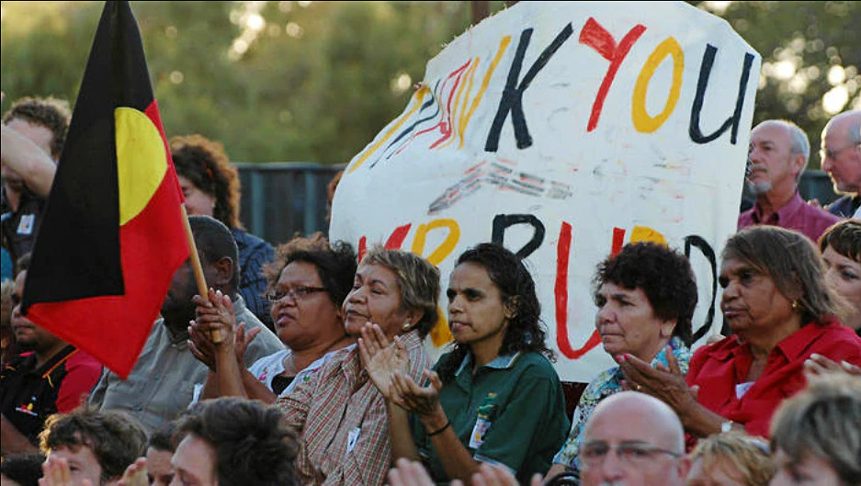
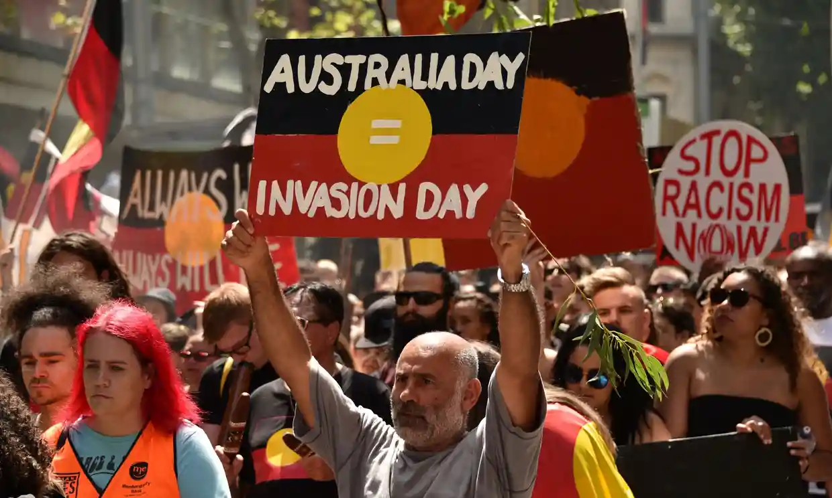
Aboriginal rights today
Apology to the stolen nation, February 13th, 2008
Prime minister Kevin Rudd delivers an apology in Federal Parliament for the mistreatment of Indigenous Australians.
In the speech he commits to closing the gap on Indigenous disadvantage and makes a statement of recognition that "today we honour the Indigenous peoples of this land, the oldest continuing cultures in human history".
Australia Day
Australia Day was established in 1935 to “celebrate all the things we love about Australia: land, sense of fair go, lifestyle, democracy, the freedoms we enjoy, but particularly our people”.
Watch the video on the next slide and discuss, does Australia day celebrate all people?
Notes:
In the late 20th century post-colonial period, a call began for the Australian Government to apologise for their treatment of the Aboriginal population. This was heavily resisted until 2008, when an apology was finally issued. Around 3% of Australia’s population today (about 800,000 people) has Aboriginal heritage. To this day the Aboriginal people are still working to retain their culture and community with varied success.
Australia Day is a national public holiday on January 26. On that day in 1788. Governor Arthur Phillip raised the British flag to signal the beginning of the British colony. It was designed to “celebrate all the things we love about Australia: land, sense of fair go, lifestyle, democracy, the freedoms we enjoy, but particularly our people”.
For many Aboriginal Australians this day is recognised as Survival Day or Invasion Day and there are yearly protests in major cities.

Slide 20

Aboriginal people respond to ‘Australia Day’ - Jan 2016
Notes:
Video link: https://www.youtube.com/watch?v=G8czHlPYXew&t=1s

